Slide 1
NGOs in policy making
Tatjana Raudsepp
Peace Child Estonia

Slide 2
Participation
Engagement

Slide 3
ECDC: the complementary roles of public authorities and citizens' initiatives and the principles of interaction in shaping and implementing public policy and building civil society in Estonia.
...for a democratic state to survive, public authorities need to listen to citizens and cooperate with as many of them as possible.
... When making decisions, the public authorities must take into account the specific interests, values and objectives of many members of society and their associations, and give them serious consideration, even if they are in a numerical minority.

Slide 4
When developing policies
civil society and public authorities:
3.1 cooperate in the formulation, implementation and evaluation through mandated members or representatives in accordance with their areas of activity and competence;
3.2 organise the gathering and submission of opinions necessary for the formulation of policies and the initiation of legislation;
3.3. take account of each other's experience and consult with civil society organisations representing different views in the process of drafting.

Slide 5
3.4 assess the social and environmental impacts of policies and legislation at all stages of their development;
3.5 enhance the capacity of their representatives to participate in policy development, implementation and evaluation;
3.6 take into account the views and opinions of civil society organisations representing minority groups in the formulation of policies affecting minority groups, and involve them in discussions and legislation;
3.7 jointly develop and follow good cooperation practices.

Slide 6
Civil Society Development Plan
Mapping and assessing the current state of inclusion
More monitoring
Improving the capacity of officials to be more inclusive
Improving the involvement and advocacy capacity of NGOs
Training of inclusion process managers and their cooperation and development
Promotion, dissemination and monitoring of the use of the guidance material on financing associations.
Representing the interests of public interest NGOs

Slide 7
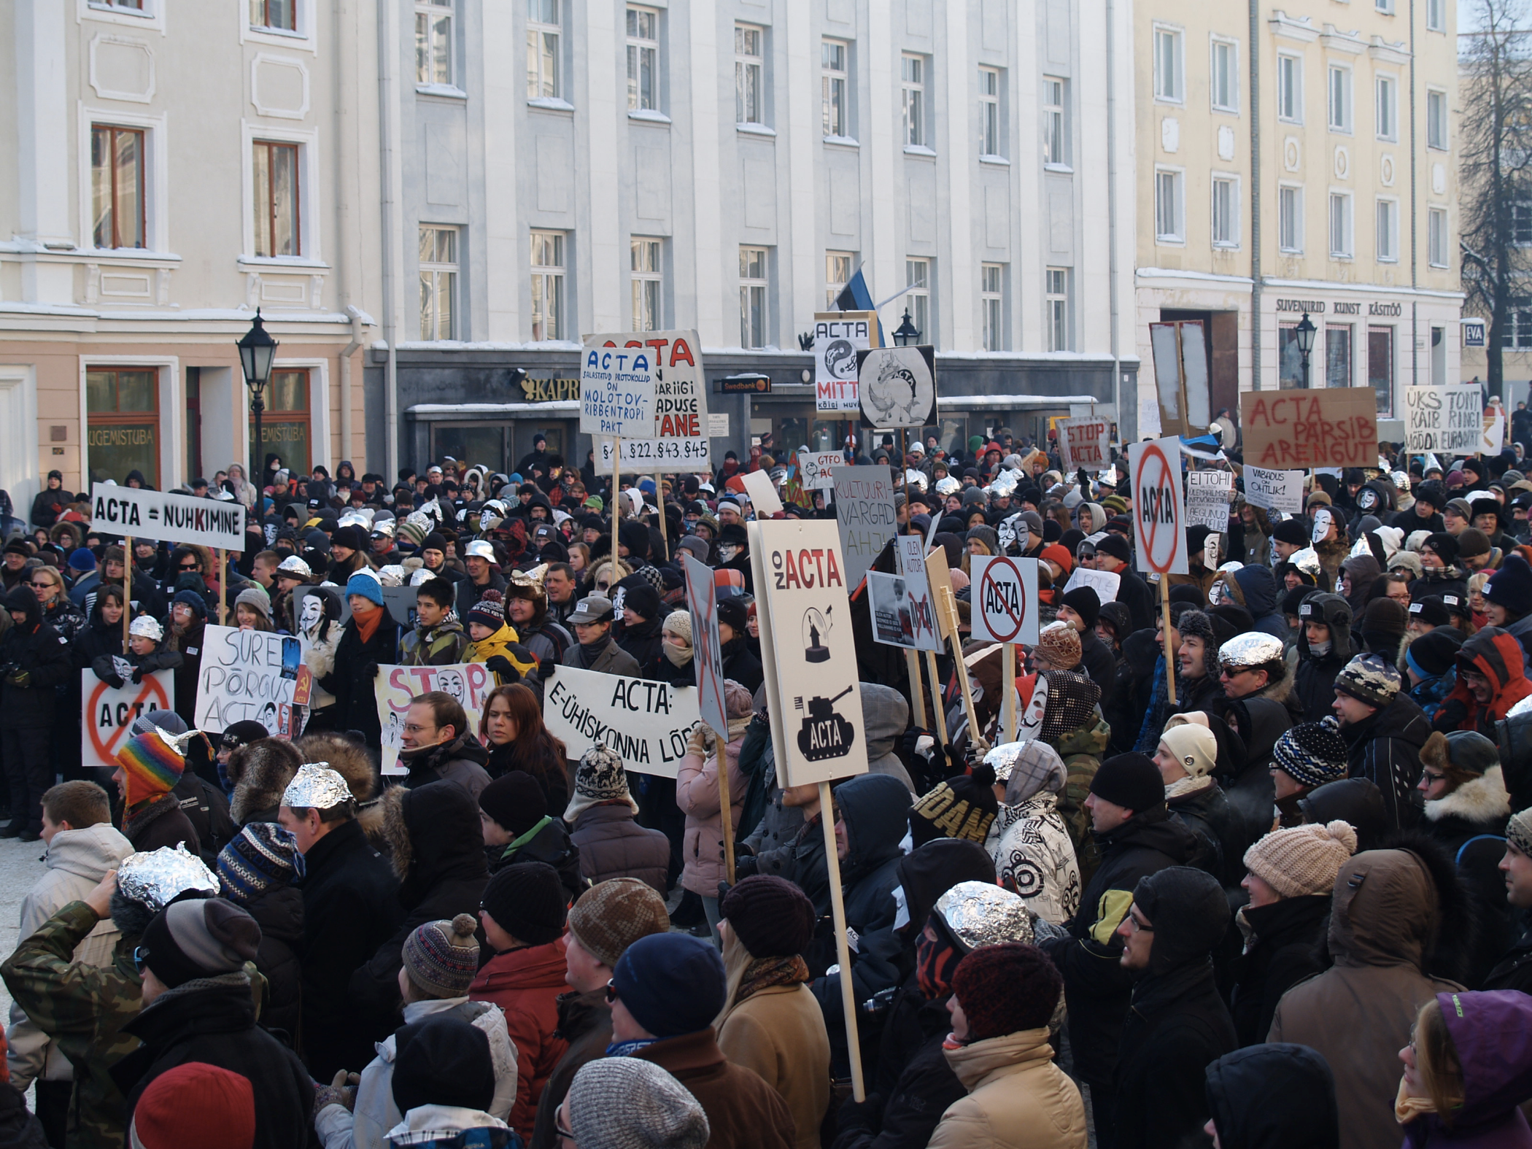
ACTA

Slide 8
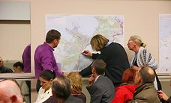
PUBLICLY about “RAIL BALTIC” train road

Slide 9
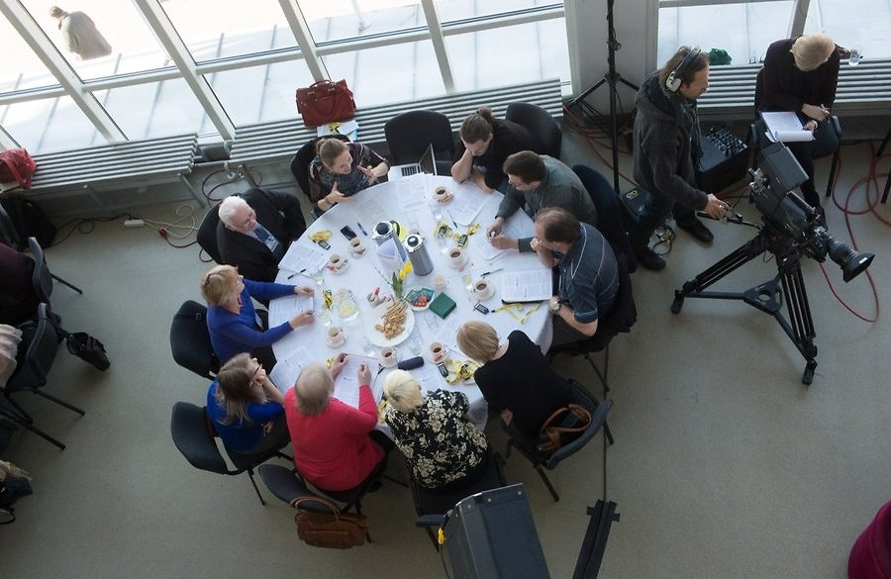
PUBLIC ASSEMBLY

Slide 10
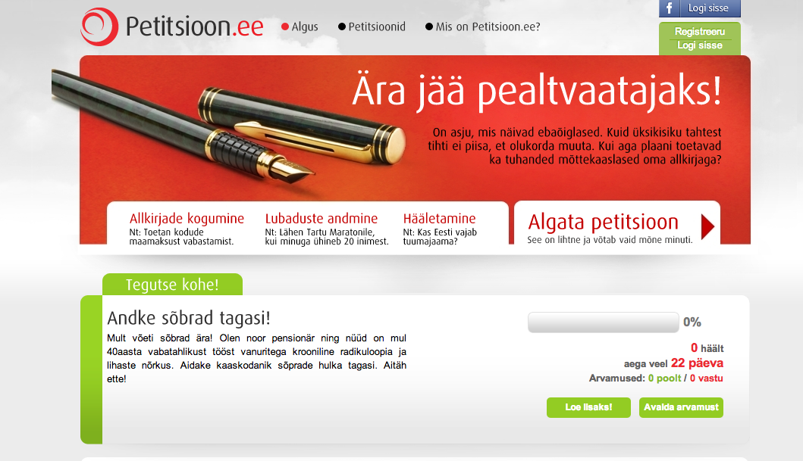
Petitions

Slide 11
WHY COOPERATION IN YOUR FIELD FAILS?

Slide 12
GOOD | NEEDS TO BE IMPROVED
ENGAGEMENT IS NORMALITY GOOD PRACTICE FOR ENGAGEMENT WE HAVE GOOD EXPERIENCES AND RESULTS THERE ARE ONLINE PLATFORMS DIFFERENT METHODS USED | NOT ALWAYS ABLE OR WILLING BECOME INVOLVED LATE, INEPTLY OR ACCIDENTALLY GOOD PRACTICE IS NOT ALWAYS FOLLOWED RADICAL LOW INTEREST

Slide 13
Participation
consulting
Spread of information

Slide 14
OPEN GOVERNMENT PARTNERSHIP
to promote local democracy
Transparency of power and access to information
Early dialogue with communities and their inhabitants, preferably open processes.
Stimulating local initiative, channelling funds to civil society organisations in a transparent way
Public services with NGOsSpecial attention to youth participation
Non-negotiable fight against corruption
Citizens' access to the internet and their ability to use it for self-development, to use public services and to participate in democratic processes.

Slide 15
A good participant:
justifies his/her proposals
also offers solutions
is prepared, has done the groundwork
prepares ahead, has prepared, has prepared the groundwork
Is punctual, timely

Slide 16
How good engager i am myself?

Slide 17
Peace Child Estonia
- www.peacechild-estoina.org
- facebook:
- Weekly newsletter on estonia, russian and english
- FB of Annual Youth Forum:
- Contact email: info@peacechild-estonia.org

