Slide 1
Aspiration to Action in the Achievement of the Sustainable Development Goals in the Asia-Pacific region
TAKAHASHI Yasuo
Executive Director, IGES

Slide 2
Overview
SDGs in Asia and the Pacific: Progress and Delays
The Impacts of the COVID-19 Pandemic
Innovative Cases in Asia and the Pacific

Slide 3
SDGs in Asia and the Pacific
Progress and Delays

Slide 4
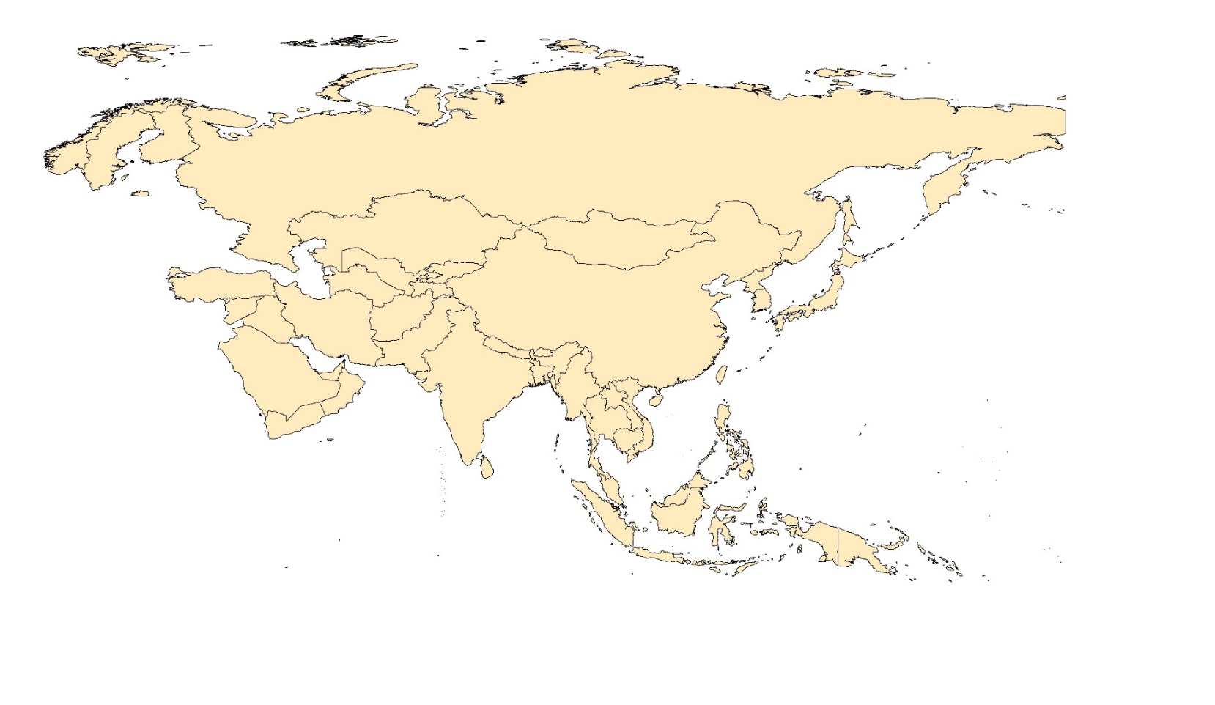
Asia and the Pacific at a Glance
A significant region in terms of demography, economy, and environmental pressure
47% share of total global primary energy consumption (2019)
2.21
Home to roughly 60% of the world’s population
(UNESCAP, “Population Trends”, 2013)
1.99
(BP Statistical Review of World Energy 2021)
19% share of total global food and agriculture exports
31% share of total food and agriculture imports
Share of global GDP to increase from 33% in 2019 to 52% in 2050
0.24
1.30
0.28
China
(IMF; ADB, “Asia 2050”)
South Asia
0.23
(FAOSTAT, Rabobank Analysis, 2016)
Other
East Asia and Oceania
Asia
(in million tonnes per year)
Boucher and Friot (2017)
The biggest source of marine plastic pollution

Slide 5



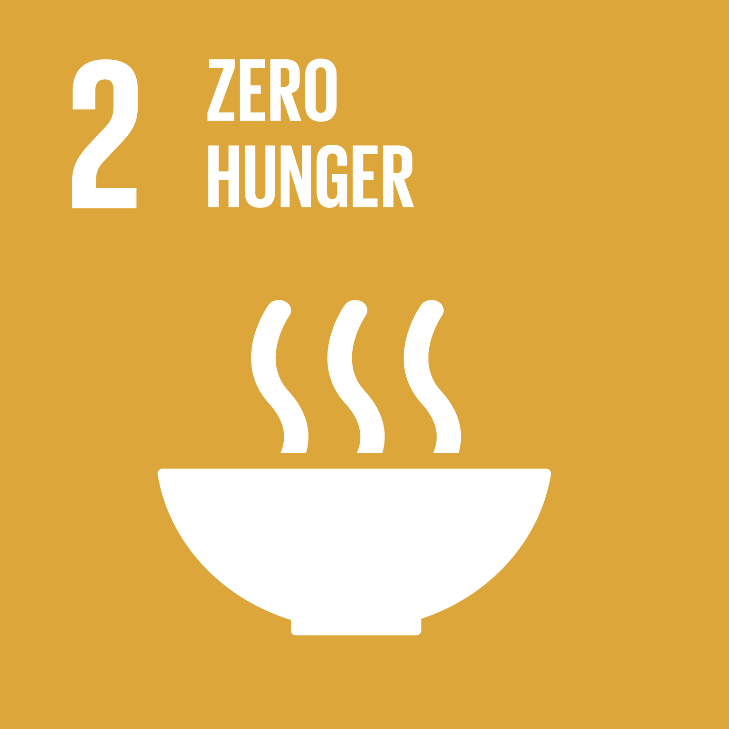

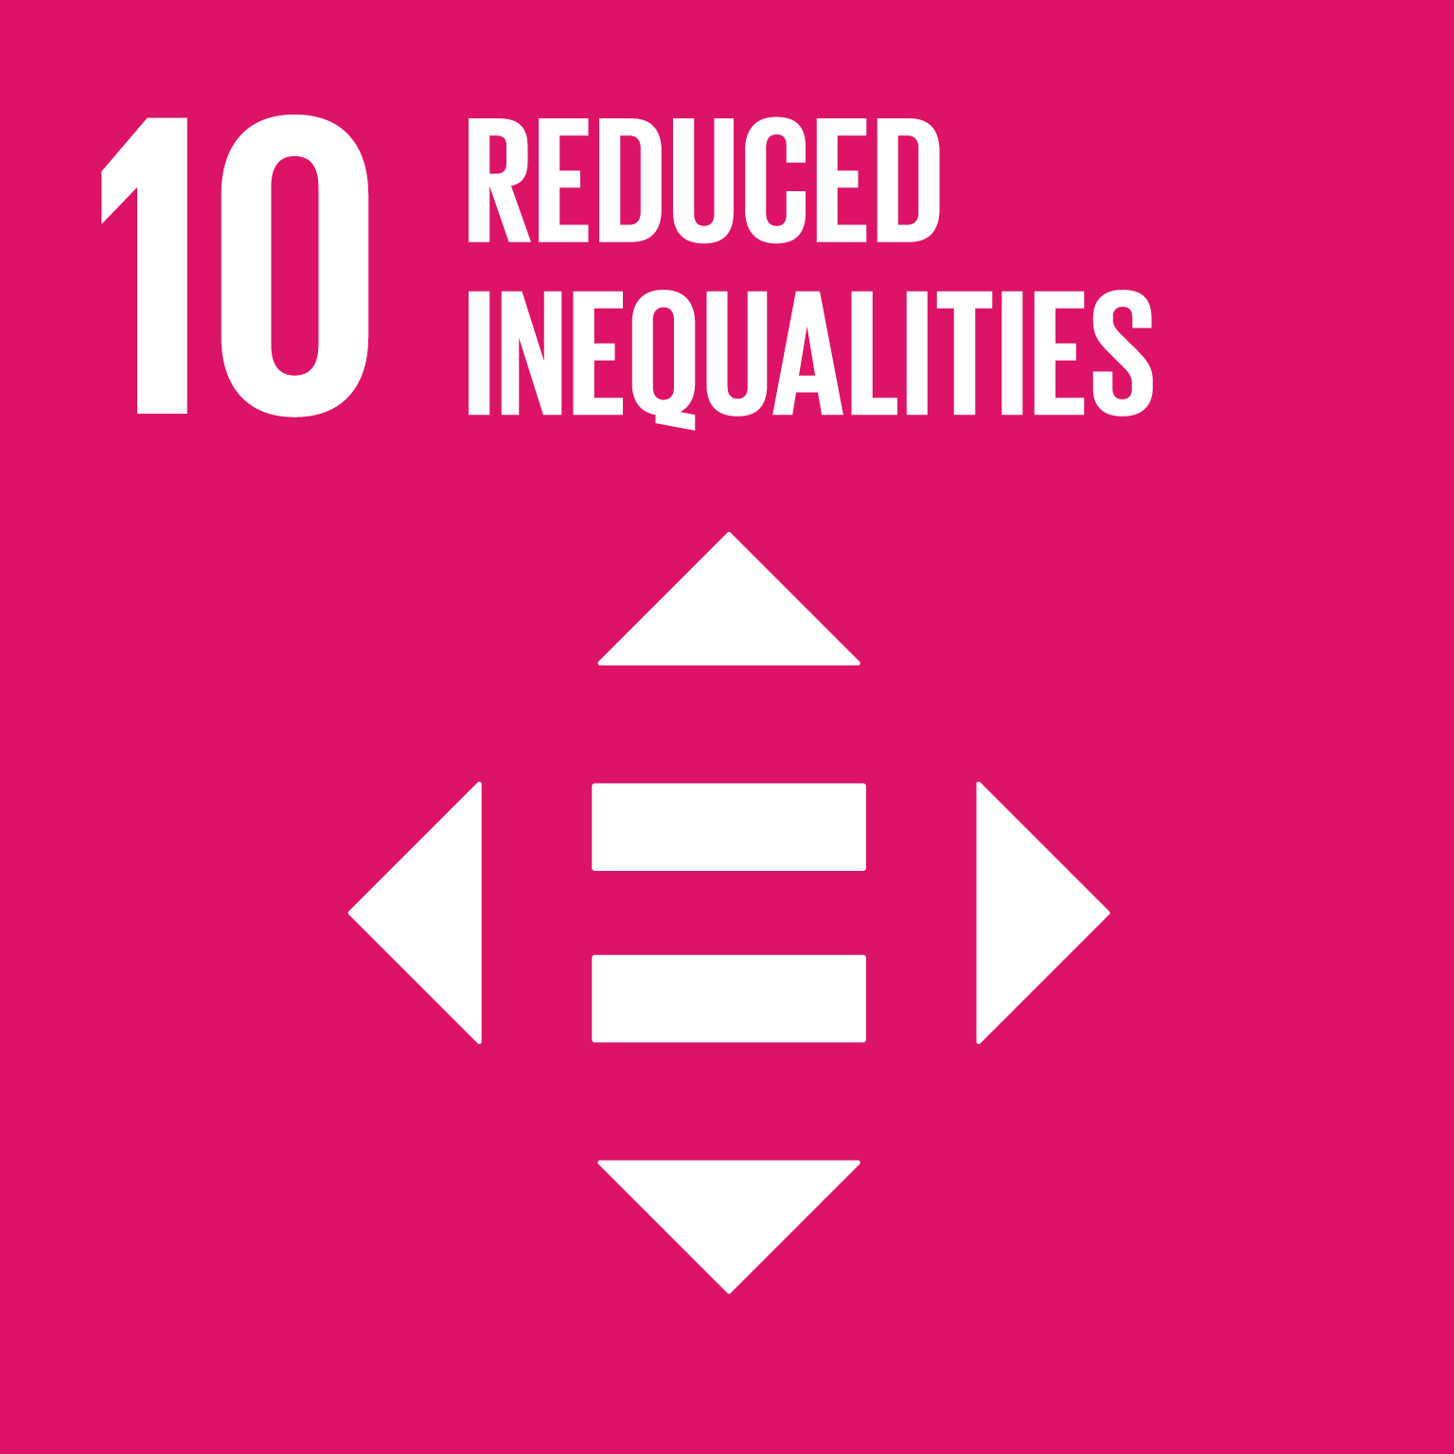



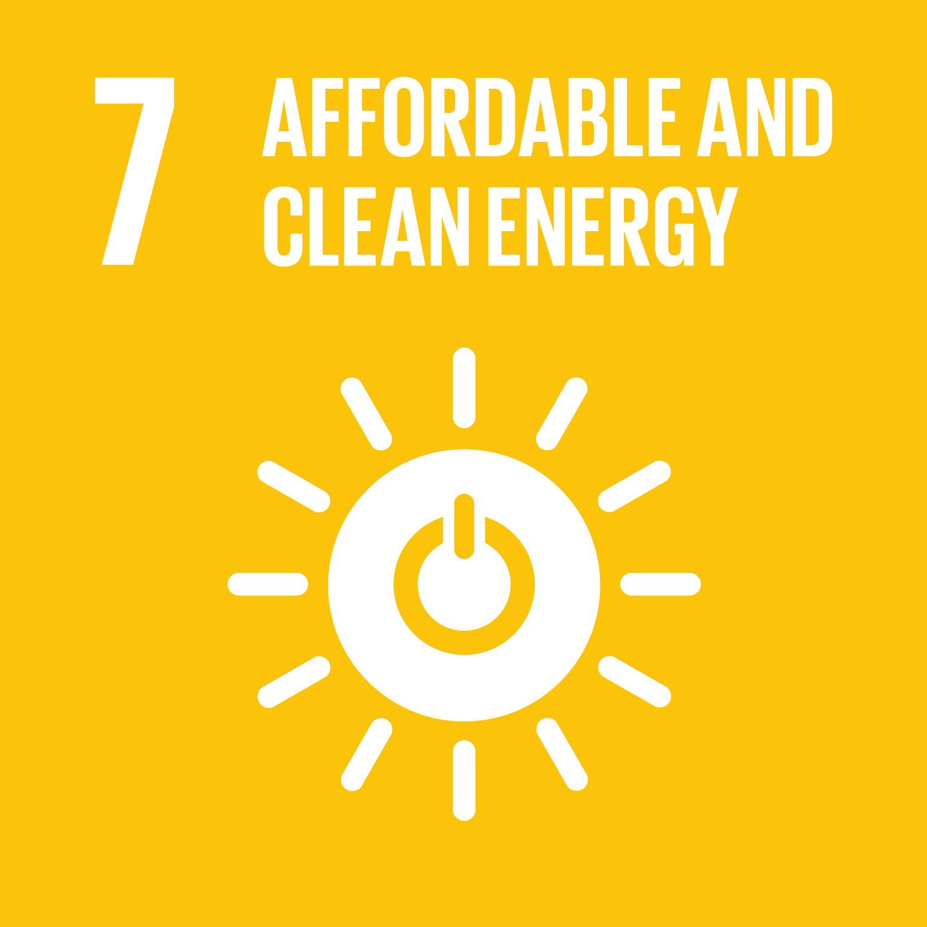

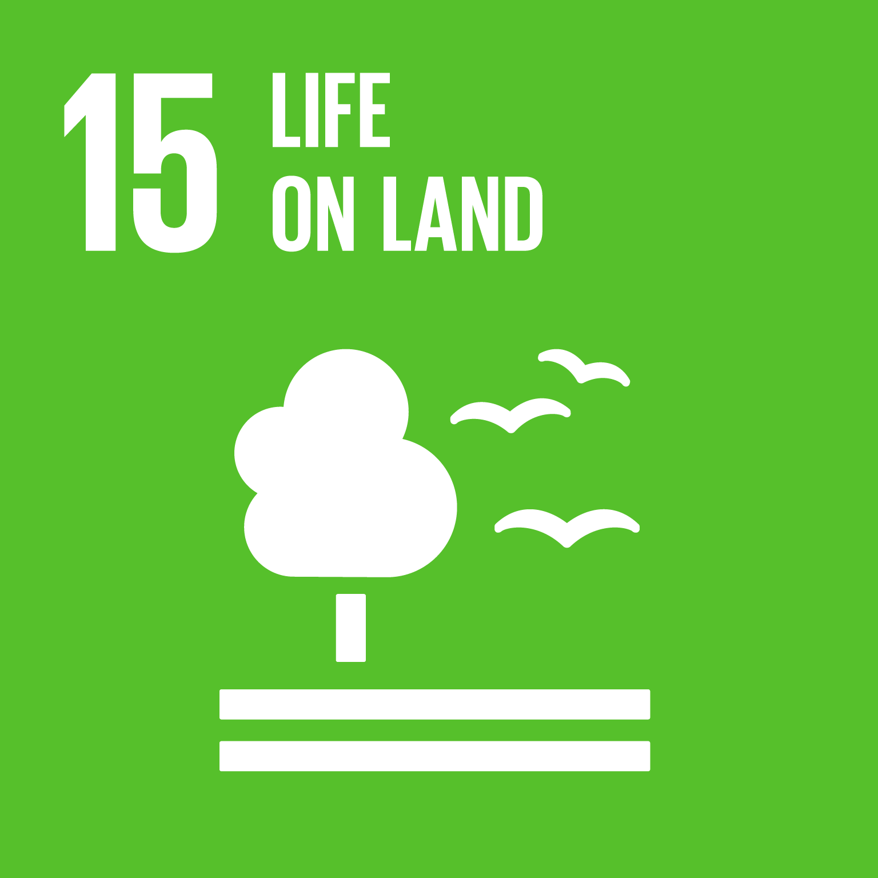
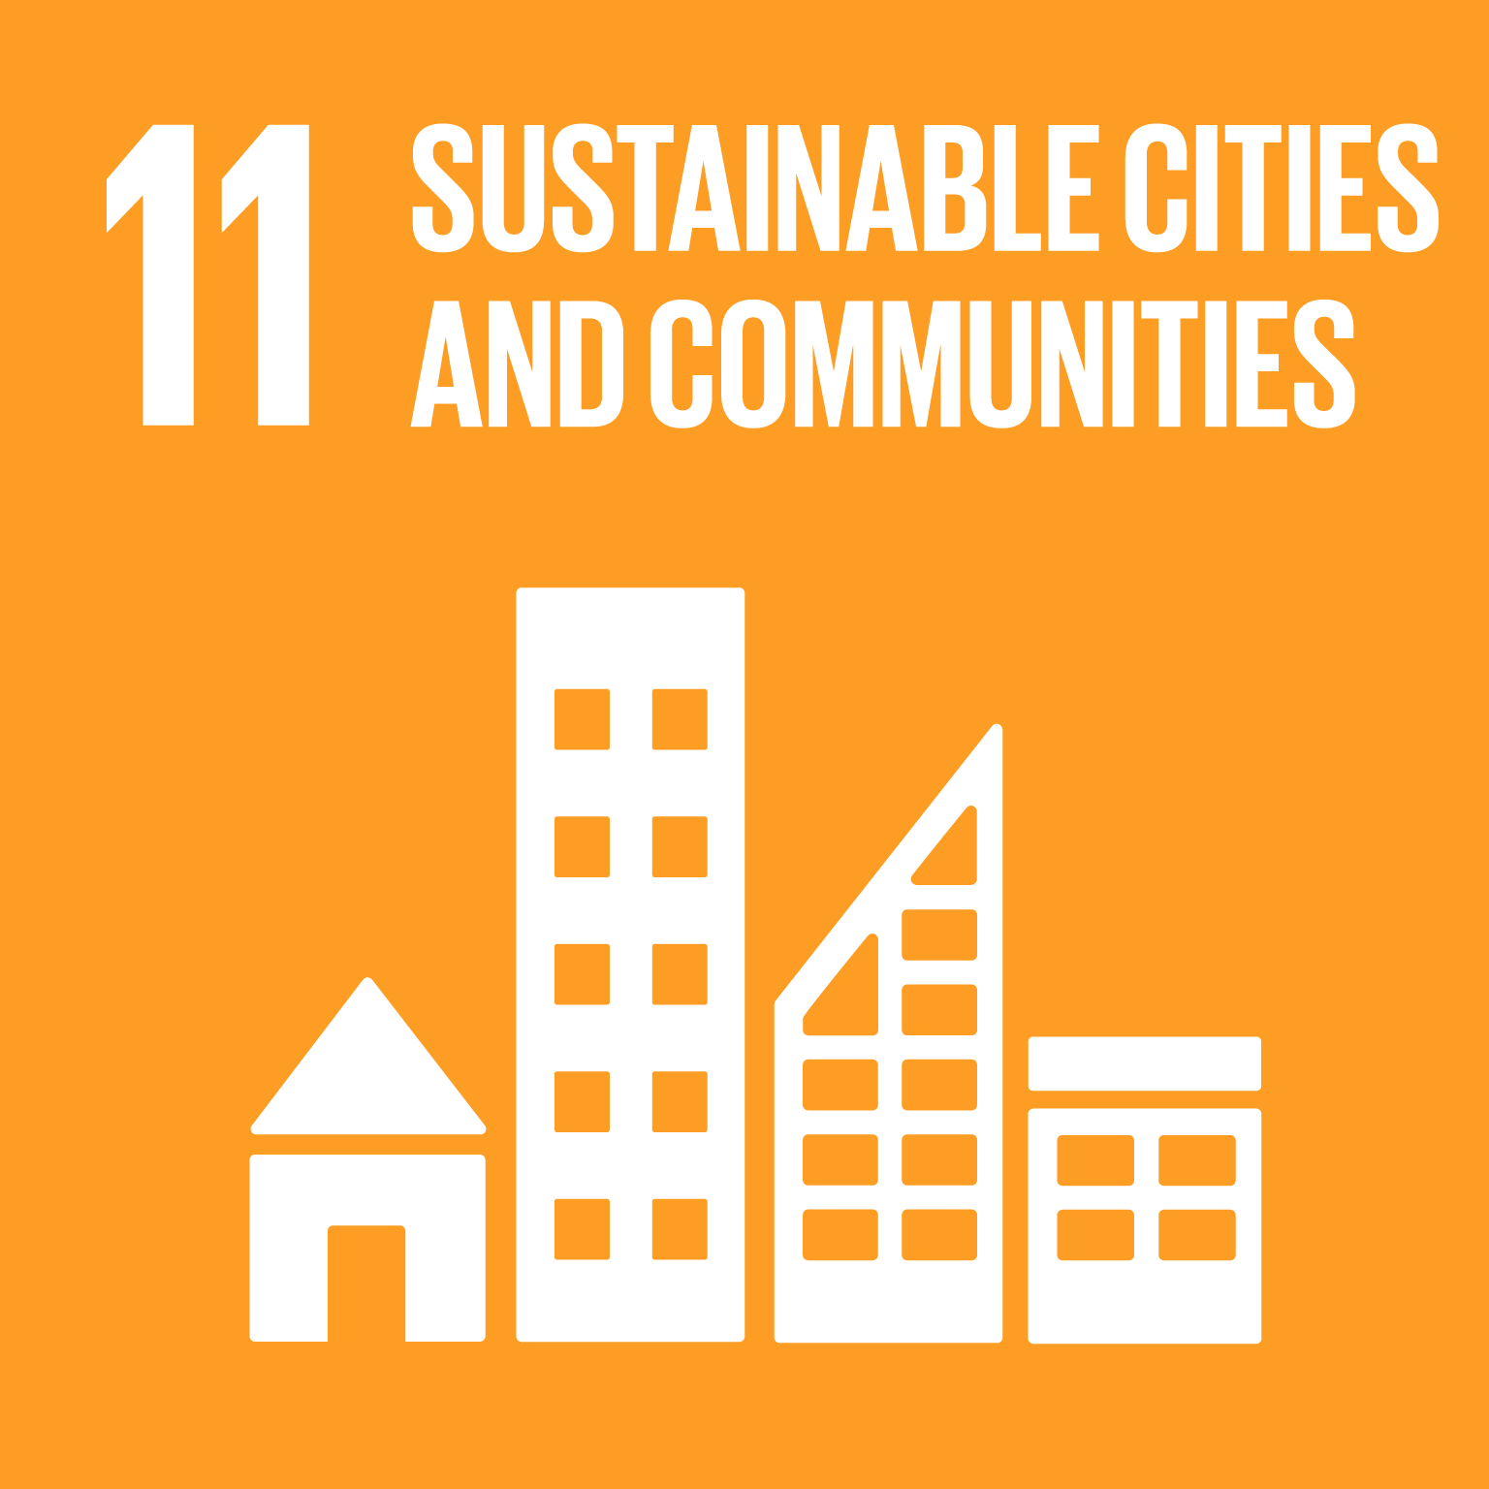
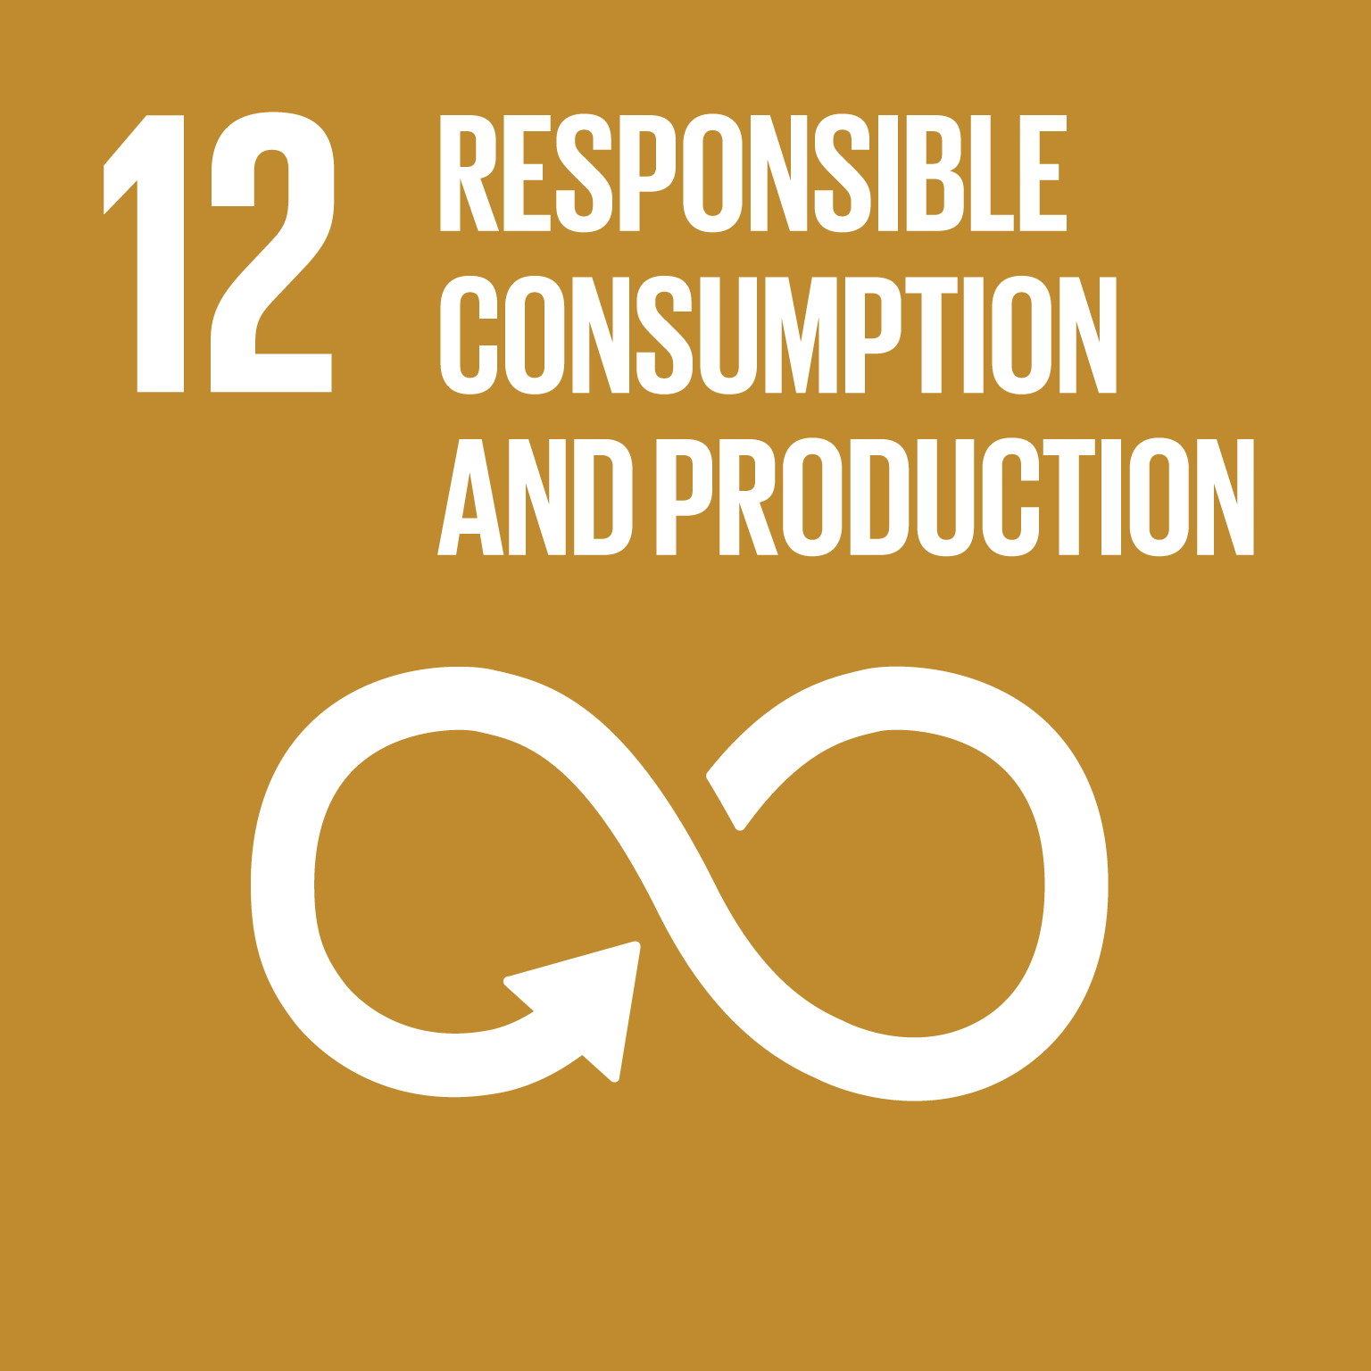


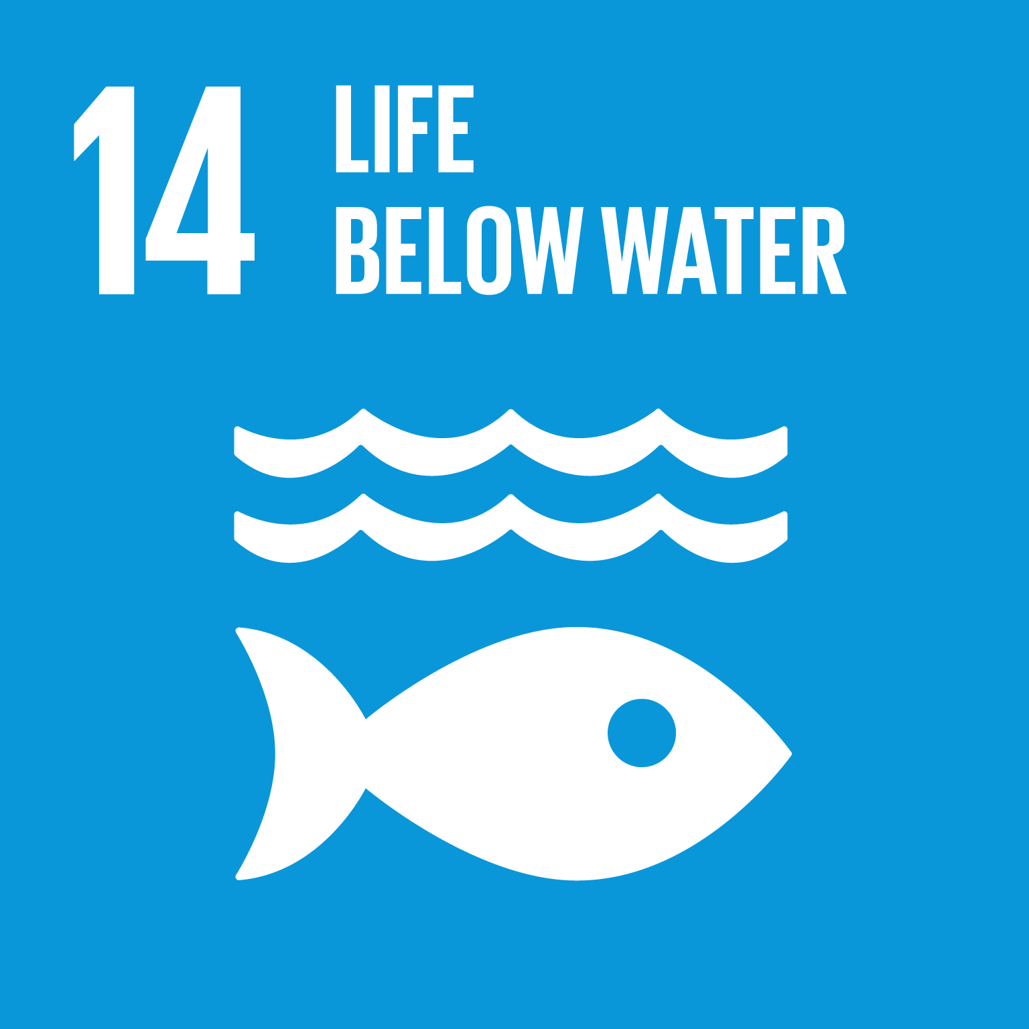
SDGs in Asia and the Pacific: Progress and Delays
Greater Progress
Progress
Slow Progress
Least Progress
Regression
UNESCAP Asia and the Pacific SDG Progress Report 2021

Slide 6
SDGs in Asia and the Pacific: Progress and Delays
Good progress in socio-economic development
  Infrastructure development
  Poverty and hunger reduction; health; education
Benefits of growth have not yet reached all
  Gender; access to water and energy; employment
Growth causes problems
  Urbanisation; resource use
  GHG emissions; water and air pollution; waste

Slide 7
Impacts of the COVID-19 Pandemic
in the Asia-Pacific

Slide 8
Impacts of the COVID-19 Pandemic
Health Impacts
Socioeconomic Impacts
Environmental Impacts
52.4 M cases, 828 K deaths
UNOCAR Asia Pacific COVID-19: Humanitarian Data Portal
-7.9% work hours lost = 140M full-time jobs
ILO Monitor: COVID-19 and the world of work. 7th Edition
71 M children impacted by poverty
UNICEF Child Poverty COVID-19 Technical Note
Drop in CO2 for a short time
Increase in medical waste

Slide 9
Impacts of the COVID-19 Pandemic
Damages on some issues making “good progress”
  Poverty and hunger reduction; health; education
More severe impacts on issues making “insufficient progress”
  Gender; inequality; employment
Some environmental challenges mitigated for a short time
Exacerbation of some environmental pressures
Need accelerated & integrated efforts on
  Employment; inequality
  Climate action; life on land; life below water

Slide 10
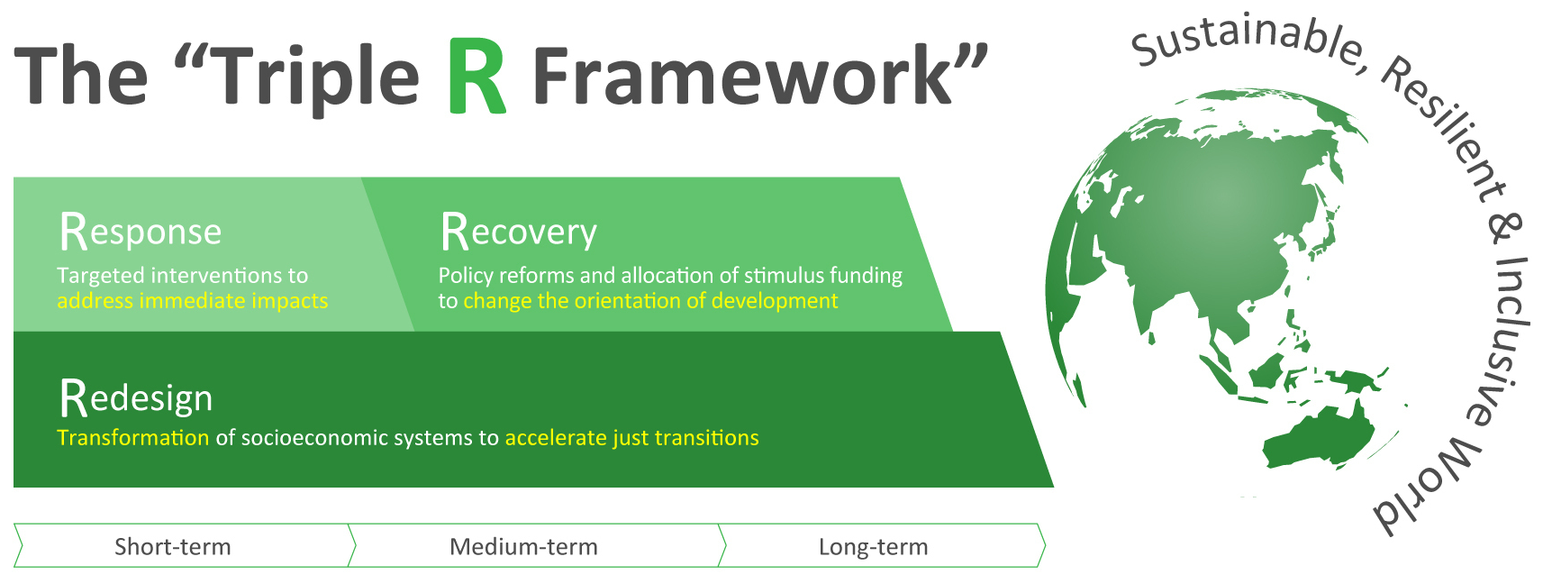
Mori et al.: https://www.iges.or.jp/en/pub/covid19-ver2-e/en
Zusman et al.: https://www.iges.or.jp/en/pub/tripler/en

Slide 11
Innovative Cases
in Asia and the Pacific

Slide 12
Redesigning toward a Sustainable & Resilient Asia-Pacific
China
Japan
Net-zero emissions by 2060
At least
US $27 billion
for renewables*
Net-zero emissions by 2050
Key initiatives:
Green community projects, etc.
Decarbonisation technologies
Manufacturing: Zero-carbon steel
Transport: Next-generation in-vehicle batteries, bio-jet fuels, international shipping
Buildings: net-zero-energy houses/buildings
Global Zero Emission Research Center (GZR) for ‘beyond zero’ emissions
*Source: Energy Policy Tracker
New Zealand
Net-zero emissions by 2050
At least
US $1.29 billion
for green recovery initiatives*
Key initiatives: Green jobs,
transport infrastructure,
recycling infrastructure,
flood protection projects, etc.
Renewable energy & energy efficiency
Next Generation Solar Cells
Offshore wind power generation
Green H₂: Fukushima Hydrogen Energy Research Field
Strategic Energy Efficiency Technology Innovation Program (NEDO)
*Source: Platform for Redesign 2020
Pakistan
Green Stimulus
Support from Multilateral Actors
Societal change
Key initiatives: Jobs for young people in major tree planting initiative, establishment of national parks, and waste management
Teleworking using advanced digital tech
Job creation in green industries
Source: Platform for Redesign 2020
Source: Platform for Redesign 2020

Slide 13
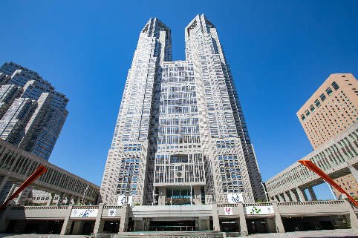
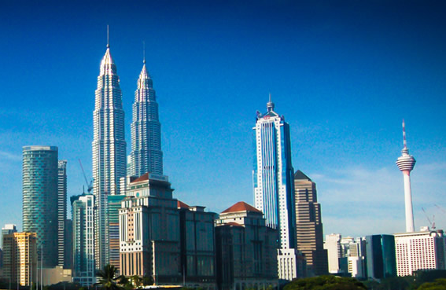
Working Together to Achieve Carbon Neutrality Goals
Tokyo Metropolitan Government
Kuala Lumpur City Hall
Net-zero Tokyo by 2050
Carbon neutral Kuala Lumpur by 2050
Memorandum of understanding signed in 2020
Exchanging knowledge on low-cost solutions to reducing emissions in key sectors (buildings, etc.)

Slide 14
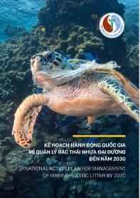
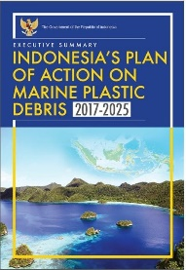


Tackling Marine Plastic Litter Reduction
Viet Nam |  | Indonesia
National Action Plan for Management of Marine Plastic Litter by 2030 |  | Indonesia’s Plan of Action on Marine Plastic Debris 2017-2025
MPL -50% (2025); -75% (2030) Single-use plastics -80% (2025); -100% (2030) | Targets | MPL -70% by 2025 (baseline: 2017)
Land waste management Programs to reduce single-use/non-degradable plastics Monitoring at rivers, beaches | Actions | Single-use plastics ban Leakage prevention on land/sea Reduction of plastic production/use Financial mechanisms Public-Private-Citizen Partnerships

Slide 15
















Local/Regional Circulating and Ecological Sphere (CES)
Self-reliant and
decentralised community
Local production and consumption
Use of renewable energy
Countryside
Provision of ecosystem services
Food, water, and timber
Renewable energy
Water purification, control of natural disasters
Cross-sectoral cooperation in policymaking and planning including climate policy
Facilitate sound cycle of funds and human resources
Shared concerns
Resource security
Economic prosperity
Health
Ecosystem assets
Disaster risk reduction
Provision of funds and human
resources
Participation in
conservation activities
Consumption of local products
Support through socio-economic systems
Investment in local funds
Self-reliant and decentralised community
Local production and consumption
Use of renewable energy
Cities
Decentralised yet connected localities
Adapted from the Ministry of the Environment’s Fifth Basic Environment Plan (https://www.env.go.jp/policy/kihon_keikaku/plan/plan_5/attach/ref_en-02.pdf)

Slide 16

Let’s accelerate these efforts and work together to build the future we want.

Slide 17
Appendices

Slide 18
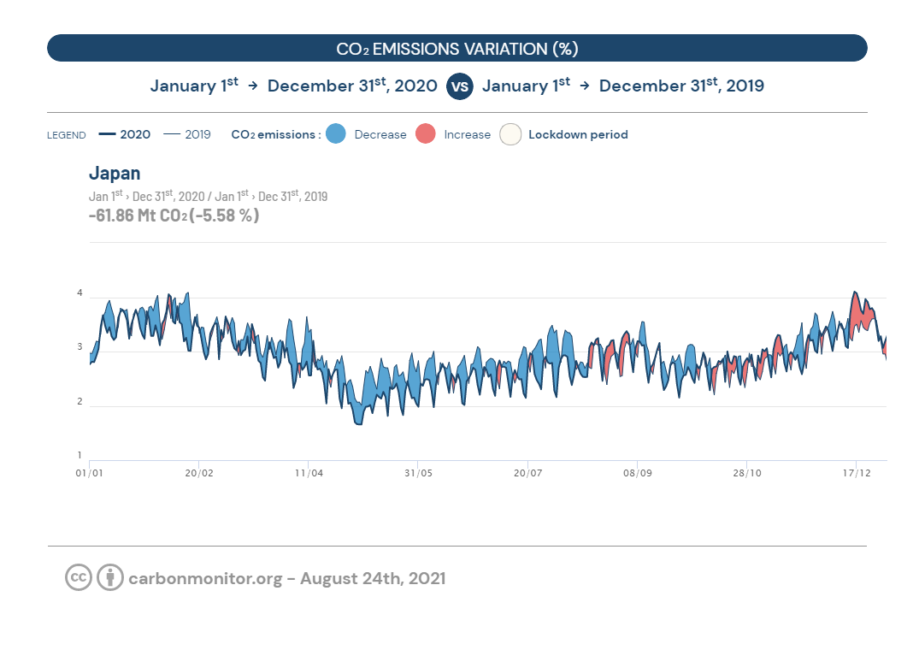
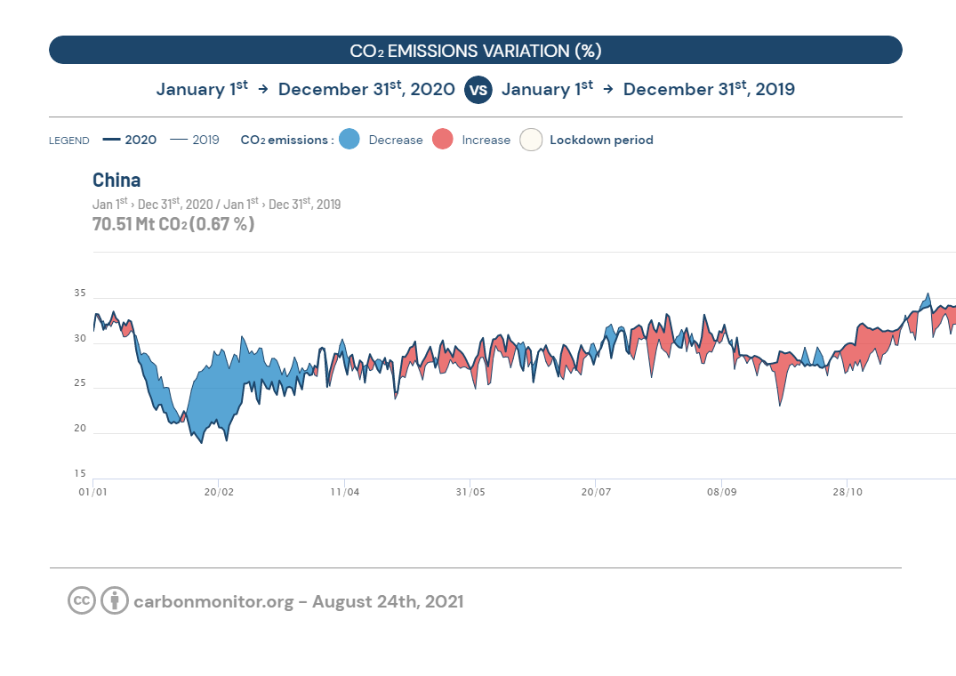
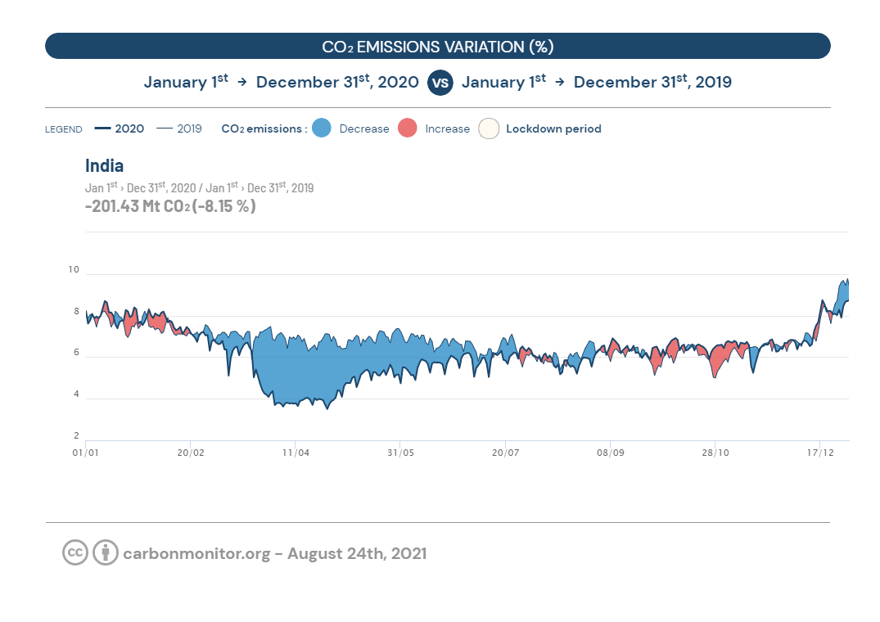
The Pandemic & Environmental Sustainability
Carbon Monitor

Slide 19
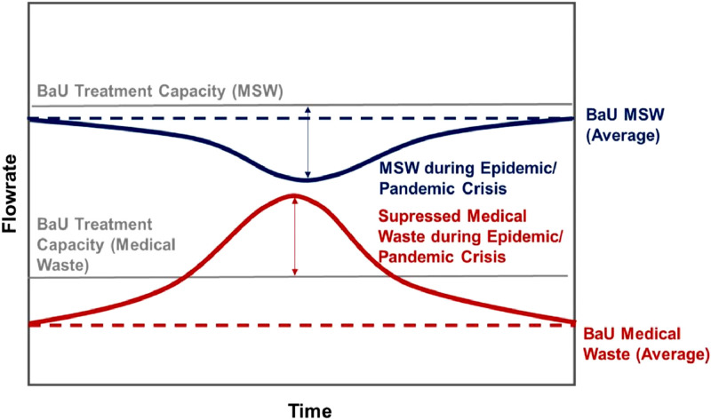
The Pandemic & Environmental Sustainability
Increase in healthcare waste
Growth of single use & plastic packaging waste
Disruption to food production and generation of food waste
Halt or reduction of waste recovery and recycling
Disruption to informal waste sector/SME activities
Sharma et al., 2000. Challenges, opportunities, and innovations for effective solid waste management during and post COVID-19 pandemic
IGES 2020 Waste Management during the COVID-19 Pandemic: From Response to Recovery

Slide 20
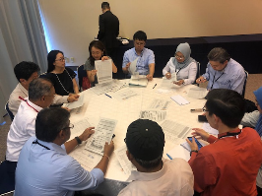
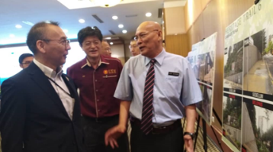
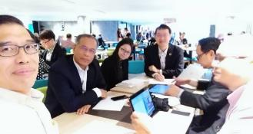
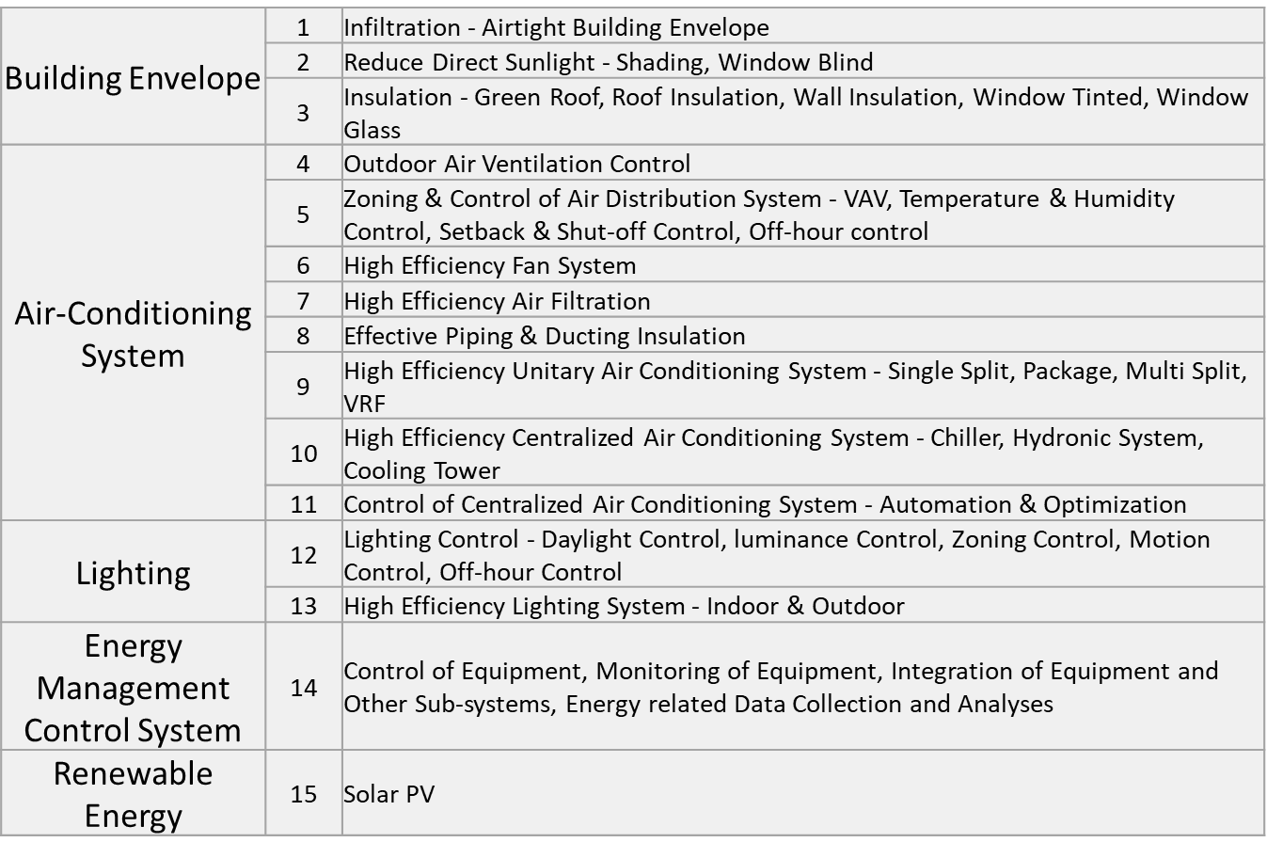
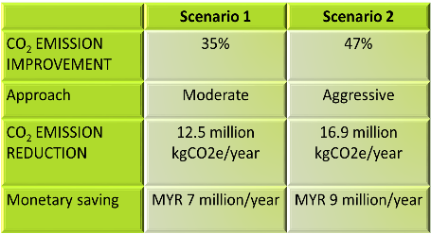
First year: Introduction of Tokyo Met. Government scheme.
Air conditioning is the largest energy use !
Technological solutions with TMG suggestion
Reduction potential based on the solutions !
Mainly TMG’s no or low cost solutions !

