Slide 1

CIVIL SOCIETIES IDEAS FOR THE SUSTAINABLE AND SECURE FUTURE OF EUROPE
NETWORK ANNUAL CONFERENCE 2022
1-4 MAY 2022 NARVA/ ESTONIA
Speech: The Role of United Nations (UN) in elimination of regional conflicts in example of the Security Council Resolution 2250
“Youth, Peace and Security”
(UNSCR 2250)
Dr Eleftheria FTAKLAKI
Doctor in European Studies and International/Regional Relations
Post Doctoral Fellow -Researcher
Lecturer at the Aegean University
Project Developer JMM EU.E.N.I.C
Co- organizers: FiMigrant/
National Civil Society Foundation and the Nordic Council of Ministers Estonian office.

Slide 2

CIVIL SOCIETIES IDEAS FOR THE SUSTAINABLE AND SECURE FUTURE OF EUROPE
NETWORK ANNUAL CONFERENCE 2022
1-4 MAY 2022 NARVA/ ESTONIA
Part A:
The Security Council Resolution 2250 “Youth, Peace and Security” (UNSCR 2250)
Dr Eleftheria FTAKLAKI
Doctor in European Studies and International/Regional Relations
Post Doctoral Fellow -Researcher
Lecturer at the Aegean University
Project Developer JMM EU.E.N.I.C
Co- organizers: FiMigrant/
National Civil Society Foundation and the Nordic Council of Ministers Estonian office.

Slide 3
“Young people are not the future; they are making the future, they are shaping the future
There are more young people today than at any other time in human history according to the United Nations Population Fund:
There are 1.8 billion people between 10 and 24 years of age, and there will be 72 million more by [2025]
Of whom more than 600 million live in conflict zones.
However, until December 2015 there was no international framework analysing or responding to issues of youth, peace and security
The demographic argument is probably one of the most powerful and compelling reasons for recognising the role of youth in building peace:
if the failure of peace processes has generally been associated with the absence or the limited inclusion of certain social groups, it was impossible to ignore a group that represents more than half of the population in fragile countries.
But it is not only a matter of the role of youth in contexts of war or armed conflict,
Young people are valuable innovators and agents of change, and their contributions should be actively supported, solicited and regarded as essential to building peaceful communities and supporting democratic governance and transition.
Sources: https://www.unfpa.org/
https://eur-lex.europa.eu/legal-content/EN/TXT/PDF/?uri=CELEX:52018XG0607(02)&from=EN

Slide 4
Security Council Resolution 2250 “Youth, Peace and Security” (UNSCR 2250)
On 9 December 2015, the United Nations Security Council unanimously adopted a historic Resolution on Youth, Peace and Security, The Resolution 2250
It finally puts youth at the centre of processes and policies for the sustainable development of peace and security.
It is a unique and unprecedented resolution for different reasons.
Resolution 2250 defines youth as persons of between 18 and 29 years of age
It is particularly significant that the adoption of this resolution, sponsored and led by Jordan, was initially pushed by civil society in general, and by youth organisations in particular
The UN Security Council adopted two key resolutions on Youth, Peace and Security: The UNSCR 2250 in December 2015, and The UNSCR 2419 in April 2018. The Resolution on Maintenance of International Peace and Security UNSCR 2419 was adopted to further pursue the implementation of the UNSCR 2250.

Slide 5
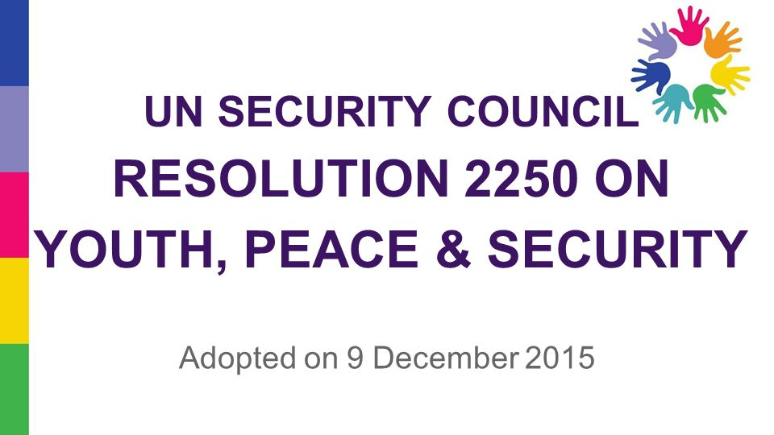
Why Resolution 2250 is historic?
Security Council Resolution 2250 , calls for
Security Council Resolution 2419, calls for
Participation: Member States to consider ways to increase inclusive representation of youth in decision-making at all levels (...) and to consider establishing integrated mechanisms for meaningful participation of youth in peace processes and dispute-resolution;
Recognizing the threat to stability and development posed by the rise of radicalization among young people, the Security Council today urged Member States to consider ways to give youth a greater voice in decision-making at the local, national, regional and international levels.
Urged Member States to consider setting up mechanisms that would enable young people to participate meaningfully in peace processes and dispute resolution
The inclusive representation of young people in processes aiming at the prevention and resolution of conflict;
- The recognition of the role that young people play in conflict prevention and resolution;
- The recognition of young people and youth- led civil society organisations’ efforts to contribute to build and maintain peace.
The resolution 2419 further recalls the need for the implementation of the UNSCR 2250.
In addition, the resolution reaffirms the role that youth can play in conflict prevention and reasserts Member States to respect, promote and protect human rights and fundamental freedoms of all individuals and in particular for youth

Slide 6
How UN trying to support Peace: in example of Security Council Resolution (SCR) 2250 of UN for Youth, Peace and Security
United Nations
(UN)
Charter
UN
Security
Council
Only the Security Council has the power to make decisions that member states are then obligated to implement under the Charter.
All members of the UN accept to agree and carry out the decisions of the Security Council
Established six (6) main organs, including the Security Council.
It gives primary responsibility for maintaining international peace and security to the Security Council, which may meet whenever peace is threatened
-to maintain international peace and security;
-to develop friendly relations among nations;
-to cooperate in solving international problems and in promoting respect for human rights;
- to be a centre for harmonizing the actions of nations.

Slide 7

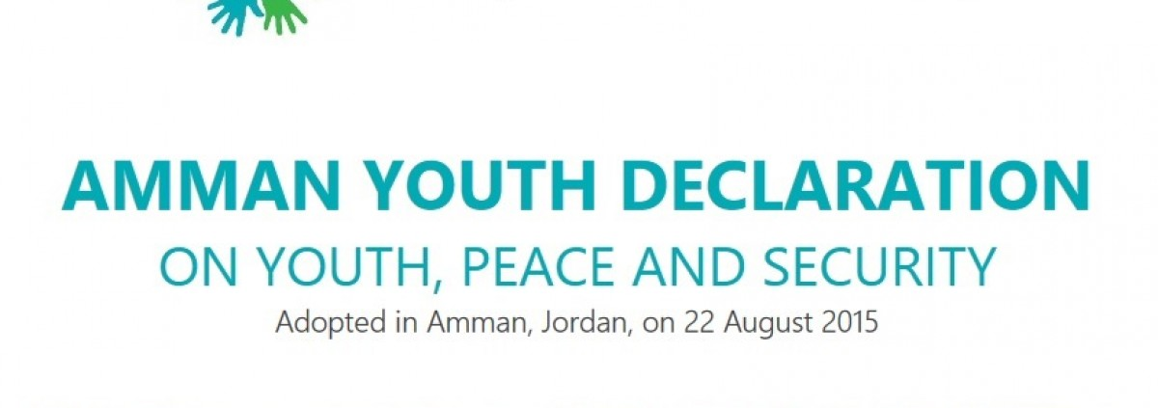
Historical background of SCR 2250
-The United Network of Young Peacebuilders (UNOY), In 2012,
A global network of youth organisations working for peace and conflict prevention, started training a group of young representatives from five continents who have been promoting the adoption of this resolution.
With the support of organisations, such as Search for Common Ground and World Vision , among others, the Youth Advocacy Team of UNOY have developed advocacy strategies, including different missions to the United Nations headquarters in New York, where they met with the permanent representations of Member States, UN agencies and civil society organisations.
One of the most eagerly anticipated outcomes of the forum was the adoption of the Amman Declaration, which reflects the commitment of young people to work for peace through a common vision and establishes a roadmap to reinforce a political framework that supports youth in conflict transformation
Guiding Principles on Young People’s Participation in Peace Building: the work of the interagency group on youth and peace, made up of representatives of various UN agencies, civil society and youth, which launched key publications
https://www.sfcg.org/
https://www.worldvision.org/
https://www.un.org/youthenvoy/2015/04/secretary-generals-remarks-open-debate-security-council-role-youth-countering-violent-extremism-promoting-peace/
/

Slide 8

Why Resolution 2250 is historic?
-Promoting the participation of young people in peacebuilding requires multiple approaches.
These include:
a human rights-based approach, grounded in the United Nations Convention on the Rights of the Child, the Convention on the elimination of all Forms of discrimination against Women (CEDAW) and the World Programme of Action on Youth;
an economic approach that identifies young people as central to the economic development of their country, and promotes their access to economic opportunities as essential for their own development ;
a socio-political approach that connects young people to civil society and the political arena, and provides them with opportunities, training and support for their active engagement and participation in public life; and
a sociocultural approach that analyses the roles of young people in existing structures and supports dialogue – including intergenerational dialogue – about these structures

Slide 9
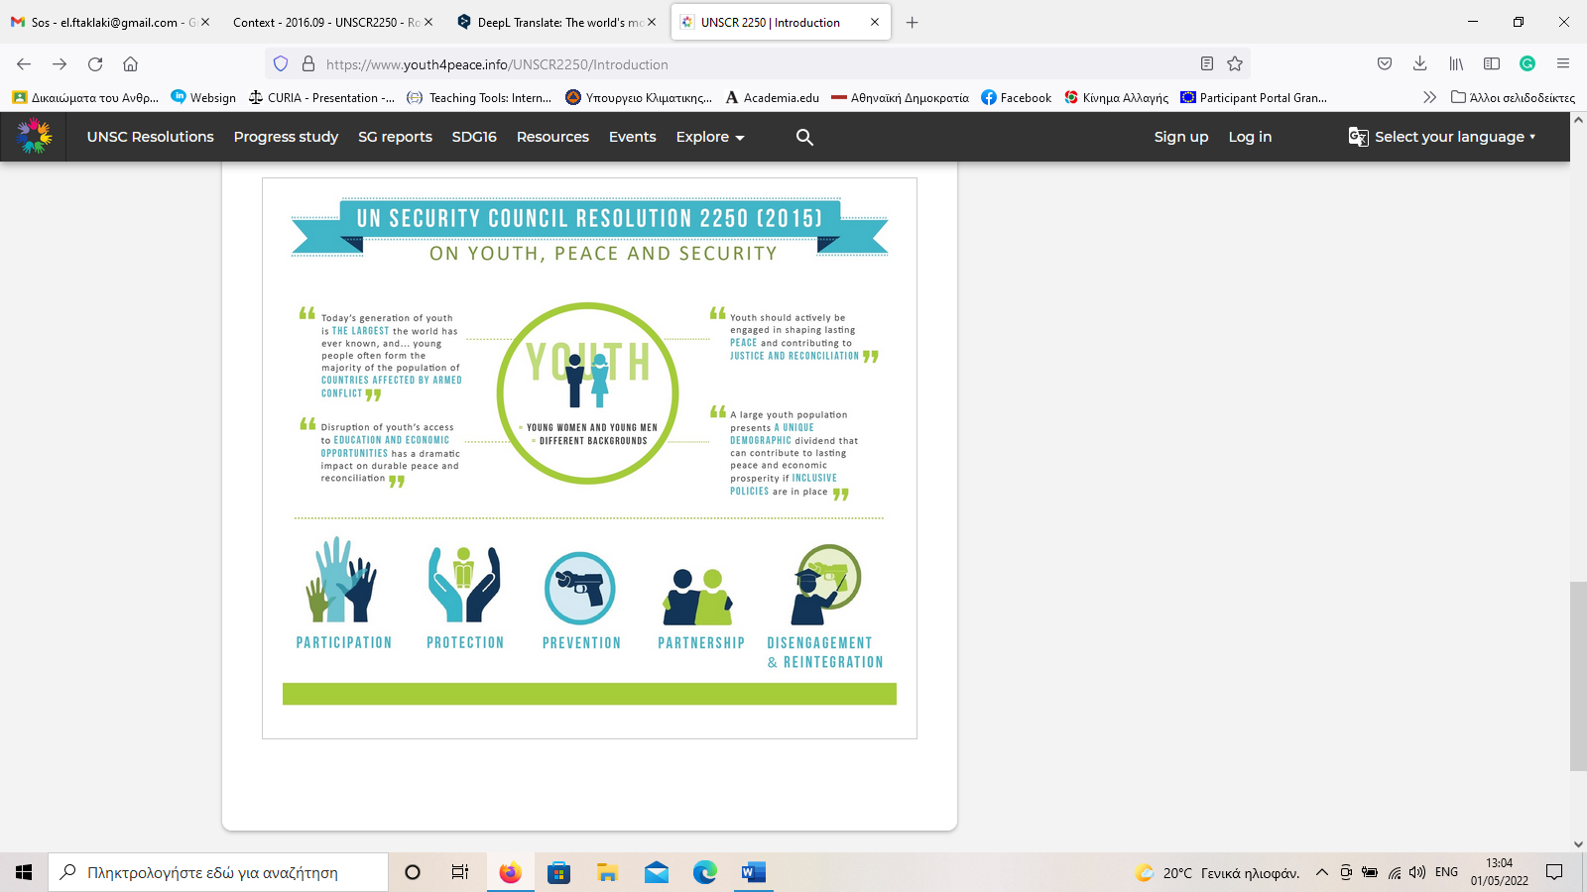
Five (5) key pillars for Action of SCR 2250
Follow-up: Finally, the Resolution requires the Secretary General to conduct a progress study of young people’s positive contribution to peace processes and conflict resolution, in order to recommend effective responses at local, national, regional and international levels
It is important to establish a starting point for understanding the current situation of young people and their participation and impact on peacebuilding in order to monitor the progress
Participation: it calls on Member States to increase the active participation of young people in decision-making processes, at the different stages both of negotiations and of the implementation of peace agreements. In addition it urges Member States to look for and provide mechanisms to encourage such participation;
Protection: it reaffirms the necessity and obligation to protect civilians, making specific reference to young people, during armed conflict and in post-conflict contexts, and in particular to protect them from any form of sexual or gender- based violence. Special mention is also made of international legal instruments such as the 1951 Convention Relating to the Status of Refugees (with its 1967 Protocol) and the Convention on the Elimination of All Forms of Discrimination against Women of 1979
Prevention: special emphasis is placed on Member States to support young people through inclusive policies and instruments that allow them to act as key players in the prevention of violence. Education stands out as a vital tool to enhance the employability of young people, to promote their political engagement, and to support youth entrepreneurship.
Partnerships: the need is underlined to increase the political, financial, technical and logistical support from UN agencies and regional and international organisations for work with young peacebuilders.
Reintegration: strategies and programs are required to disconnect young men and women from involvement in armed conflict and reintegrate them
.

Slide 10
-Concluding, we can understand the adoption of the SCR 2250 as the result of a number of factors:
(i) firstly, it is undeniable that civil society and youth organisations play a key role as promoters of this Resolution. Since 2012, especially, they have struggled to raise awareness among different stakeholders on the need for and the importance of such a resolution, publishing reports on the triangular relationship between youth, peace and recognition/ inclusion/ participation
ii) The leading role of Jordan was a key factor; this non-permanent member of the Security Council managed to conduct the negotiations and bring about a unanimous vote by the Council’s 15 Member States.
(iii) The path opened up by the women’s movement working for the adoption in 2000 of Security Council resolution 1325 on Women, Peace and Security, undoubtedly favoured youth organisations, both in terms of learning from the process and in the formulation of the text.
(iv) Finally, one cannot ignore the current security context which is shaking a large part of the world: the attraction of many young people towards terrorist groups has reinforced the labelling and narratives about youth as perpetrators of voice. The resolution was also adopted with the intention of counteracting that.

Slide 11
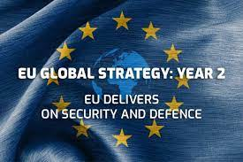
CIVIL SOCIETIES IDEAS FOR THE SUSTAINABLE AND SECURE FUTURE OF EUROPE
NETWORK ANNUAL CONFERENCE 2022
1-4 MAY 2022 NARVA/ ESTONIA
Part B :
The role of EU in Resolution
“Youth, Peace and Security” (UNSCR 2250)
EU Global Strategy
Dr Eleftheria FTAKLAKI
Doctor in European Studies and International/Regional Relations
Post Doctoral Fellow -Researcher
Lecturer at the Aegean University
Project Developer JMM EU.E.N.I.C
Co- organizers: FiMigrant/
National Civil Society Foundation and the Nordic Council of Ministers Estonian office.

Slide 12
European Union and the UN Security Council Resolution 2250 on Youth, Peace and Security (YPS)
-Talking about peace in Europe has a particular resonance as our continent has been ravaged by war over the past century. From the hashes of World War II, European integration has been an inspiring initiative geared towards peace and youth organisations were on board since the beginning.
-Peace and Security means more than the absence of violence or conflict in society. It is inherently linked to the respect of human rights, and specifically to youth participation, social cohesion and climate justice.
-From the Universal Declaration of Human Rights (UDHR) to the EU Charter of Fundamental Rights , ensuring peace and security must be seen not only as a common objective and a shared value, but also as a fundamental human right. In line with this, more is needed to promote just, peaceful and inclusive societies than the traditional focus on the judiciary, police and army forces.
-Youth organisations are doing their fair share in taking responsibility by engaging in political processes, by reporting human rights violations and by advocating for climate justice and fostering social cohesion.

Slide 13
From words to action…
Global Strategy
for the EU’s Foreign -Security Policy (CFSP)
European Union (EU)
The European Union (EU) has been taking important steps towards the recognition of youth in building and maintaining peace.
However, more needs to be done by their level in order to fully recognise the role of young people in this framework.
So far, it has been the European External Action Service (EEAS) showing the greatest interest in developing actions and policies in this regard.
Calls for increased societal resilience by deepening work on education, culture and youth in order to foster pluralism, coexistence and respect
However, this Strategy does not go far enough in viewing young people as actors of change, but rather approach them as beneficiaries.
In 2018, the Council of the European Union adopted Conclusions on “The role of young people in building a secure, cohesive and harmonious society in Europe”.
provides an active and meaningful participation of youth in building peaceful and resilient societies including through the use of non-formal learning and peer-to-peer approach, and gives direction to Member States on the implementation of the UNSCR 2250

Slide 14


European Union and the UN Security Council Resolution 2250 on Youth, Peace and Security (YPS)
- The Council of Europe:
Has a long tradition of working with young people, pioneering this work among international organisations, and relying on co-management by youth organisations and governments.
The Council of Europe also supports youth work at interregional and global level through the youth cooperation programme of the “Youth, Peace and Security” (YPS)
The Youth Cooperation Programme of the North-South Centre is developing a “Youth, Peace and Security” (YPS) agenda with the view of including the most recent developments in the field of youth participation and youth policies to achieve its mission to increase young people and youth organisations’ capacities and facilitates their participation in decision making processes towards the achievement of the UN Sustainable Development Goals.
In 2020, the Council of Europe adopted its Youth sector Strategy 2030, running for 10 years and including as one of the key four priorities “living together in peaceful and inclusive societies

Slide 15
European Union and the UN Security Council Resolution 2250 on Youth, Peace and Security (YPS)
Crucial Questions
-The Council of the European Union has recognised the importance of the UN Security Council Resolution 2250 on Youth, Peace and Security (YPS) in two of its conclusions – of 5 June 2020 and 23 May 2018, which called on the EU and the Member States to promote and take forward the YPS agenda.
-However, only one Member State, Finland, has concluded a YPS national implementation plan Council conclusions on the role of young people in building a secure, cohesive and harmonious society in Europe, recognise that Youth, Peace and Security is not just a global agenda — it is also a European agenda. (2018/C 195/05).
in this context the council invites the European Commission and the European External Action Service within their respective spheres of competence to Promote, review and highlight good practices regarding young people’s role in sustaining peace and preventing violence
What other Member States are developing their national strategies on YPS?
What has the Commission done to encourage them?
Does the European External Action Service (EEAS) plan to develop its own YPS Strategy and if so, what is schedule?
How have the Commission and the EEAS supported partner governments in their implementation of the YPS agenda?

Slide 16
Financing
Peacebuilding Fund
To ensure that the resolution is implemented and that it gives rise to concrete programs and policies, specific funding mechanisms are needed.
The resolution states that Member States and regional organisations should contribute financially to UN funds so that programs and tools can be developed to effectively implement the resolution
Thus the European Commission, responsible for introducing and implementing the European budget, must activate the mechanisms necessary to ensure a budget line that supports youth projects and peace or at least that its funding instruments in the field of peace, security and stability consider the inclusion of young people.
In June, the Peacebuilding Fund launched its first ever Youth Promotion Initiative, calling both UN partners and non-governmental organizations to submit proposals supporting the implementation of UNSCR 2250 in eligible countries.
US$ 5 million were allocated to projects in Guinea, Kyrgyzstan, Mali, Myanmar, PNG and Sri Lanka.

Slide 17
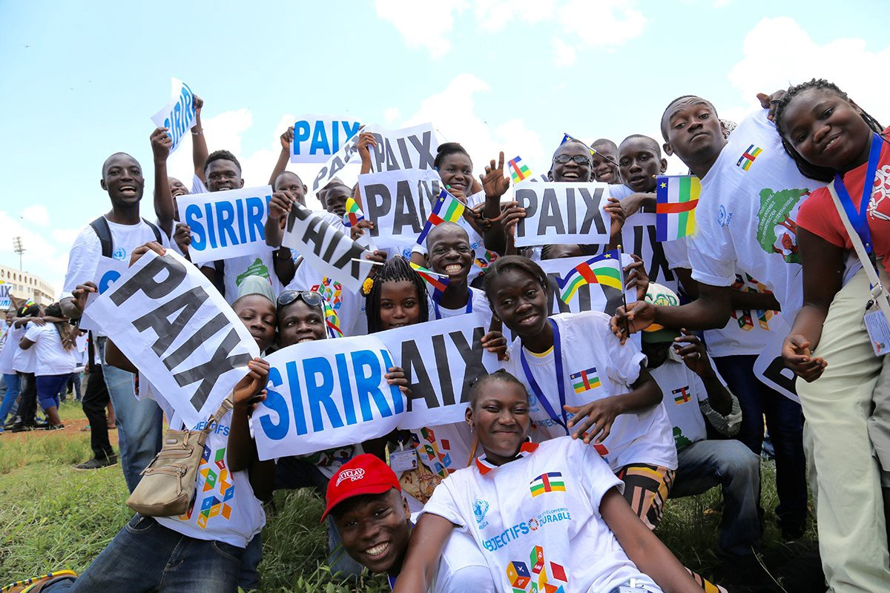
- The intergenerational challenge
Challenges of UN Security Council Resolution 2250
- Representing the diversity
- Coordination and partnerships

Slide 18

How young people can help to build peace
#YouthWill
1.Understand the history of the conflict —
and learn both sides.
2.Read and follow the news. Stay updated.
3.Discuss, and then act.
4. Join conferences, lectures and programs advocating peace and cultural exchange.
5. Start a peace project of your own or join one.

Slide 19
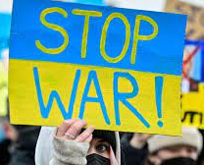
CIVIL SOCIETIES IDEAS FOR THE SUSTAINABLE AND SECURE FUTURE OF EUROPE
NETWORK ANNUAL CONFERENCE 2022
1-4 MAY 2022 NARVA/ ESTONIA
Part C
The Role of United Nations (UN) in elimination of regional conflicts:
Ukraine
Cyprus
Africa
Dr Eleftheria FTAKLAKI
Doctor in European Studies and International/Regional Relations
Post Doctoral Fellow -Researcher
Lecturer at the Aegean University
Project Developer JMM EU.E.N.I.C
Co- organizers: FiMigrant/
National Civil Society Foundation and the Nordic Council of Ministers Estonian office.

Slide 20
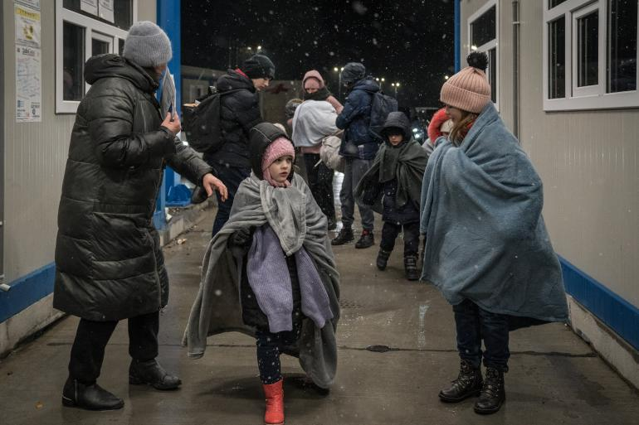
Initiatives relevant to conflict preventions
Over 12 million people – more than a quarter of the Ukrainian population – have fled their homes since the start of the war
Role of UN in achieving peace and elimination of conflicts, could raise question of Ukraine
United nations Security Council Resolution for Ukraine
Security Council Fails to Adopt Text Demanding Civilian Protection, Unhindered Humanitarian Access in Ukraine, as 13 Members Abstain (SC/14838- 23 March 2022)
Two (2) Vote in Favor (defeated by China, Russian Federation) , None against, with Delegates Denouncing Draft as Attempt by Moscow to Justify Aggression against Neighbor
It was the Council’s third vote since 24 February (SC/14808/ 25.02.2022 and SC/14809/ 27.02.2022) and would have needed nine votes in favour with no veto to pass.
Belarus, Democratic People’s Republic of Korea and Syria joined the Russian Federation in submitting the text.

Slide 21
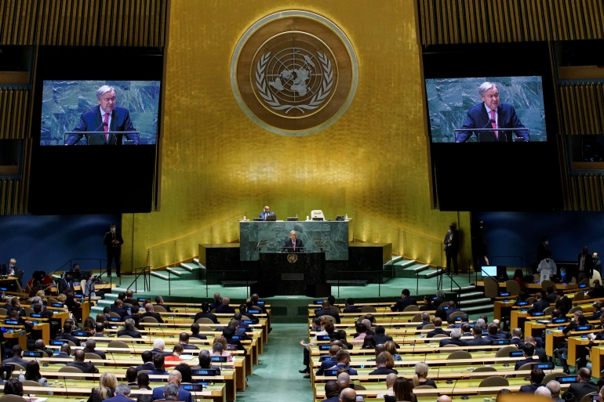
How Decisions are taking in UN …
In general, to be adopted, a draft resolution on a non-procedural matter must have the affirmative vote of nine members of the Council, including the concurring votes of the five (5) permanent members:
China, France, Russian Federation, United Kingdom of Great Britain and Northern Ireland, and the United States of America.
These countries have the power to veto Security Council resolutions, enshrined in the UN Charter – a right accorded to them because of their key roles in establishing the United Nations.
Following the resolution adopted by consensus, any such use will now trigger a General Assembly meeting, where all UN members can scrutinize and comment on the veto.

Slide 22
Initiatives relevant to conflict preventions
The International Court of Justice
The Court indicates provisional measures
(No. 2022/11, 16 March 2022)
By thirteen votes to two, The Russian Federation shall immediately suspend the military operations that it commenced on 24 February 2022 in the territory of Ukraine;
The ICJ Principal judicial organ of the United Nations, has delivered its Order on the Request for the indication of provisional measures submitted by Ukraine in the case concerning Allegations of Genocide under the Convention on the Prevention and Punishment of the Crime of Genocide (Ukraine v. Russian Federation)
By thirteen votes to two, The Russian Federation shall ensure that any military or irregular armed units which may be directed or supported by it, as well as any organizations and persons which may be subject to its control or direction, take no steps in furtherance of the military operations referred to in point (1) above
More than €7 million has been made available to support Ukraine in gathering and submitting evidence of war crimes to the International Criminal Court by EU.
(Josep Borel The HR of EU Foreign Policy)

Slide 23

Initiatives relevant to conflict preventions
The Security Council today renewed the mandate of the United Nations Peacekeeping Force in Cyprus (UNFICYP))
It recalled the status of Varosha — set out in relevant resolutions, including resolutions 550 (1984) and 789 (1992), and its presidential statement (document S/PRST/2021/13),
The Security Council extended the mandate of the United Nations Peacekeeping Force in Cyprus (UNFICYP) for six months — until on 31 July — expressing serious concern about several issues, including the continued violations of the military status quo along the ceasefire lines.
The Security Council called on the leaders of the two Cypriot communities and all involved parties to refrain from any actions and rhetoric that might damage the settlement process and that could raise tensions on the island. It also expressed concern over tensions in the Eastern Mediterranean, and underlined that disputes should be resolved peacefully, in accordance with applicable international law.

Slide 24
Youth Initiatives in Cyprus
All in Cyprus: “An inclusive society with empowered women and youth is on the way”
A new intercommunal advocacy group established during the Young Leaders in Action initiative, which provided a space for young Cypriots from both communities of the island to brainstorm different ideas and put in practice initiatives to help increase participation of women and youth in peace activism on the island.
Young Leaders in Action:
Inclusion of Women and Youth in Peacebuilding is an action within the ‘Peacebuilding in Divided Societies’ programme implemented by the United Nations Peacekeeping Force in Cyprus, in collaboration with the British Council and the British High Commission in Nicosia.

Slide 25
Youth Initiatives in Africa
African Youths International Development Foundation (AFYIDEF)
AFYIDEF is based in Nigeria, and it's programmes focus on the socio-economic development of young people and the promotion of peace and co-existence.
ALEXANDER Initiative for Children and Youth (AICY)
AFCY promotes the provision of basic human rights, social justice, and peacebuilding in Nigeria, particularly for children and young people
Association of Youth for Peace and Development
AYOPAD promotes youth participation in peace and democratisation
Children &amp; Young People Living for Peace (CYPLP)
CYPLP works in Nigeria to enable young people to become active citizens, to tackle the root causes of violence and to build community cohesion.
National Youth Council of Nigeria (NYCN)
NYCN provides a platform for advancement, mobilization and coordination of youth development and promotion of peace, unity and tolerance.
Youth for Peace and Development (Y4PD)
Y4PD is a youth-led organisation formed out of the belief that there has been limited youth participation as active members in the field of peacebuilding and social change in Zimbabwe.
Y4PD works primarily on two activities: advocacy for youth participation in peacebuilding and development actors in the form of training series, long term partnerships and publications.
Their advocacy activities aim to shape policy and practice in peacebuilding, creating and enabling environment for young peace builders working at local, national and regional level

Slide 26
SIX WAYS TO SUCCESSFULLY ENGAGE YOUTH IN PEACEBUILDING
Considerations
Despite the fact that the main international organisations have been developing policy frameworks to promote the role of young people and youth organisations in peacebuilding activities, a lot remains to be done to fully include in a meaningful way young people and youth organisations.
Moreover, apart from the work undertaken by international organisations, more needs to be done by national authorities to implement international policy frameworks and include young people and their representatives in it.
Create spaces for youths to express their opinions — and listen to them
Enhance the peace-building knowledge and skills of young people
3. Build trust between youths and governments
Promote intergenerational exchange
Strengthen monitoring and evaluation
Support youths who are positively contributing to their communities

Slide 27
CIVIL SOCIETIES IDEAS FOR THE SUSTAINABLE AND SECURE FUTURE OF EUROPE
NETWORK ANNUAL CONFERENCE 2022
1-4 MAY 2022 NARVA/ ESTONIA
Part D
What is the future of United Nations ?
Dr Eleftheria FTAKLAKI
Doctor in European Studies and International/Regional Relations
Post Doctoral Fellow -Researcher
Lecturer at the Aegean University
Project Developer JMM EU.E.N.I.C
Co- organizers: FiMigrant/
National Civil Society Foundation and the Nordic Council of Ministers Estonian office.

Slide 28
Crucial Question
Can the UN Security Council help prevent conflicts?
In his first address to the United Nations (UN) Security Council, Secretary- General António Guterres called for a ‘whole new approach’ to conflict prevention.
In his speech, he stated that prevention is ‘the priority’ for the global organisation.
Guterres also noted that the international community spends far more time and resources responding to crises rather that preventing them
The UN has not been able to present a clear, unified definition for conflict prevention
More than ever, the international community must develop effective conflict prevention mechanisms to be able to sustain peace
In the spirit of contributing towards a culture of prevention, this report reflects on the role played by the UN Security Council in the prevention of armed conflict.
-How we could make UN and people closer to each other / or the time of UN is over?
-The need to reform the United Nations is critical.

Slide 29
The future of international cooperation: Time to think big
The Summit should take account of today’s more complex context for global governance…a more inclusive and networked multilateralism, to navigate this complex landscape and deliver effective solutions.
On top of the Summit of the Future, the report proposes biennial high-level meetings at the level of Heads of States and Government, between the G20, Economic and Social Council (ECOSOC), the heads of International Financial Institutions, and the UN Secretary-General, aimed at creating a more sustainable, inclusive and resilient global economy.
The report also calls for better partnerships between governments, multilateral organizations, the private sector, and civil society; and an emergency platform to better prepare for global crises, with stronger global health security.
One example is the creation of a Futures Lab, which would work with partners including governments, academia, civil society, and the private sector, to issue regular reports on megatrends and catastrophic risks.
The Secretary-General recommends a Summit of the Future, which would “forge a new global consensus on what our future should look like, and how we can secure it”.
The Summit would address the perennial issues of peace and security, setting out a “New Agenda for Peace”, with more investment for peacebuilding, support for regional conflict prevention, a reduction of strategic risks such as nuclear weapons and cyberwarfare - and a dialogue on outer space to ensure that it is used peacefully and sustainably.
-

Slide 30
The future of international cooperation: Time to think big
In addition, measures on education, skills training and lifelong learning are proposed, including a Transforming Education Summit planned for 2022, to address the learning crisis and expand opportunities and hope for the world’s 1.8 billion young people, and a Global Social Summit, to be organized in 2025, which would coordinate international efforts to create peaceful, secure societies based on human rights and dignity for all.
Other UN-related proposals concern the improved participation of youth in the political process and efforts to cut youth unemployment.
The reports recommends the appointment of a Special Envoy for Future Generations, to give weight to the interests of those who will be born over the coming century, and a new UN Youth Office to strengthen engagement with young people across the work of the Organization.
An upgrade, with a more participatory and consultative approach, gender parity by 2028, the re-establishment of the Secretary-General’s Scientific Advisory Board, and a policy that puts people at the centre of the UN System, taking into account age, gender and diversity.
As the UN embarks on the Decade of Action – 10 years to make real progress to deliver the promise of a sustainable, fairer future by 2030 – there is an opportunity to reshape the world for the better, with multilateralism at the heart of the process.
“Governments should never again face a choice between serving their people or servicing their debt”,
said Mr. Guterres.
-

Slide 31
The UN Turns Seventy-Seven.
Here's How to Make it Relevant Again
-
All of this will take energy, time, money, and leadership.
It will also require a new compact between the United Nations and the public because the organization’s legitimacy and influence will increasingly rest on a sense of ownership. In today’s complex world, identifying problems, designing policies, and delivering change is no longer within the power of states standing alone.
It requires participation of diverse actors, including non-profits, grassroots movements, corporations, and local authorities.
Working out how to bring the United Nations closer to “we the people” and remaining relevant for future generations should drive the organization as it enters its next phase
To avoid another major global conflict, the supporters of the United Nations—with all its imperfections—need to reinforce and reinvigorate its collective power.

Slide 32
The UN Turns Seventy-Seven.
Here's How to Make it Relevant Again
-
The United Nations stands at a crossroads.
Unlike its predecessor, the League of Nations, it has endured, and in its seventy-five years as the largest and most representative global multilateral institution, it has recorded many successes.
Today, however, it is be devilled by a litany of challenges, including gross underfunding, bloated bureaucracy, disunity, and geopolitical rivalry among the permanent members of the Security Council. These and other issues both weaken its effectiveness and undermine its relevance.
UN reform has been on the agenda since the organization was created in 1945.
The greatest challenge confronting the organization—one that has repeatedly rendered it unable to act decisively on critical global issues—is intransigence among the permanent members of the Security Council.

Slide 33
The UN Turns Seventy-Seven.
Reforming the Security Council
The Security Council as currently constituted in terms of membership, functions, and powers cannot effectively respond to the myriad crises engulfing the world.
As powerful countries move toward unilateralism, populism, and nationalism at the expense of multilateralism and collective action, a united and forward-looking Security Council capable of effectively driving the wider United Nations to achieve its goals is sine qua non.
Reforming the Security Council to be more inclusive, representative, transparent, and effective, and to demonstrate greater cooperation and consensus-building, therefore remains critical to the United Nations’ overall success.
Doing so will require restructuring the Security Council to reflect the changed power distribution in today’s world and to tackle inaction by veto.
From an African perspective, reform of the Security Council should be in line with the Ezulwini Consensus*, which proposes two additional permanent seats and two additional elected seats for Africa. Under this proposal, the two permanent members would be granted all prerogatives and privileges of permanent membership, including veto power.
Ezulwini Consensus is a position on international relations and reform of the United Nations, agreed by the African Union

Slide 34
The UN Turns Seventy-Seven.
Rebuild the UN's Legitimacy
Established powers do not believe that new powers comply adequately with existing institutions.
New powers do not believe that existing institutions have the legitimacy to govern global affairs.
Add the unilateral tendencies of populists into the mix and it is clear that the United Nations needs to prove itself to a new generation of peoples and countries.
The need to rebuild its legitimacy, whether in real or perceived terms, is urgent.
Legitimacy involves at least two components that need strengthening:
representation and effectiveness.

Slide 35
The UN Turns Seventy-Seven
Embrace New, Creative, and Collective Actions
Crises are moments of great uncertainty, but they also harbour great opportunities. More than ever the world needs collective action.
The United Nations is best suited to actively and creatively address existing and future challenges guided by the ideals and vision laid out in its Charter.
These include promoting peace, security, justice, respect for obligations, treaties, and international law; improving social conditions and living standards; reaffirming fundamental human rights, dignity, tolerance, equality, and freedom for all—regardless of race, sex, language, or religion for large and small nations alike.
These ideals and visions, now just as then, should be the driving inspiration for everyone.
Inspired by the founding ideals and including issues and challenges the world faces today, this agenda should definitely embrace new, creative, and collective actions involving all sectors of society, “to ensure the future we want and the United Nations we need.”
In this new challenges Youth must be on the front line and be part of the new era in UN

