Slide 1
TALLINN AS A DIGITALLY SMART AND RESOURCE EFFICIENT GREEN CITY
Toomas Türk
Digital services
City of Tallinn
Notes:
Slide 1 – Cover slide
Ladies and Gentlemen, I am very pleased to present Tallinn, my hometown, at your high-level event here. This a great opportunity to extend our cooperation globally.
Daamid ja härrad, mul on väga hea meel tutvustada oma kodulinna Tallinnat teile. See on suurepärane võimalus laiendada meievahelist koostööd globaalselt.

Slide 2

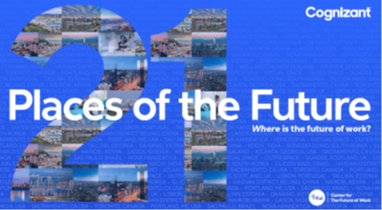
City of Tallinn
City administration
1 500
1000 startups, 24 enterprises per 100 residents
Population
450 000,
Area
159 m²
Hanseatic town, Lübeck rights since 1248
Fitch AA-stable, ½ of the country`s GDP
Budget
861 ml €

Slide 3

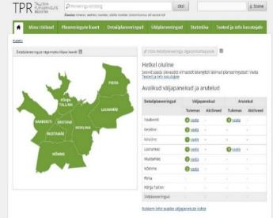
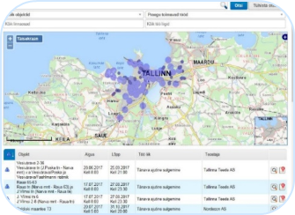
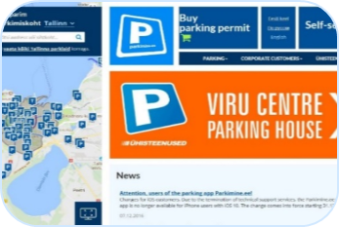

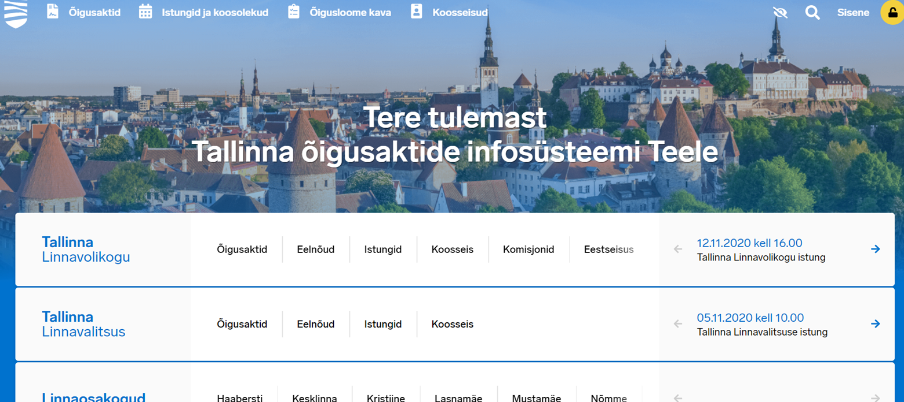
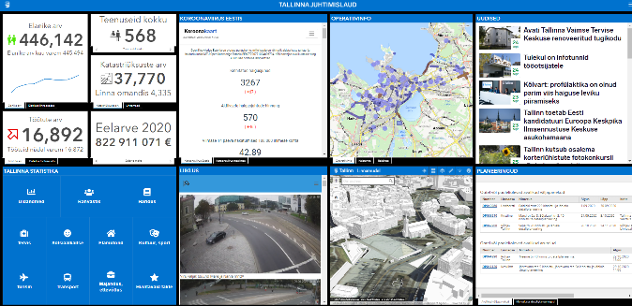
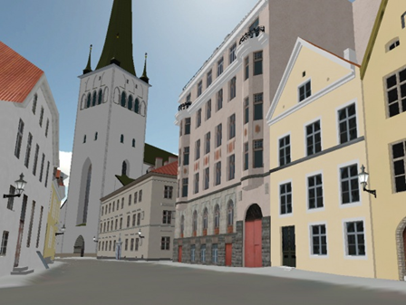
TALLINN E-GOVERNANCE
Tallinn Planning Register
Parking management
Tallinn City e-democracy solutions
Tallinn Dashboard
Tallinn 3D
Source: www.tallinn.ee
Notes:
All our e-services are based on trust of people: hard to get, easy to lose! Describe the connections with space
Slide 7 – Tallinn e-Governance
Over the last 20 years Tallinn has invested significantly in novel Smart City solutions, and especially into e-services. Some of them are for example mobile parking – first introduced already in 2001, Urban Planning Register, different applications for document administration and to provide the citizens more quality with hassle-free services. We cooperate and use data from state registries together with secure access and digital signature.
Tallinn on viimase 20 aasta jooksul palju investeerinud uudsetesse nutika linna lahendustesse ja eriti e-teenuste arendamiseks. Mõnedeks näideteks on mobiilne parkimine - esmakordselt kasutusele juba 2001. aastal, linna planeeringute register, erinevad dokumentide halduse rakendused ja kodanikele kvaliteeti pakkuvad „keerukuse vabad“ teenused. Me teeme koostööd ja kasutame riiklike registrite andmeid koos turvalise juurdepääsu ja digitaalallkirjaga.

Slide 4
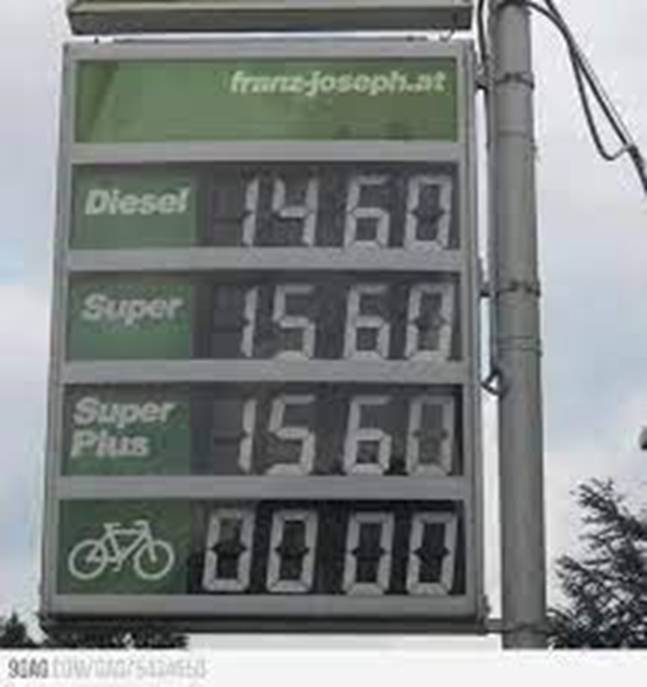
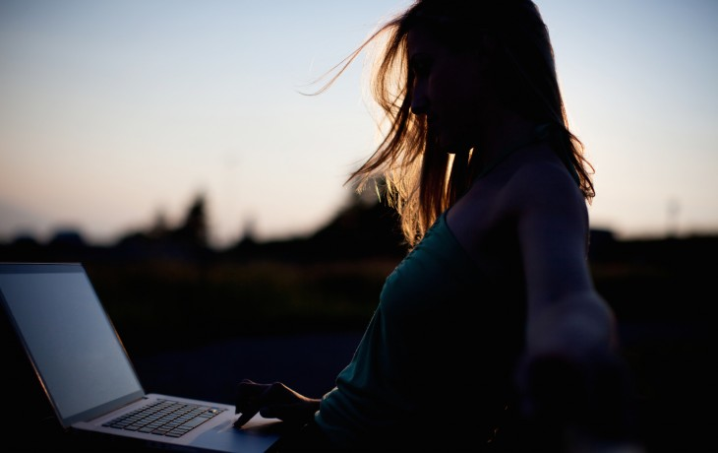
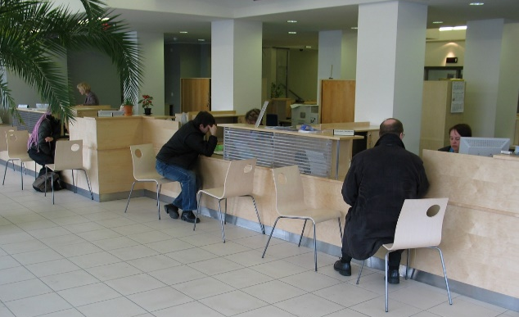
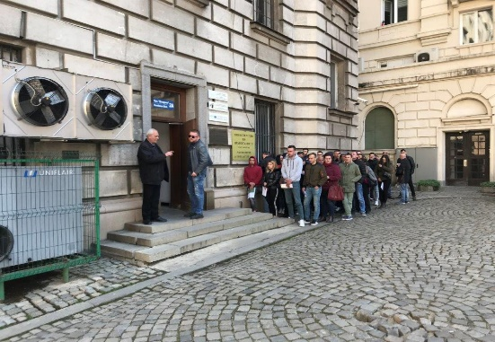
Service evolution steps
24/7/365
Service hall
Open Mon–Fri 8:00am–5:00pm
Customer asks the service

Slide 5
Process is 100% digital, whole process and documentation within the same system (example: disabled people transportation service)
Citizen
Social services specialist
Logistic
Taxi or bus driver
Digital applicaton
Service applicaton and acceptance
Route planning
Actual service provided

Slide 6
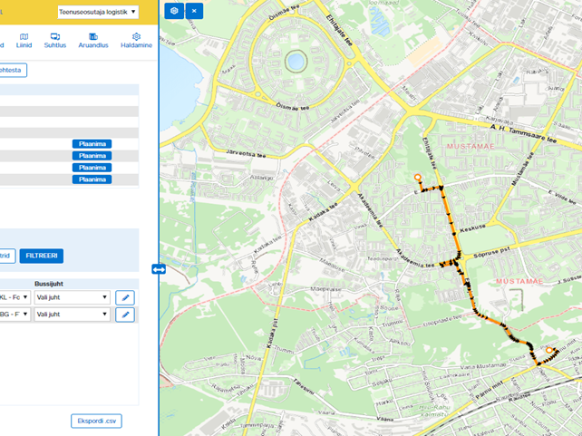
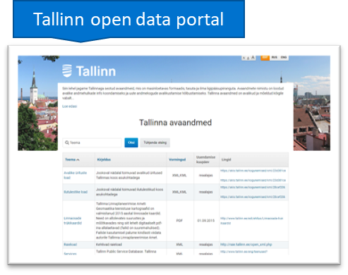
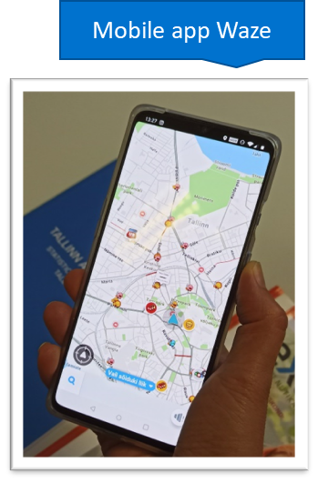
Open Data and GIS component

Slide 7
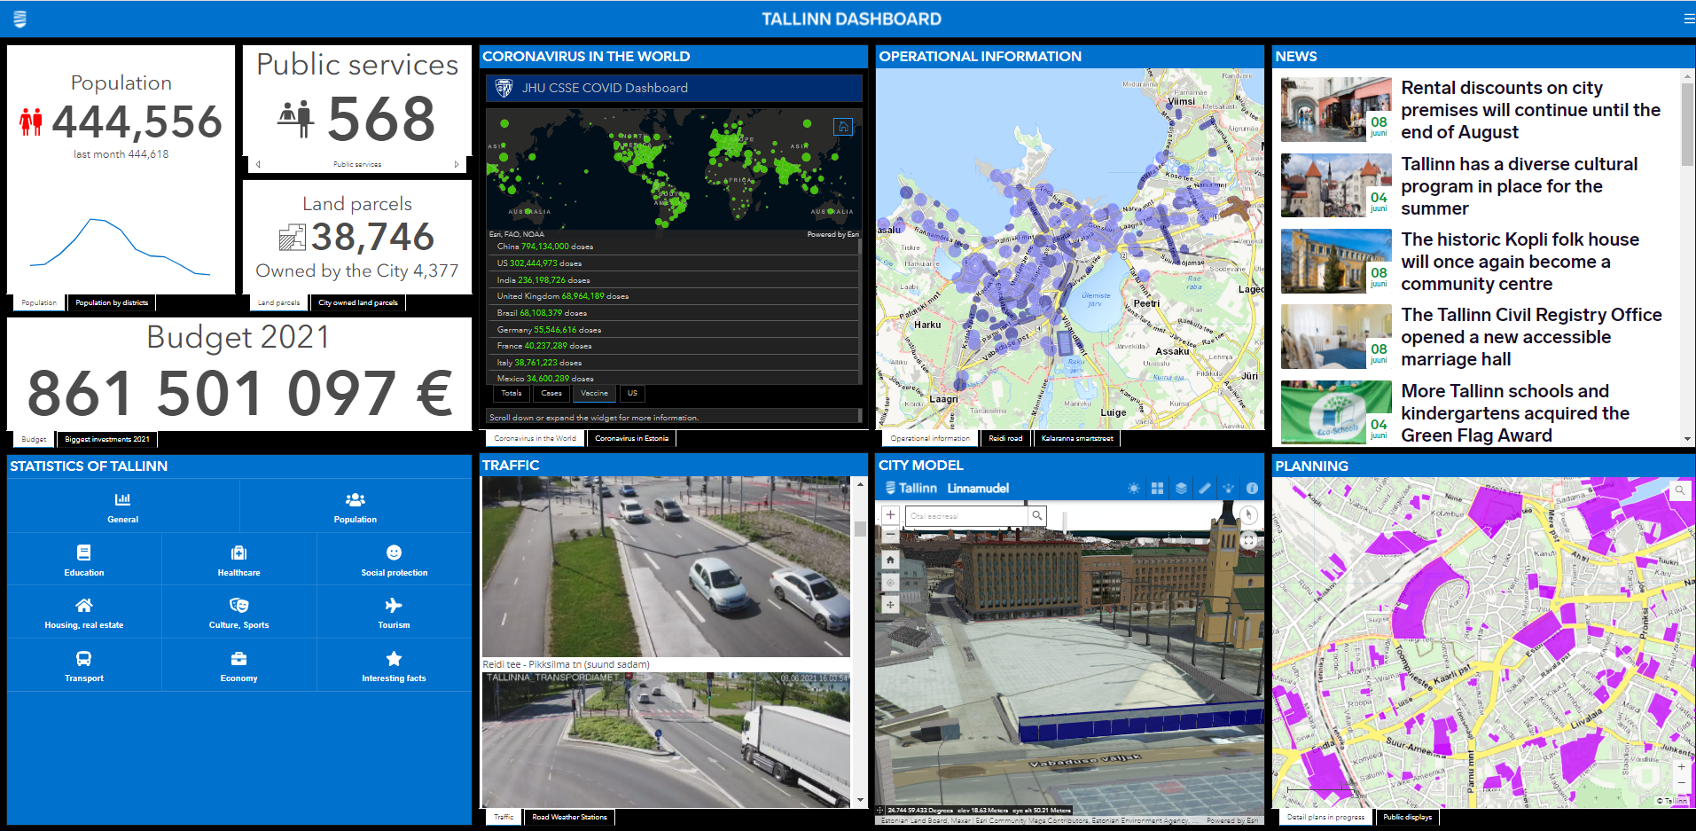

Slide 8
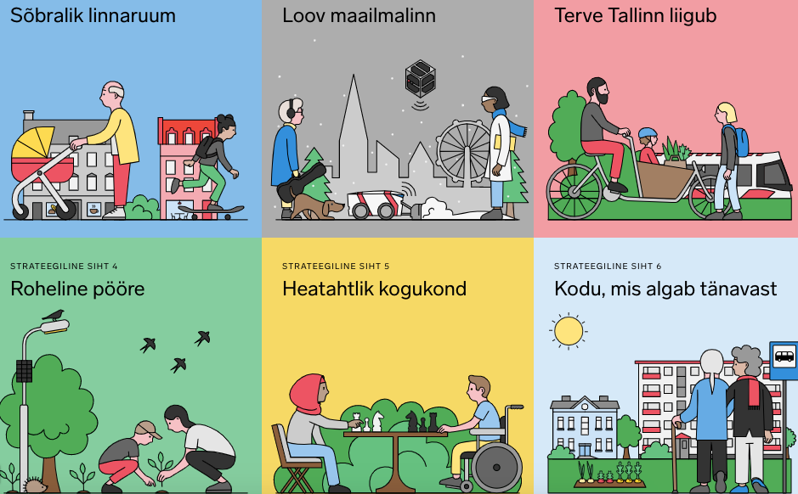
GREEN TALLINN STRATEGIC DIRECTIONS
ENABLING URBAN SPACE
CREATIVE METROPOL
THE WHOLE CITY MOVES
Climate change Sustainable land use Nature and biodiversity Air quality Noise Waste Water Energy performance Sustainable decisions
https://strateegia.tallinn.ee/
GREEN TRANSITION
WELCOMING & CARING COMMUNITIES
HOME THAT STARTS FROM STREET

Slide 9
Intelligent City vs Local Government role and actions
Smart citizens
Educated and active community
Innovative and digital solutions and services
Political support
Citizen engagement
Zero bureaucracy
Data management
Innovative education

Slide 10
Notes:
Slide 9 – Tallinn’s Ecosystem
Of cource, we don’t deliver this all alone. There is a wider network of our partners. From industrial parks to startup incubators, from International organisations to globally famous universities, cooperation programmes and events. (Specific examples are with globaal impact Robotex, Let’s Do it, The Global Hack etc; network cooperation: ESA business incubator, globally TOP20 science park, Startup community)
Muidugi, pole me võimelised seda kõike üksi teostama. Meie partnerite võrgustik on laiem. Tööstusparkidest alustavate inkubaatoriteni, rahvusvahelistest organisatsioonidest ülemaailmselt tuntud ürituste, ülikoolide ja projektiprogrammideni.

Slide 11

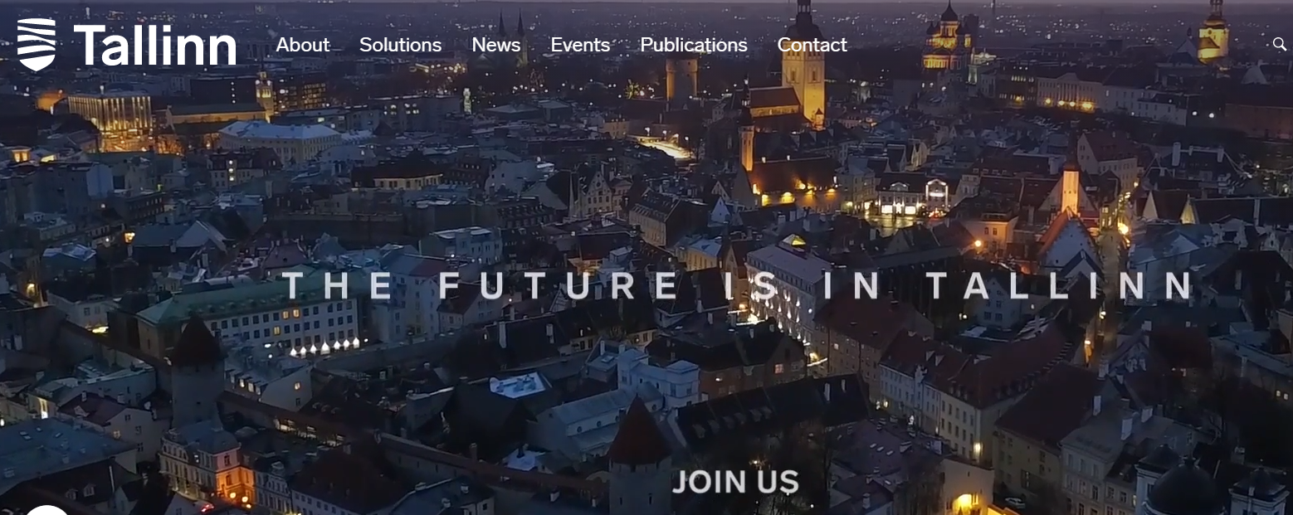
www.tallinnovation.ee
Notes:
Tallinnovation concept

Slide 12
Thank you!
w.tallinn.eewww.tallinn.ee
www.tallinn.ee
www.tallinnovation.ee
Dashboard.tallinn.ee
Notes:
Slide 13 – final slide
Thank you for your attention and I wish to all of us a successful cooperation and networking during the event! Let’s build the future together!
Tänan tähelepanu eest ja soovin meile kõigile edukat koostööd ja võrgustamist ürituse jooksul! Loome koos tulevikku!

