Slide 1


Slide 2




Global Conversation 2021 A green, socially sustainable and digitally integrated world
26 -29th August 2021
www.unsdg.ee

Slide 3
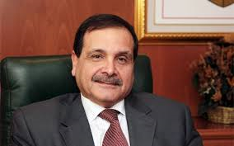
Ambassador Hatem Atallah Moderator of the Conference

Slide 4
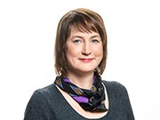
Jane Õispuu, Head of Political Team at the European Commission Representation in Estonia

Slide 5
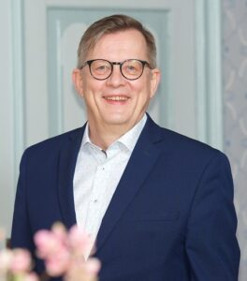

Christer Haglund, Director of Nordic Council of Ministers’ Office in Estonia (Video)

Slide 6
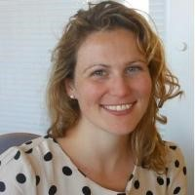
Clair Inder, UN Common Agenda Team, Executive Office of the Secretary-General (online)

Slide 7
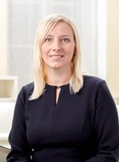
Eili Lepik, Deputy Strategy Director of Strategy Unit of Estonian State Chancellery; (online)

Slide 8
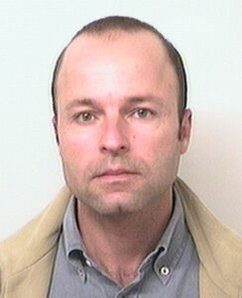
Miguel Silva, North-South Centre of the Council of Europe (Portugal); (online)

Slide 9
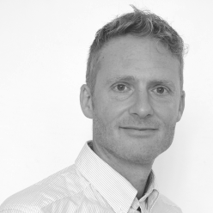
Mr. Rich Wilson, Global Assembly (UK)

Slide 10
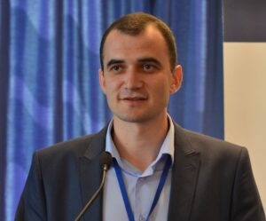
PhD Hab Nicolai Tsveatkov, Deputy Chief Bureau Politics for reintegration, State Chancellery of Republic of Moldova

Slide 11
Eleonora Insalaco, Programmes Manager of Anna Lindh Foundation (Egypt, Online) and PhD. Mahmoud Ezzat, Deputy Director of Center for Strategic Studies at Bibliotheca Alexandrina

Slide 12
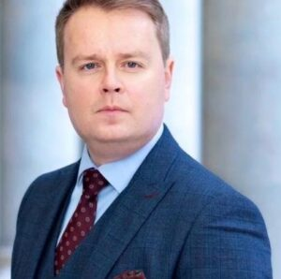
Alexander Dubowy, Senior Fellow at Welt Trends-Institut für Internationale Politik; General Secretary of the Society for Eurasian Studies, Institute for Security Policy, University of Vienna (Austria)

Slide 13
DAY 2

Slide 14
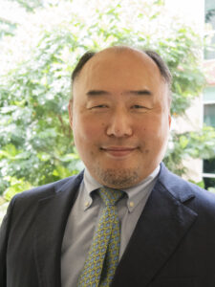
Ambassador Toru Morikawa, Executive Director of Asia - Europe Foundation "Asia - Europe Dialogue on Environment and Climate Change“ (Online)

Slide 15
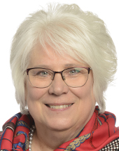
Marina Kaljurand, Member of European Parliament, the Chair of the Global Commission on the Stability of Cyberspace (Online)

Slide 16
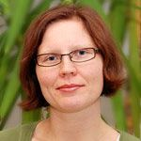
Jenni Kaupila, Advisor the UNA Finland: "Nordic vision of SDGs achievement by 2030: challenges and solutions“ (Online)

Slide 17
Marina Kaljurand, (Moderator) Member of European Parliament, the Chair of the Global Commission on the Stability of Cyberspace (Online)

Slide 18
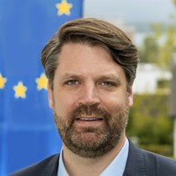
Dr. Robert Krimmer, ERA-Chair Professor of e-Governance at University of Tartu

Slide 19
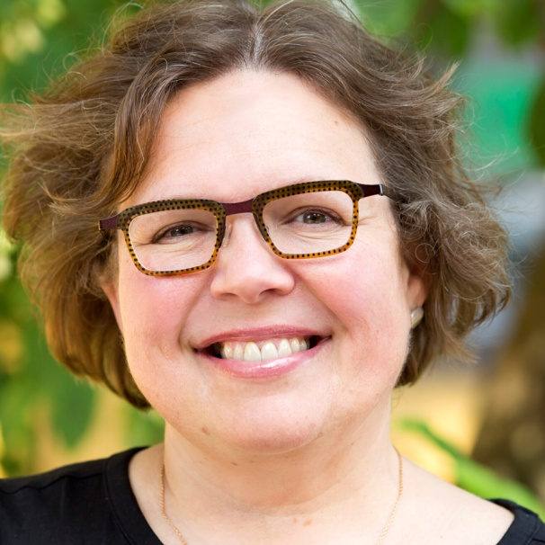
Kristina Mänd, Senior expert of e-Governance Academy, Estonia

Slide 20
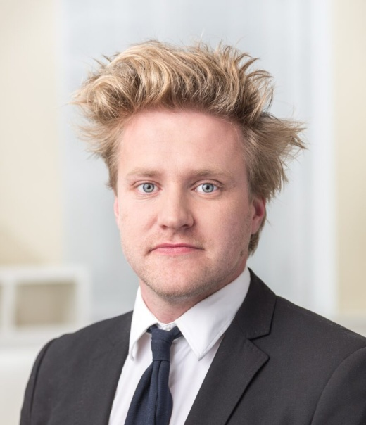
Marten Kaevats, Estonian National Digital Advisor, Estonian State Chancellery (online)

Slide 21
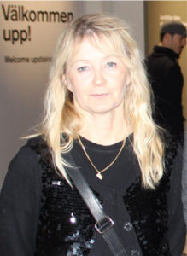
Susanne Kallanvaara, Burgårdens Gymnasium (Sweden)

Slide 22
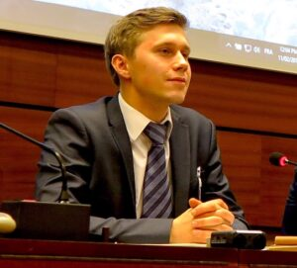
Jean Kostrzewski, London University (Poland/France)

Slide 23
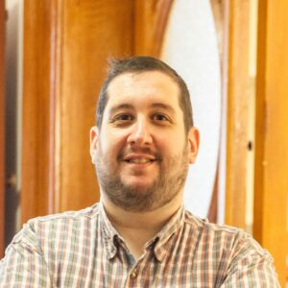
Michael Kavuklis, Europe House of Rhodes (Greece)

Slide 24
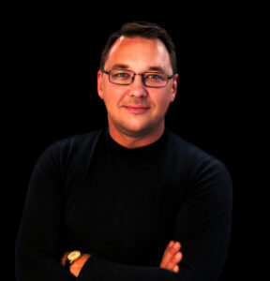
Andrius Becys, CEO of GoalHUB (Lithuania, online)

Slide 25
LUNCH

Slide 26
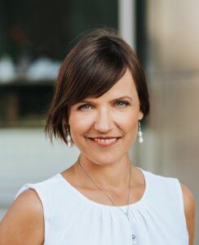
Anneli Ohvril, CEO of Let’s Do It World World Cleanup Day
Estonia

Slide 27
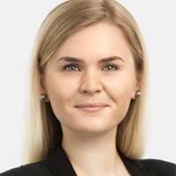
Kädi Ristkok, Head of Climate Department, Estonian Ministry of Environment

Slide 28
Jane Õispuu, Head of Political Team at the European Commission Representation in Estonia

Slide 29
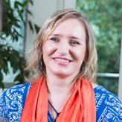
Grazyna Pulawska, Associate Director, Asia-Europe Foundation (Singapore), online

Slide 30
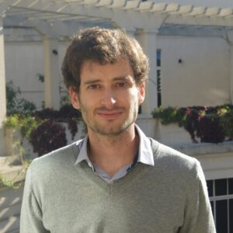
Gonzalo del Castillo, Director of consulting centre on sustainability CeSUS Executive Director of the Club of Rome (Argentina)

Slide 31
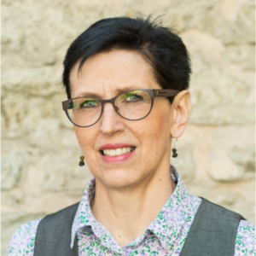
PhD. Kaja Peterson, Programme Director Sustainable Development Programme, Senior Expert of Stockholm Environment Institute Office in Tallinn

Slide 32
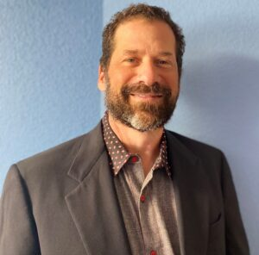
Harrison Pollak, Environmental attorney California (USA)

