Slide 1
Civil society input in ensuring Peace and Security in example of Transnistria case
Nikolay Tsvyatkov,
PhD Hab in political sciences,
Deputy Chief Bureau for reintegration politics,
State Chancellery, Republic of Moldova

Slide 2
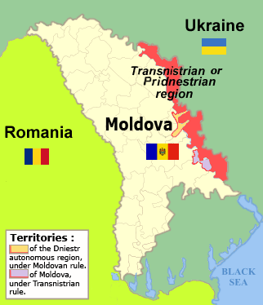
The conflict in Eastern Moldova
Part of Moldova’s territory, known as the Transdniestrian region, declared its de-facto secession from Moldova in September 1990 and has remained outside of the control of Moldova’s central government since then.
Civil society offers continuous support to the efforts of the Republic of Moldova in the negotiation process.
Notes:
Tähän saatetaan tarvita useampi kuin yksi dia

Slide 3

Positive responsibility and Civil society
The most obvious difficulties in management of the Transdniestrian file are dealing with the lack of effective control over the situation in the region, the inapplicability of national legislation, the inaccessibility of the region for incumbent officials, the rhetoric of constant confrontation of Tiraspol and the use of unilateral actions.
Despite this, and until the final settlement of the Transdniestrian conflict, Chisinau will make all possible efforts together with civil society organisms to provide the necessary assistance to the residents of the eastern regions of the country.

Slide 4
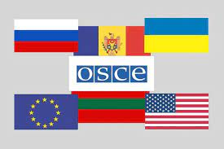
Formats of negotiation process
Negotiation format „5+2” (conflict parties, mediators and observers).
Central goal of which is to determine the final parameters of the model for the settlement of the Transdniestrian conflict.
Agenda is divided into 3 thematic baskets: socio-economic issues, human rights, institutional, political and security issues.
Format„1+1” - working meetings at the level of leaders or between political representatives of Chisinau and Tiraspol.
Sectorial working groups (economy, education, road transport, human rights, public security, etc.) are composed of profile experts from Chisinau and Tiraspol set to solve technical problems faced by the inhabitants of both banks of the Dniestr River.

Slide 5
Civil society input in Peace negotiations
Actually more than 11.000 civil society organizations are registered in the Republic of Moldova and about 3.000 NGO – in Transdniestria
Human rights. The main institution is Ombudsman office.
Free movement. The main priority is elimination of all unjustified barriers to free movement in/from localities in the Transdniestrian region
Mass-media. Freedom of opinion is guaranted by art. 32 and 34 of Moldovan Constitution and a lot of normative acts.
Confidence-building measures to improve cooperation and distinct support for keeping dialogue between the inhabitants and civil activists from the two banks of the River.

Slide 6

The Moldovan Government expressed its firm commitment to further support to this autonomous public authority with clear objectives such as:
contributes to improving the legislation and the practices in the area of human rights and freedoms.
monitors the level of observance of human rights and freedoms
ensures promotion of human rights and freedoms in the society
ensures the collaboration with the national and international non-commercial organizations in the area of human rights’ and freedoms’ defense and with mass-media
Ombudsman’s Office
Main objectives
http://ombudsman.md/en/

Slide 7
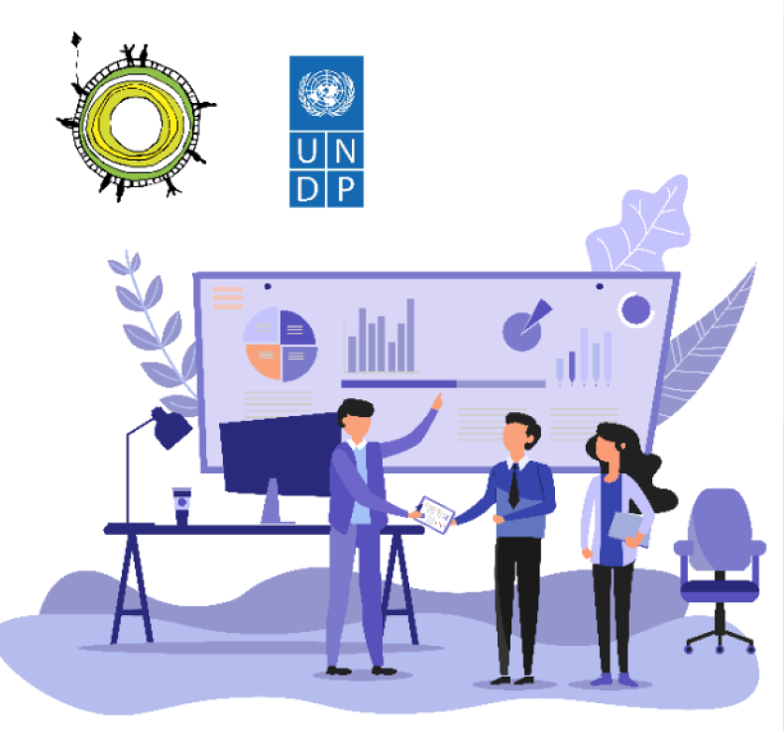
Role of EU and UNDP
The EU plays an important role and is actively involved in these processes.
Thus, the EU, together with UNDP Moldova has funded hundreds of sustainable development projects involving civil actors on both banks of the Nistru River and strengthening confidence-building measures among people.
Therefore, in the period 2009-2021, 5 phases of the „Support to Confidence Building Measures” (CBM) Program were implemented, with a total budget of 14.3 million euro and 21.79 mln $.

Slide 8

Role of Council of Europe
Council of Europe constantly carried out projects since 2010 and has allocated around € 2.5 million through action plans to support democratic reforms in the Republic of Moldova:
In the areas of human rights in places of detention and in the social sphere, media, civil society, inclusive education for people with disabilities, the collaboration of professionals in educational institutions and the medical field.
Transfers of expertise, thematic seminars, trainings, round tables, sports and cultural events were organized.
These activities are aimed at debating common problems and challenges, taking over the positive experiences of other states.

Slide 9
Absolute priority
for the Moldovan authorities and civil society
The Moldovan authorities provide all possible assistance, using the dialogue platform at the level of political representatives and actors of the „5 + 2” format, raising awareness of international organizations (OSCE, UN, Council of Europe, European Union), cooperation with human rights promoters, involvement of national law enforcement bodies, to achieve a comprehensive, peaceful and sustainable settlement of the Transdniestrian conflict, based on the sovereignty and territorial integrity of the Republic of Moldova, within its internationally recognized borders, with a special status for the Transdniestrian region

Slide 10
Thank you for your attention.
Nikolay Tsvyatkov,
PhD Hab in political sciences,
Deputy Chief Bureau for reintegration politics,
State Chancellery, Republic of Moldova
nicolai.tveatcov@gov.md

