Slide 1
HUMAN RIGHTS
AND
DIGITALIZATION

Slide 2
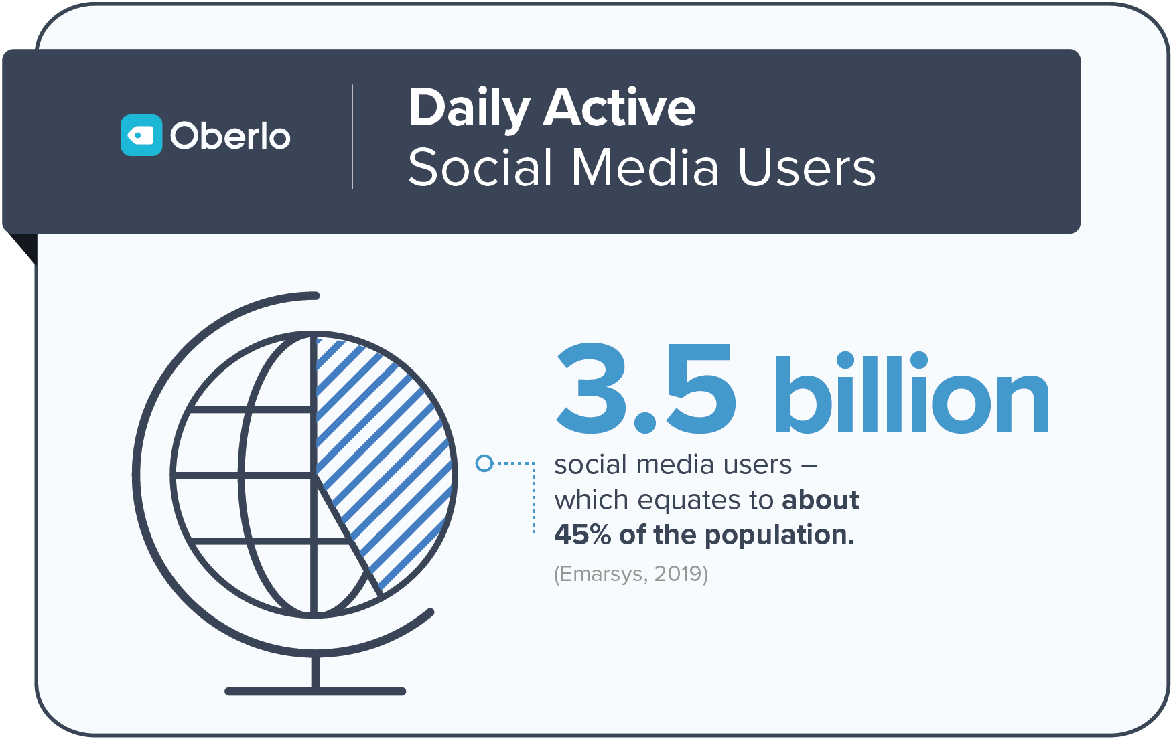
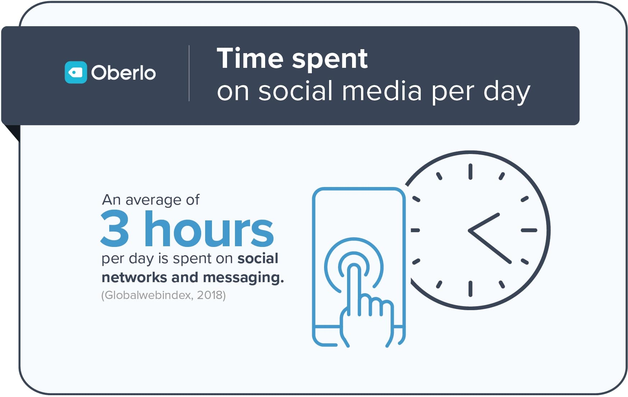
We live in a world today where vast Information and communications technology infrastructures and extensive flows of information have become natural and unquestioned features of modern life.
Rapidly growing online services — everything from social media to e-commerce and virtual collaboration — have come to define our day-to-day lives in ways unimaginable just a decade ago.

Slide 3

Do digital technologies hurt or support human rights?
Digital technology already delivers many benefits.
Its value for human rights and development is enormous. We can connect and communicate around the globe as never before. We can empower, inform and investigate. We can use encrypted communications, satellite imagery and data streams to directly defend and promote human rights. We can even use artificial intelligence to predict and head off human rights violations.
But we cannot ignore the other side. I cannot express it more strongly than this: The digital revolution is a major global human rights issue. Its unquestionable benefits do not cancel out its unmistakable risks.
Neither can we afford to see cyberspace and artificial intelligence as an ungoverned or ungovernable space –a human rights black hole. The same rights exist online and offline. The UN General Assembly and the Human Rights Council have affirmed this.

Slide 4
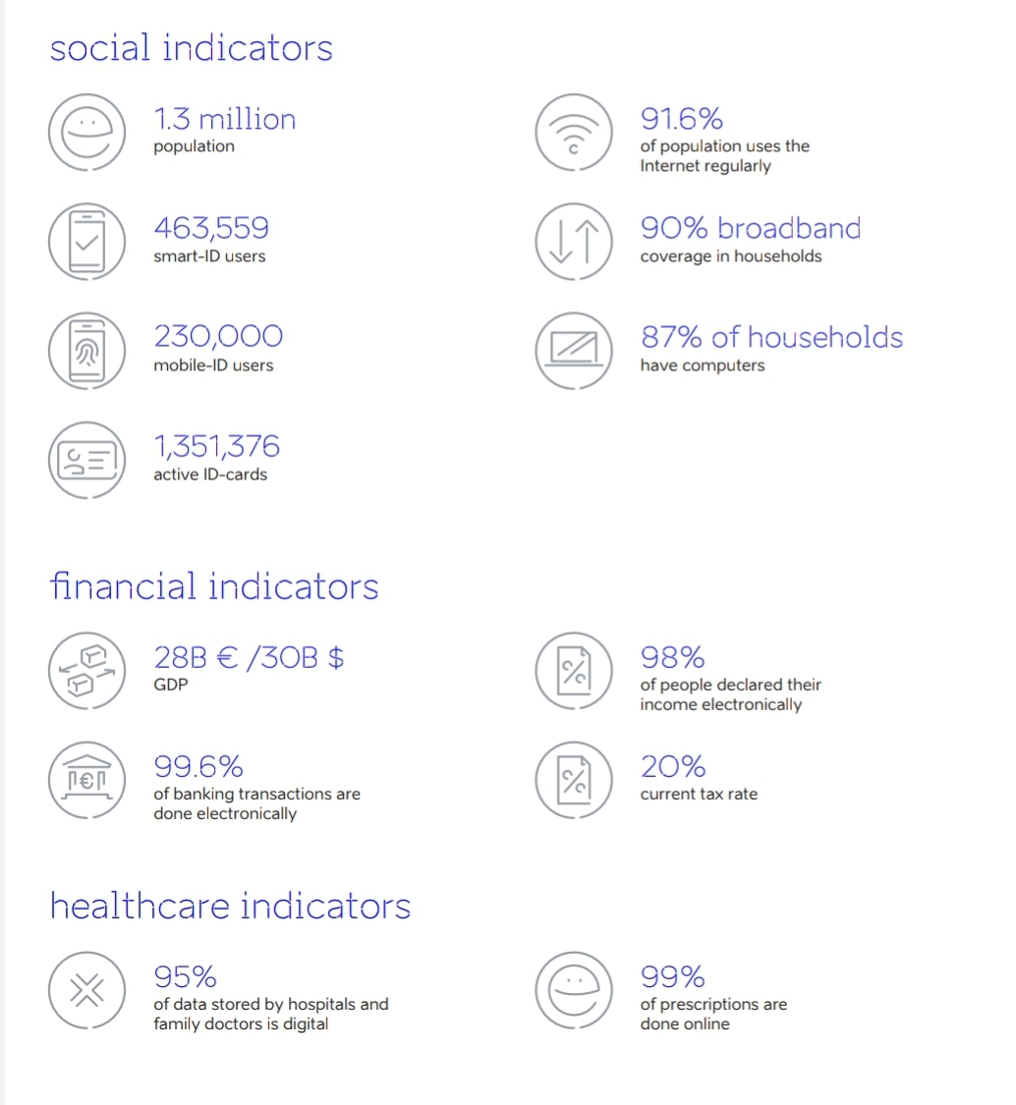
E-Estonia facts
Estonia has 1.3 million citizens and it has become the paradigm example of digital services in a mere 20 years.
Estonia’s digital services include aspects such as e-Tax and Digital ID.
In 2002, Estonia launched a high-tech national ID system. Physical ID cards are paired with digital signatures that Estonians use to pay taxes, vote, do online banking and access their health care records.
For a small country, Estonia has made a big impression on the global stage.

Slide 5
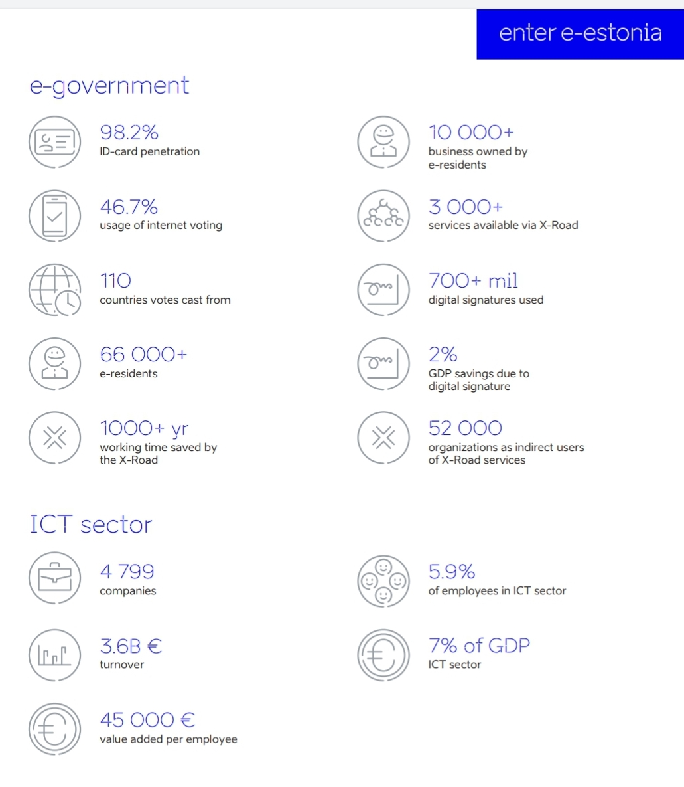
Around the globe, people are searching for innovative ideas to tackle problems created by the COVID-19 pandemic. Countries are scrambling to find solutions to combat the looming economic crisis, manage pressure on the medical system all the while trying to ensure that life can continue as normally as possible. Even the New York Times recently estimated that some countries might have a competitive edge in their way out the Covid-19 crisis.
Estonia among them due to the digital society, startup ecosystem, and agile business and government partnerships. However, a lot of the ideas entrepreneurial Estonians have come up with, can be implemented elsewhere, not to mention that businesses are offering some solutions for free as well.

Slide 6
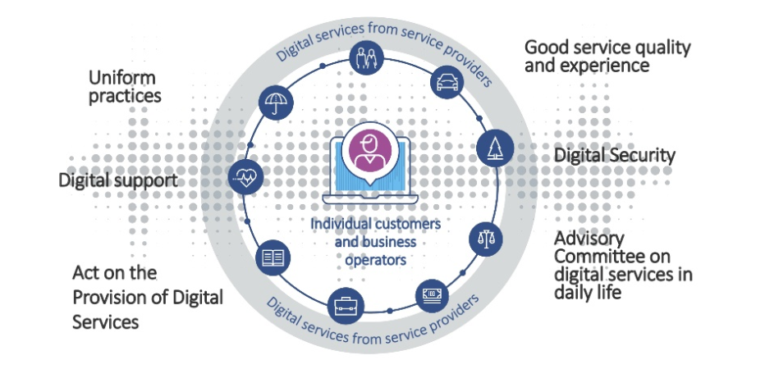
Finland
The reform of digital identity management supports citizens’ mobility, inclusion and life management.
The aim is that Finland will become a forerunner in information policy and application of artificial intelligence
Digital, high-quality public services are available to citizens and companies.
Business operators will in future interact with public services only in the digital service channel.
The operating model for digital support is in use in the whole country and digital support is developed to serve business operators as well.
All citizens have in use a digital identity enabling digital services.

Slide 7
Formulation of digital human rights
10 December 1948 the UN General Assembly in Paris adopted the Universal
Declaration of Human Rights. The digital revolution was then still a long way off.
A resolution of the General Assembly of 18 December 2014 stated that human rights also apply online and that privacy must also be protected in the digital sphere. In addition, we consider that explicit
recognition of several digital fundamental rights as human rights by the UN General Assembly is
required in order to give them a correspondingly high priority.
We are convinced that the following points should be taken into account:
The right to privacy, the right to informational self-determination and the equal right of participation in media information and communication are recognised as human rights.
Everyone has the right to the protection of his personal data. The confidentiality and integrity of all relevant information technology systems must be ensured.
Everyone has the right to protect his data, information and communication against the knowledge of third parties by choosing suitable means, in particular with regard to public authorities.

Slide 8
4. Any personal observation of an individual, his behaviour, social contacts, use of the media or communication without his explicit consent shall be regarded as an unlawful interference with his private life in accordance with Article 12 and his freedom of expression and information in accordance with Article 19 of the Universal Declaration of Human Rights. Everyone has the right to legal protection against such surveillance, interference or impairment. When exercising the state’s responsibility to protect, narrow constitutional limits must be observed. Unjustified mass surveillance is impermissible. 5. Everyone has the right to determine for himself the collection, use, analysis, storage, correction and deletion of personal data relating to him, unless this conflicts with civic obligations. The obligatory collection of personal data by state authorities must be limited to an essential minimum. Everyone has the right to receive information about all data and information relating to him in a reasonable time and format.
6. Everyone has the right to know which algorithms, procedures, controls or criteria have become effective in automated assessments or decisions concerning him and to have them verified by a human being. Automated decisions and artificial intelligence must be taken responsibility for by natural or legal persons. They must not violate human rights or discriminate people for exercising their fundamental freedoms.
7. Everyone has the same right to non-discriminatory access to information and communication services. Access to the Internet must be a fundamental component of public services without restriction, even in times of political unrest. Network neutrality must be guaranteed.
8. Participation in public elections and votes and the exercise of other fundamental rights must not be tied to the use of digital media.

Slide 9
This text was written following a workshop held
in Tallinn in February 2020
Achievement of the SDGs in our digital world will require recognition of the need not only to prevent misuse of data, but also to ensure that when data can be used responsibly for the public good, general guidance on data privacy, data protection and data ethics concerning the use of big data, collected in real time by private sector entities as part of their business offerings. The next UN World Data Forum will be held in October 2020, where major challenges will be discussed on high level. We need to look at main issues digital technology vs. Human rights / safety and privacy in our daily life, education need to update to the favor of digital skills? This and other questions need to be addressed and discussed from the youth point of youth.

Slide 10
How do we make the Internet safe for children?
What constraints should we put on Facebook and social media to protect our privacy?
Does the Universal Declaration of Human Rights and other Human Rights Instruments need updating?
Should Human Rights be made a priority in all education systems up there with literacy and numeracy?

Slide 11
#UN75
There is already an urgent need for governments, social media platforms, and other businesses to protect the fundamental pillars of a democratic society, rule of law, and the full range of our rights online: a need for oversight, accountability, and responsibility.
As the digital frontiers expand, one of our greatest challenges as a human rights community will be to help companies and societies to implement the international human rights framework in the land we have not yet reached. This includes clear guidance on the responsibilities of business as well as the obligations of States.

Slide 12
At its best, the digital revolution will empower, connect, inform, and save lives.
At its worst, it will disempower, disconnect, misinform, and cost lives.
Human rights will make all the difference to that equation.

