Slide 1
Fake, disinformation, propaganda
Network Annual Conference “Civil Society Ideas for the sustainable and secure Future of Europe”, May 2nd 2022
Barbi Pilvre
Associate Professor, Ph.D
Tallinn University, BFM

Slide 2
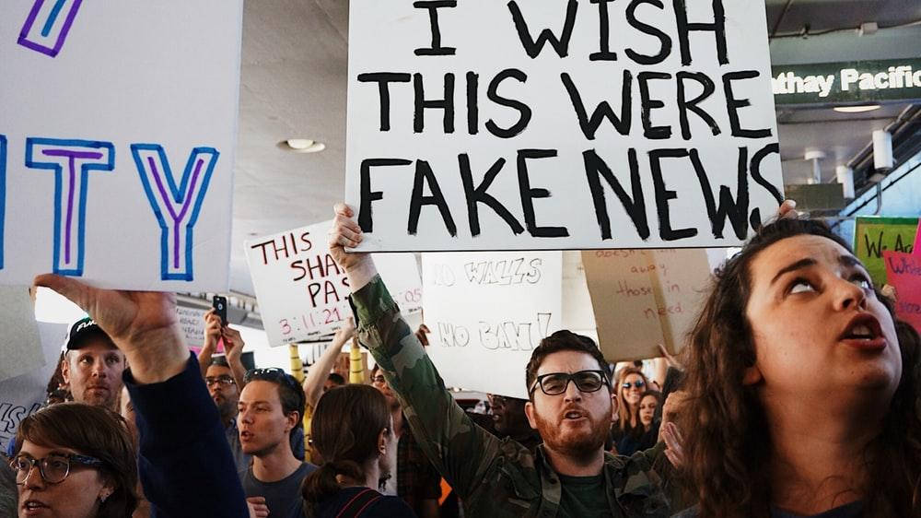

Slide 3
Disinformation as a global issue
Meediapädevus, tark meediakasutus ja võitlus infokorratuse vastu Media literacy, smart usage of media and fight against disinformation. Tallinn University, BFM, free online course
Disinformation is a rising global issue. According to 2018 data, 85% of surveyed EU citizens consider disinformation to be a threat to democracy (Debunk EU)
The scale of the issue is also apparent while looking at the number of attempts to spread false information. The Russian-Ukrainian war has made disinformation issues more actual as ever.
Disinformation includes all forms of false, inaccurate, or misleading information which is designed, presented and promoted to intentionally cause public harm or to gain profit. Those can vary from misinformation to actually harmful propaganda.

Slide 4
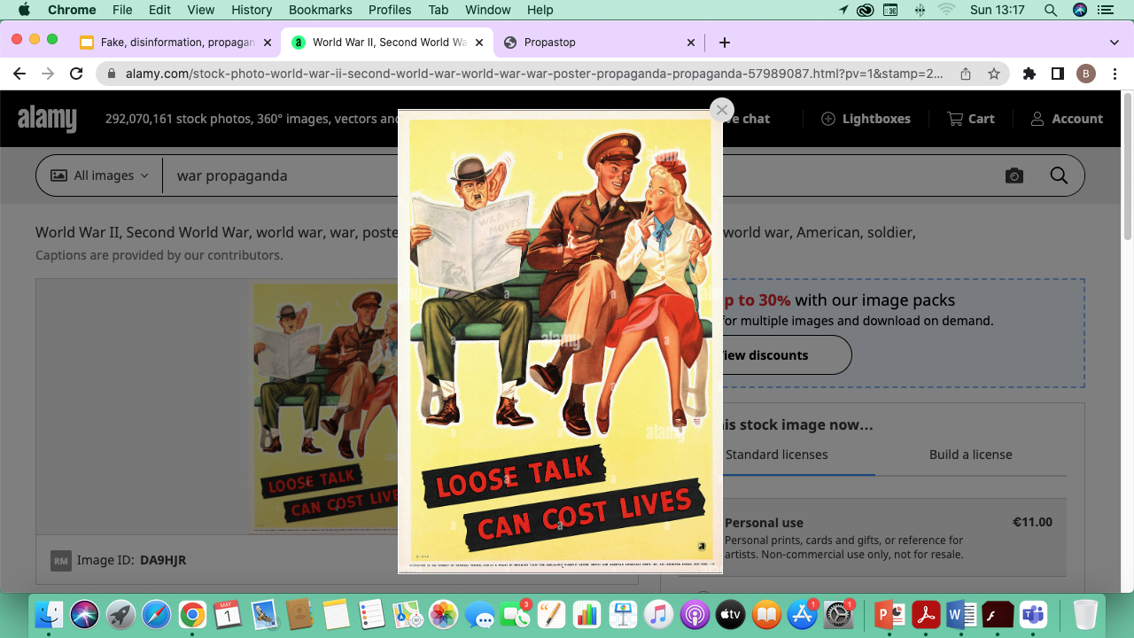

Slide 5
Images of war propaganda through ages
War Propaganda High Resolution Stock Photography and Images - Alamy

Slide 6
Disinformation - a major challenge of our time
All over the world, disinformation has already become a major challenge, even for the most powerful countries and organizations
Disinformation has also become a test for us by creating an illusory alternative to objective facts in both mainstream and alternative media.
Already before the Russian invasion to Ukraine disinformation has cost a lot and has even created preconditions for strengthening the overall social climate of insecurity. Reluctant approach to disinformation in 2019-2021 has already had impact on the election results of several countries (such as the USA and the UK) and COVID-19 crisis.

Slide 7
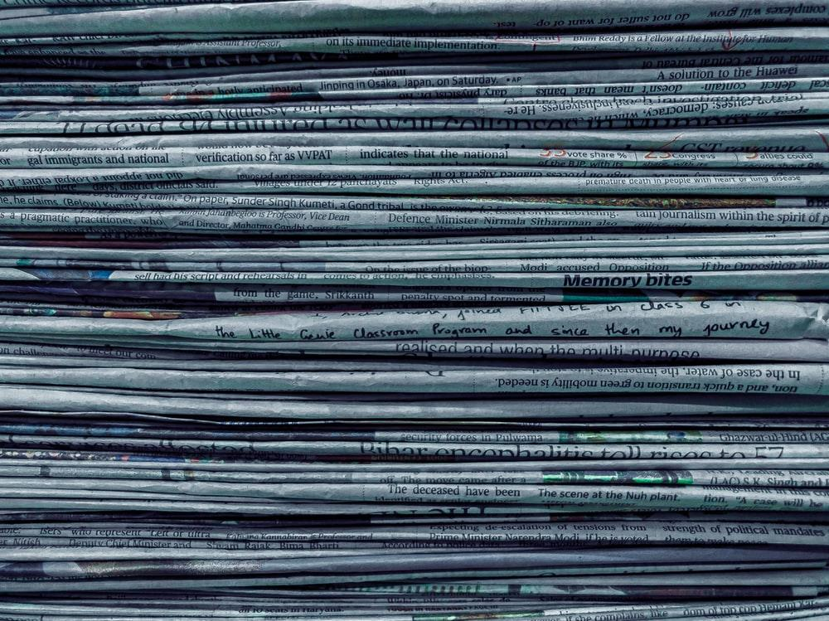

Slide 8
Logical fallacies, persuasion techniques
Communication includes persuasion. A logical fallacy is a flaw in reasoning. Logical fallacies are like tricks or illusions of thought.
Logical fallacies are often very sneakily used by politicians, the media, salesmen, advertisers to fool people. One needs critical thinking and training to recognize those fallacies.
https://kreativcopywriting.com/10-logical-fallacies-know-spot/
https://yourlogicalfallacyis.com/
The same techniques are used in propaganda in a different scale.
Propaganda is using information, especially of a biased or misleading nature, used to promote a political cause or point of view.

Slide 9


Slide 10
From conspiracy theories to whataboutism
False information can influence and shape the public opinion on certain issues using written, visual and audio tools which can be spread through various channels.
Disinformation techniques include conspiracy theories, fabrication, band-wagoning (appealing to popularity); clickbait content to attract attention and encourage visitors to click on a link to a particular web page;
Whataboutism or whataboutery (as in "what about…?") is a variant of the tu quoque logical fallacy that attempts to discredit an opponent's position. By using those and many other techniques, hostile actors manipulate and distort the truth.

Slide 11
Fight against disinformation in European Union
EU countries fight against disinformation, along with technological giants – Facebook, Google, etc.
Modern societies in Europe as elsewhere are attacked by disinformation on a daily basis through cyber means and with a continuous flow of disinformation.
These attacks range in tens of thousands of purposeful attacks against the country and its society throughout the year.
Misleading news creates confusion, spreads distrust in democratic institutions and the state itself, and causes negative psychological, emotional, and economic consequences.

Slide 12
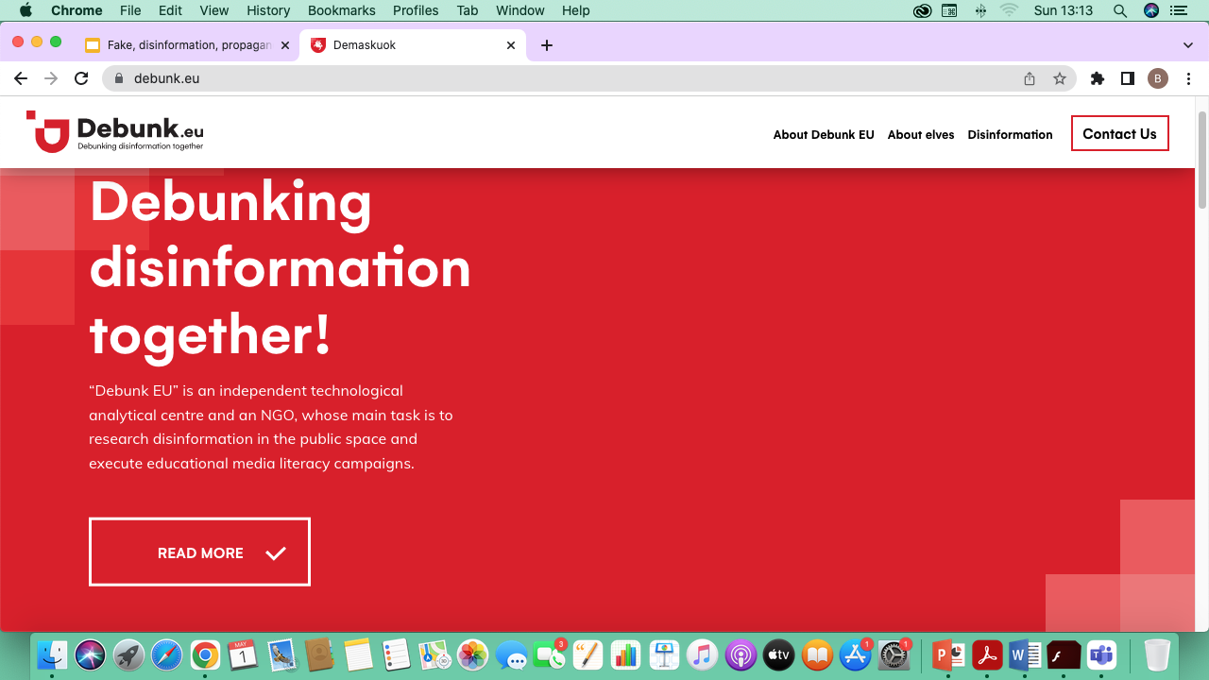

Slide 13
Debunk EU
Debunk EU is an independent technological analytical centre and an NGO, whose main task is to research disinformation in the public space and execute educational media literacy campaigns.
By using artificial intelligence, “Debunk EU” carries out detailed research on disinformation in the Baltic states and also works on joint projects with their partners in the United States and North Macedonia. “Debunk EU” initiative has also received praise from international media giants, such as “The Financial Times”, “The Economist”, and “The Independent”. The organisation has introduced their work in 17 countries so far, including the U.S., Germany, United Kingdom, France, Serbia and others.

Slide 14
Propastop
Propastop
is an independent Estonian blog in Estonian, English and Russian languages. It is run by volunteers, of whom many belong to the Estonian Defence League, an Estonian voluntary national defence organisation. It works under Ministry of Defence. Propastop blog is aimed at contributing to Estonia’s information space security. If they detect that someone is disseminating lies, biased or disinformation or manipulating information, they will bring it to the public. Propastop will juxtapose lies with facts, show motives behind the actions and bring out the ones interested in manipulating information.

Slide 15
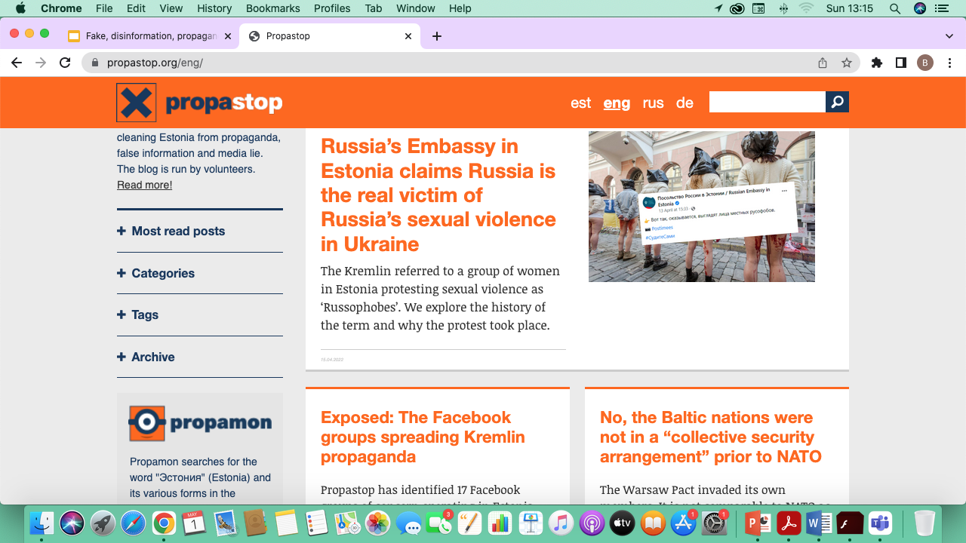

Slide 16
Internet resources to fight disinformation
Fighting disinformation – European Commission resources
https://debunk.eu/
Artiklid vene keeles (also in Russian) TÕE SÕNA
Online course "Introduction to StratCom" Riga based NATO strategical communication center
NATO e-learning online learning
Seminar for media representatives "Supercharge your credibility and readability with tools and tips for factchecking and authenticity" – coming soon

Slide 17
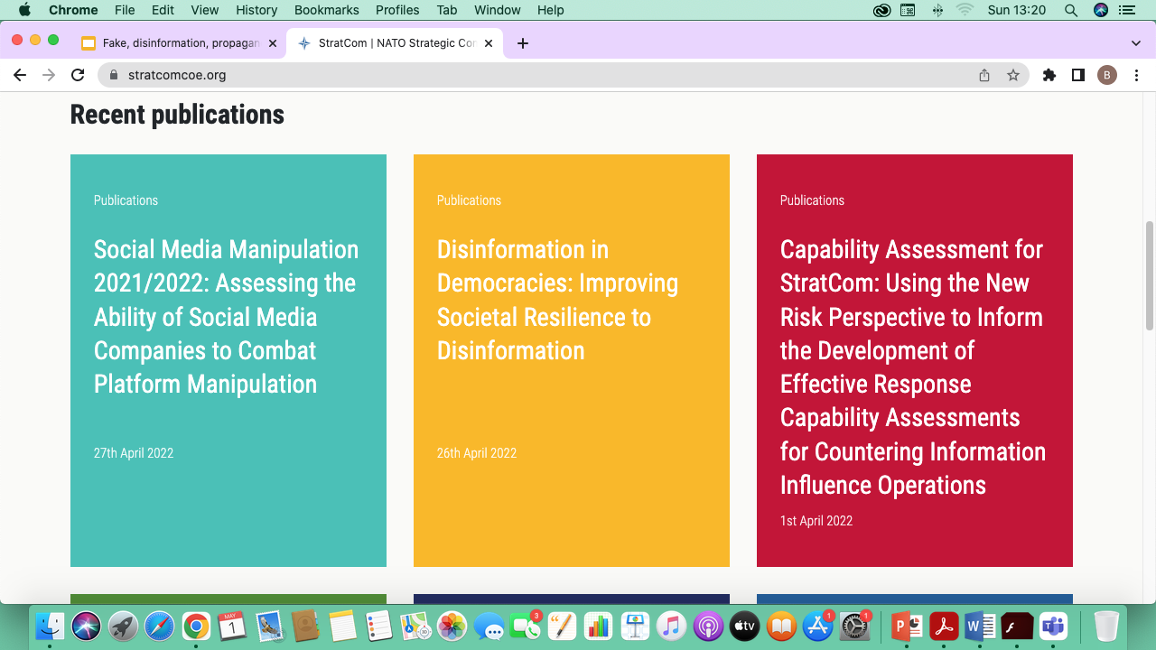

Slide 18
Internet tools of checking information
Internet Archive: Wayback Machine internet sites history
Wolfram|Alpha expert level fact checking, using algorithms, AI
Google Images versions of images
FotoForensics origin of photos, checking changes
EXIF Data Viewer origins of photos
Resources - bellingcat geolocation of taken photos

Slide 19
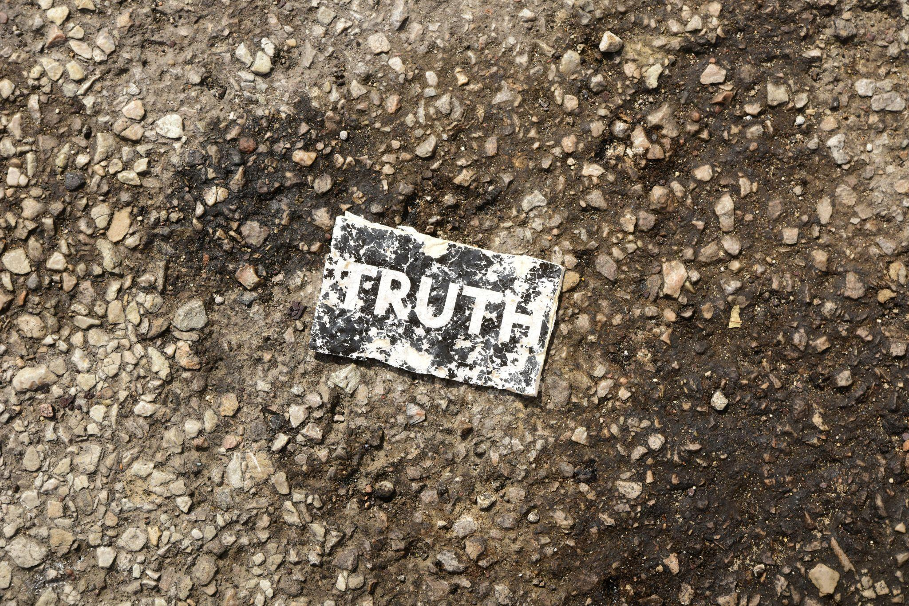
Notes:
(Image Michael Carruth, Random card found on a parking lot along Interstate 294, outside Chicago.)

