Slide 1
Realities and Challenges of Estonian Strategies for Achieving Sustainable Development Goals
Eili Lepik
Government Office
27.08.2021

Slide 2
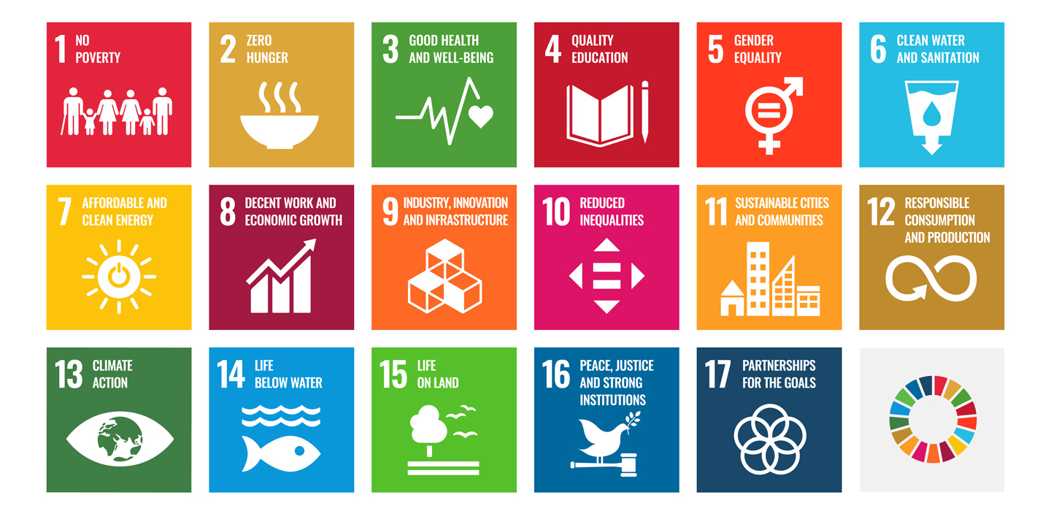


Slide 3
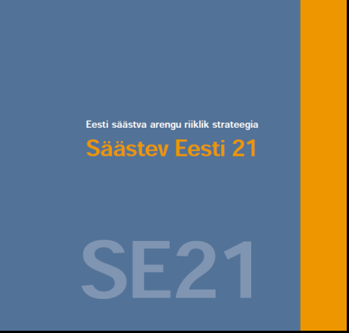

Strategic framework for Sustainable Development in Estonia
Sustainable Development Law (1995)
Estonian Sustainable Development Strategy “Sustainable Estonia 21” (2005)
Viability of cultural space
Growth of welfare
Coherent society
Ecological balance
Sustainable Development Indicators

Slide 4
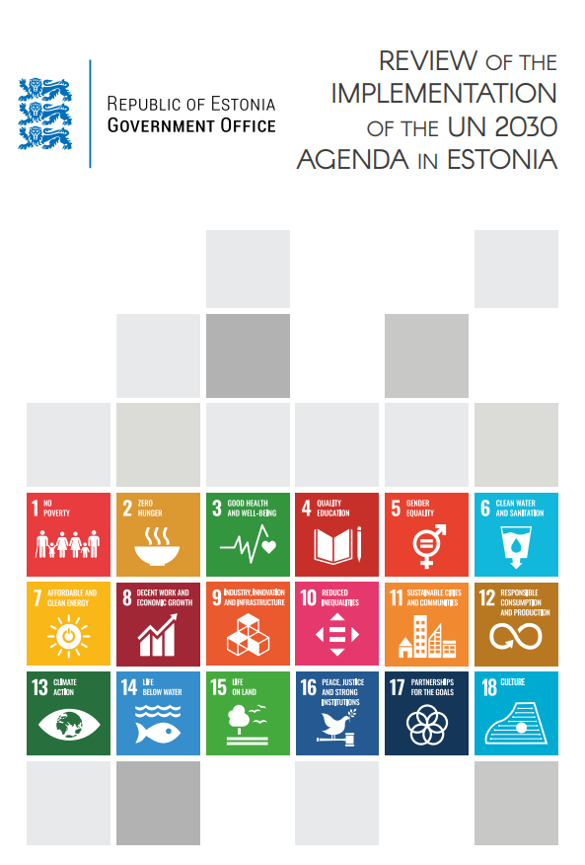
UN High Level Political Forum on Sustainable Development Voluntary National Reviews Estonia 2016 2020

Slide 5





Agenda 2030 implementation in Estonia Main strenghts
Accessible and quality education
Effective healthcare system
High employment rate with minimal long-term unemployment
High proportion of renewable energy in overall energy consumption
Accessible public services (e-services, digital solutions)

Slide 6





Agenda 2030 implementation in Estonia Main challenges
Resource efficiency, waste management and recycling
Greenhouse gas emissions
Energy efficiency
Biodiversity
Gender equality (gender pay gap)
Risk of poverty for women and disabled people, including families with disabled children

Slide 7
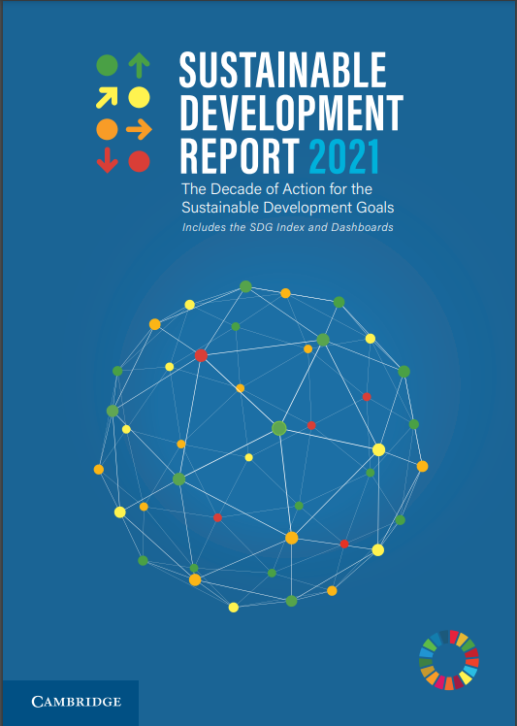
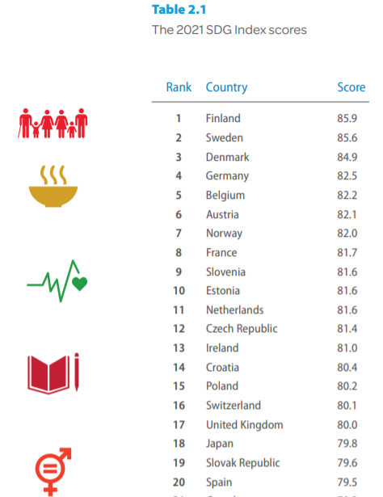
Notes:
Eesti on 162 riigi hulgas koondindeksiga 10. kohal. Aga pole põhjust hõisata või loorberitele puhkama jääda. Järgmine slaid näitab, et meil ei ole ühtegi „rohelist“ kategooriat.
https://s3.amazonaws.com/sustainabledevelopment.report/2019/2019_sustainable_development_report.pdf

Slide 8
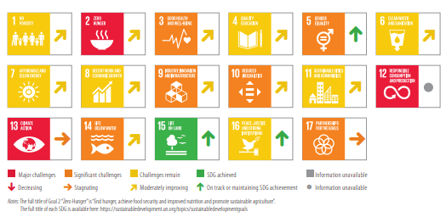

Slide 9
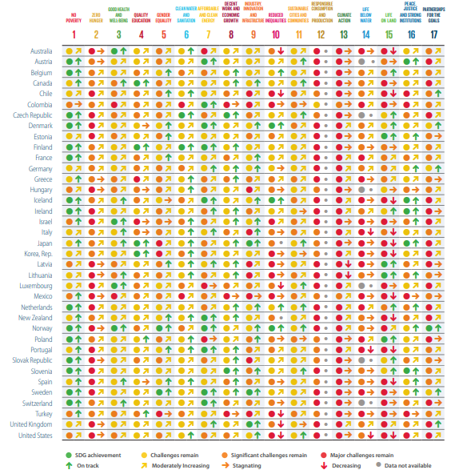
Every country has challenges in achieving the SDGs

Slide 10
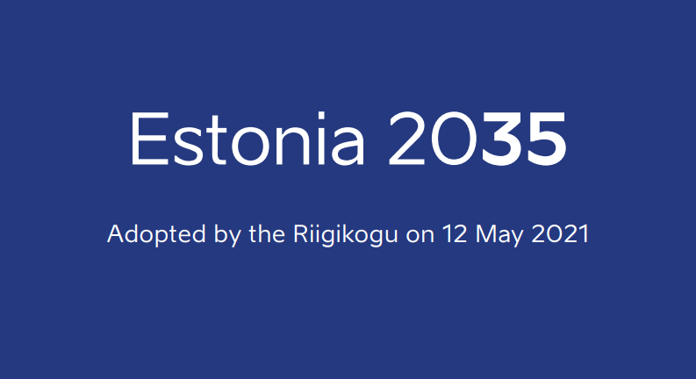

Strateegia
„Eesti 2035“

Slide 11
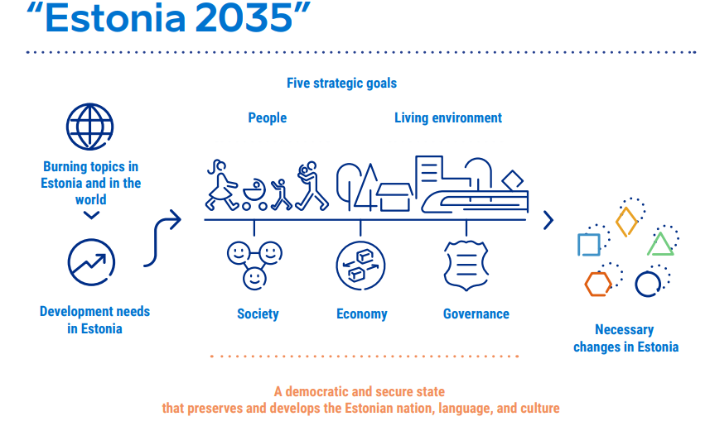
National long-term development strategy „Estonia 2035“

Slide 12
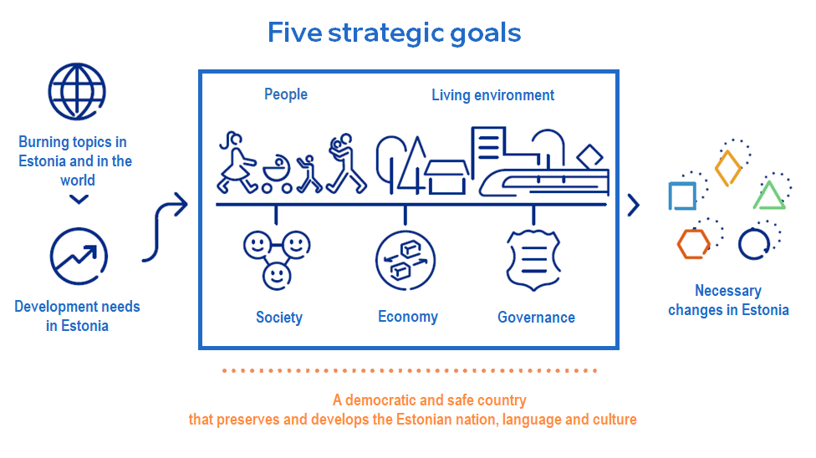

Slide 13
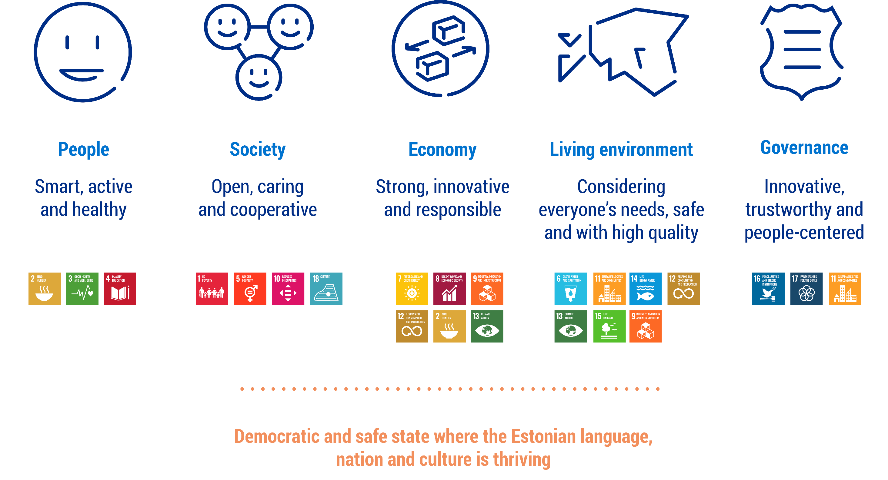

Slide 14
Strategic framework 2021+
Policy Principles (Parliament)
ESTONIA 2035
Sectorial Development Plans (4-10y)
Government Action Plan (4y)
Riigikogu (Parliament)
Programme 1 (4y)
Programme 2 (4y)
Programme … (4y)
State Budget & State Budget Strategy (1+3y)

Slide 15

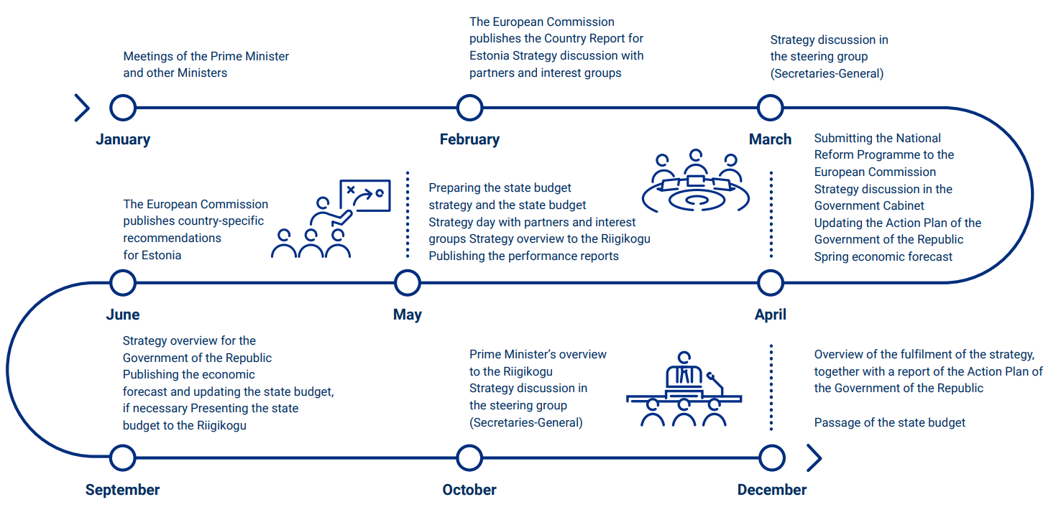

Slide 16
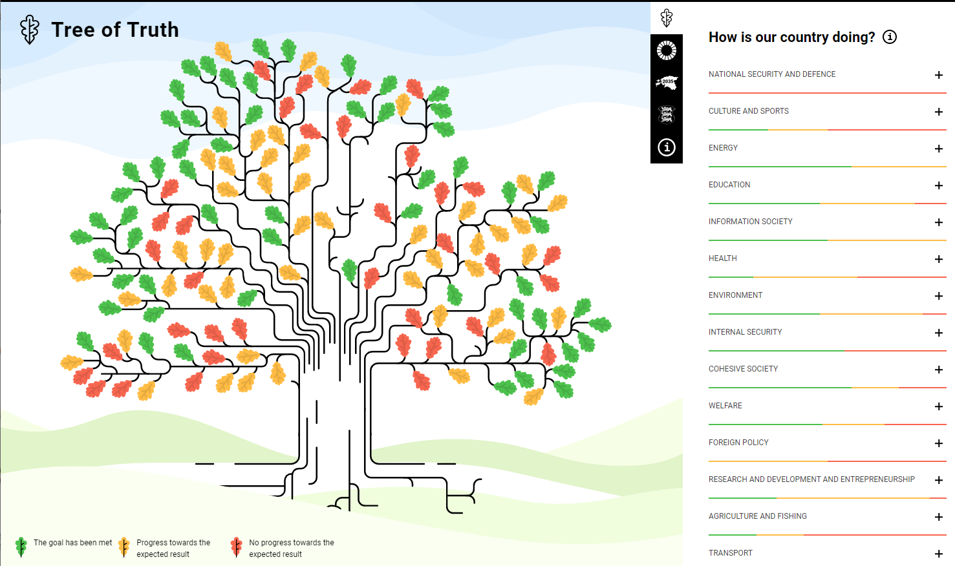
https://tamm.stat.ee/

Slide 17
Thank you!

