Slide 1
Drivers and barriers
of SUP reduction in ASEM
Single-use plastic waste & climate change
Global Conversation 2021
28/08/2021
Narva, Estonia
Grazyna Pulawska
Asia-Europe Foundation (ASEF) &
Dora Almassy, PhD
Central European University

Slide 2

Plastic & Climate change
Plastic & Climate Change
Drivers and barriers of SUP reduction in ASEM Study by ENVforum
Follow up

Slide 3

Plastic & Climate change
Greenhouse gas emissions from the plastic lifecycle jeopardises the global community stay below 1.5°C
By 2050, emissions from plastic could reach over 56 gigatons—10-13% of the entire remaining carbon budget*
Under BAU with supportive policies, the sector’s fossil fuel consumption will increase
Up to 8% of annual global oil consumption is associated with plastics
Projected reliance on plastics will account for 20% of oil consumption by 2050**
*Source: Plastic & Climate: The Hidden Costs of a Plastic Planet by CIEL
**Source: WEF

Slide 4
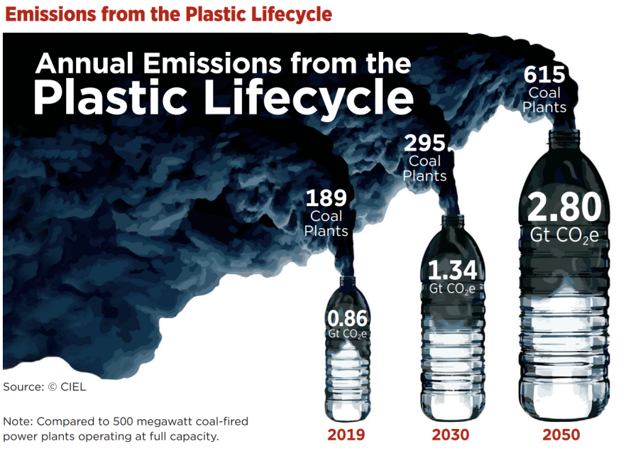
Plastic & Climate change
Nearly every piece of plastic begins as a fossil fuel, and greenhouse gases are emitted at each of each stage of the plastic lifecycle:
fossil fuel extraction and transport,
plastic refining and manufacture,
managing plastic waste, and
ongoing impact once it ends
in oceans, waterways, and landscape
Source: Plastic & Climate: The Hidden Costs of a Plastic Planet by CIEL

Slide 5
Drivers and barriers of SUP reduction in ASEM Study
Scope:
Characterising single-use plastic waste reduction initiatives across ASEM
Implementation drivers and barriers
Impact of COVID-19

Slide 6
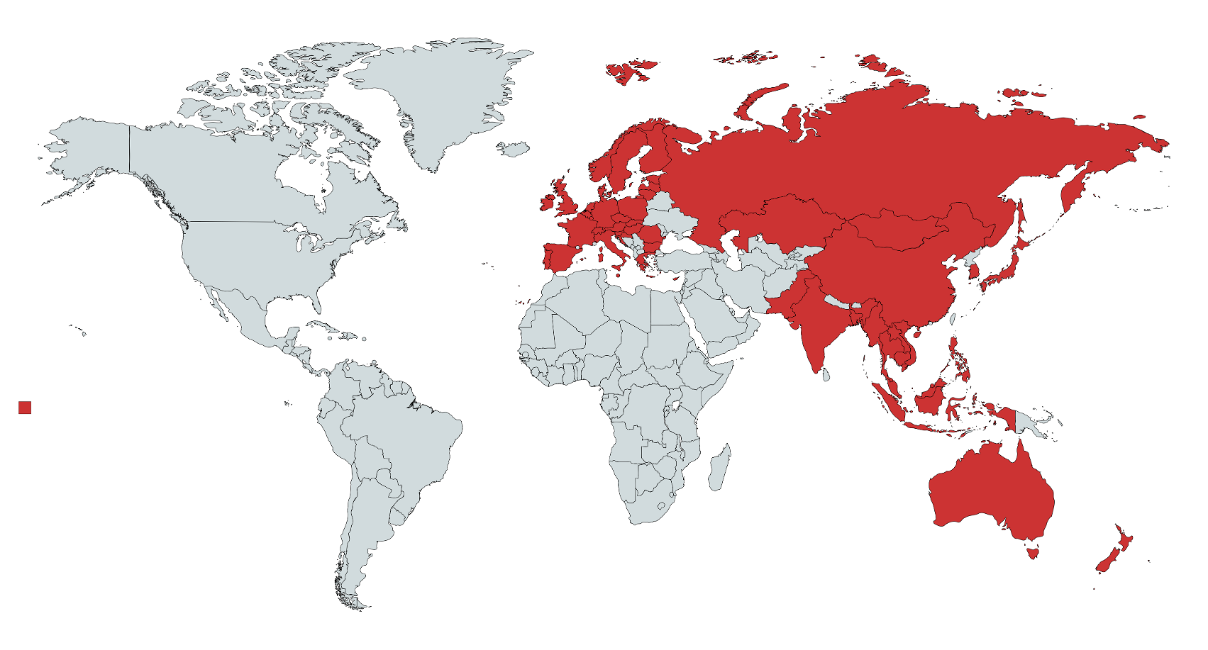
Asia-Europe Meeting Partner Countries
Generated at www.mapchart.net

Slide 7
Project objectives of the studied initiatives and projects
Refuse or Reduce
Reuse
Recycle
Recover
Dispose
Less preferred

Slide 8
Size and scale of the identified projects: prevalence of medium-sized organizations with local or national scope of activities

Slide 9
Managing organizations: the majority of identified projects were initiated by for-profit organizations
Notes:
Other: Business NGOs, Universities, Transnational networks
Other businesses: insurance companies, consultancies, tech companies

Slide 10
Activities: projects initiated by businesses are more likely to focus on recycling and collection

Slide 11
Innovations delivered by the studied projects
Notes:
Business were more likely to develop product, process and infrastructural innovations than other managing organization

Slide 12
Implementation drivers and barriers of single-use plastic waste initiatives in ASEM

Slide 13
Scalability of projects

Slide 14
Potential barriers of upscaling single-use plastic waste reduction initiatives
the lack of or limited availability of regulation/standards;
tax incentives to reduce the manufacturing cost of plastic alternatives or the cost of recycling;
public and private funding to support initiatives until they can become profitable;
insufficient collection and recycling infrastructure
lack of or limited awareness, interest or commitment
limited or lacking coordination along the plastic production chain

Slide 15
Impacts of Covid-19
Most companies continued to operate without any interruption while following the required health measures
Shifting production to produce protective equipment and sanitizers for medical use.
Education and awareness-raising initiatives moved online
Notes:
: The COVID-19 pandemic also affected the organizations of the single-use plastic supply chain.
, although in some cases, they had to temporarily suspended their activities due to the pandemic situation.

Slide 16
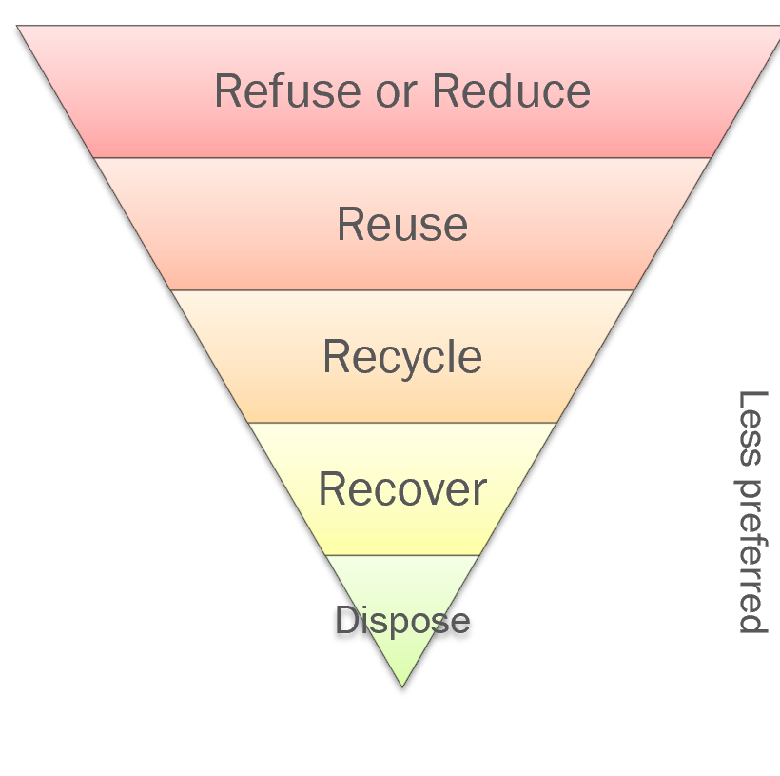
What are the solutions?
Businesses across ASEM have a high potential to deliver product, process and infrastructural innovations – legislation addressing whole lifecycle product chain could stop “do now and worry later approach”
Potential to create synergies, if single-use plastic waste reduction are coordinated across the supply chains
Focus on innovations to tackle the plastic waste challenge
There is a need to support the expansion of scattered single-use plastic waste initiatives to trigger systemic change

Slide 17
Follow up
Check out what we do at www.ASEF.org
8th ASEF Regional Conference on Higher Education (ARC8)
Outlook 2030: Inclusive and Diverse Higher Education on Asia and Europe
https://arc.asef.org/
20th Informal ASEM Seminar on Human Rights
Training on HR of Older Persons
https://asef.org/projects/asemhrs20-training/
Future of Food & Climate Change Conference
Preregistration is open at: https://asef.org/projects/future-of-food/

Slide 18
Thank you for the attention!
@ env@asef.org

