Slide 1
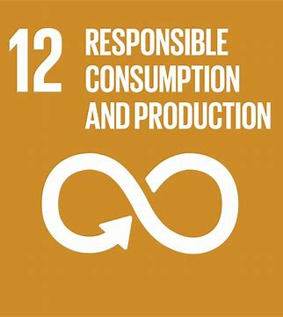
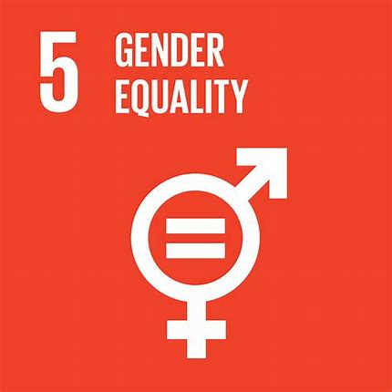
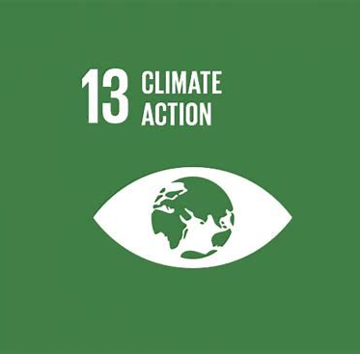
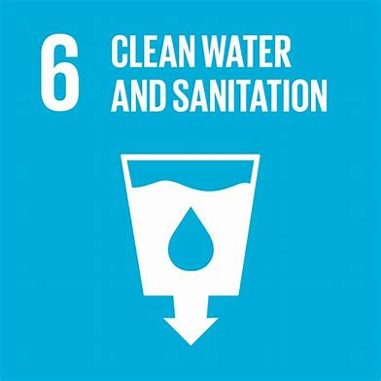

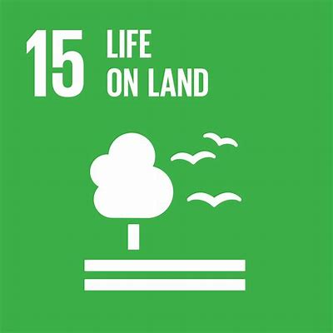
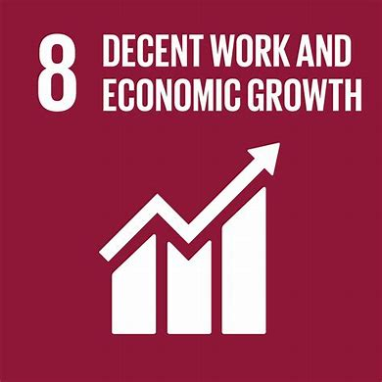
How sustainable fashion habits can resolve the Climate Emergency
By Abigail Wordsworth
Notes:
Hello everyone, my name is Daina and I am the founder of the anti-fast fashion campaign ‘News to Reuse Estonia.’ I wouldn’t say I am an expert. But we don’t just need experts, we need enthusiasts. We need this generation of young people to be adequately educated and clued up on the issues that are so pressing in modern society so that they themselves can be climate activists and reverse some of the damage already done by global warming.

Slide 2



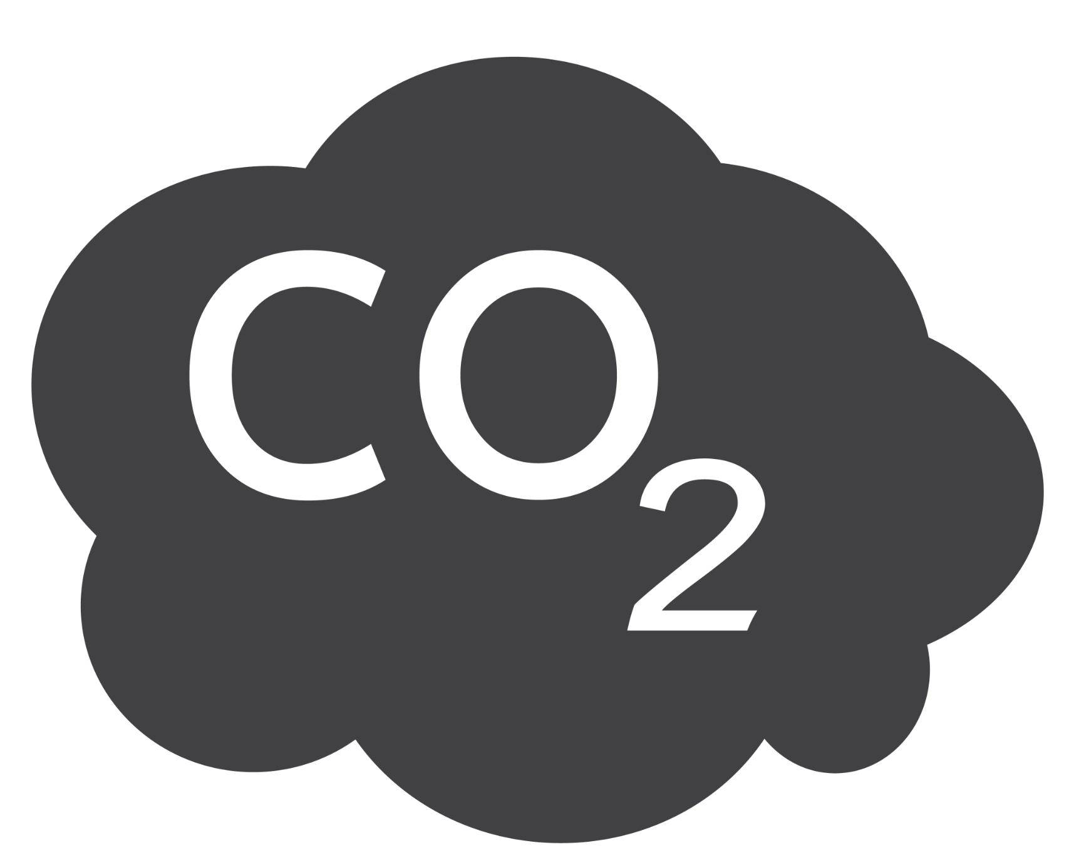
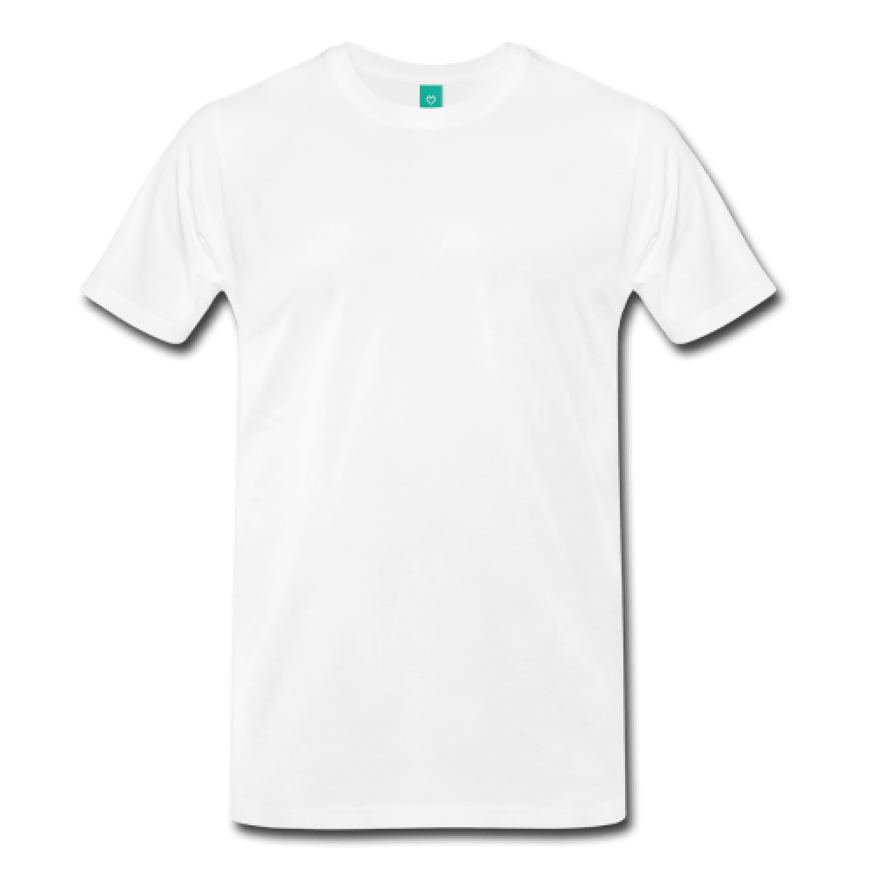






Buying just one white cotton shirt produces the same amount of emissions as driving 35 miles in a car.
35 miles
The textile industry produces more greenhouse gas emissions than the shipping and aviation industries combined.

Slide 3
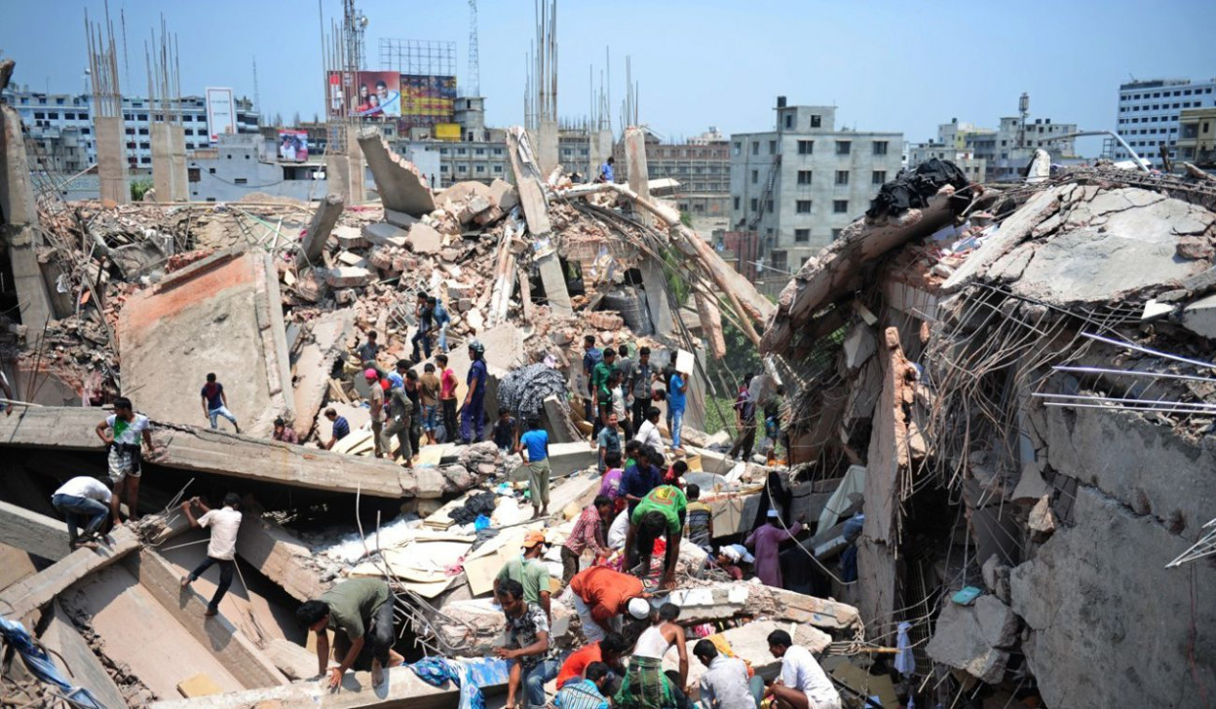
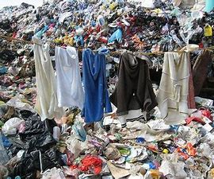



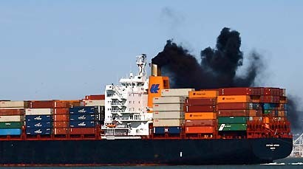

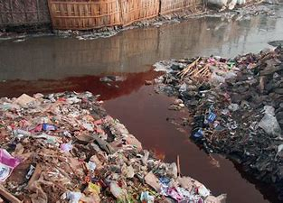

Consumer habits need to change.
One in six young people say that they don’t feel they can wear an outfit again once it’s been seen on social media.
Overconsumption is on the rise, with the average garment lasting just 7 wears.
Notes:
The UN sustainable development goals are undoubtedly hindered by fast fashion, with each section of the supply chain, from the extraction of raw materials, to manufacturing and shipping having associated impacts such as high co2 emissions, chemical leaching.
The unprecedented growth of social media and the “ideal” image perpetuated by influencers exacerbates the impacts as there is a certain pressure to fit in, which often requires keeping up with trends at the expense of the environment and garment workers.
Not only does fast fashion have environmental impacts, but also causes social devastation. (Rana Plaza factory collapse in Bangladesh, which had a death toll of 1,134)

Slide 4
What can be done?

Slide 5

Education
Whilst the climate crisis as a topic briefly appears in Science, Geography and Textiles, it is often overlooked. As a result, children lack vital knowledge on how their habits can impact the climate.
All children should know about:
Climate change/ global warming
The Global Waste Trade
Sewing/ mending (and other simple solutions- reduce, reuse, recycle)
The problems with consumerism in the Western World
Sustainability should be a mandatory subject in schools.
Notes:
Consumer demand is so high that textile waste is increasing- to the point where high income countries such as the UK ship the waste abroad to relieve themselves of the burden. This is significantly harmful in that not only is the environment affected on local or national scales, but also global levels. Even if methods are in place to enforce positive change within the industry, the lack of education is a key issue that propels the environmental impacts. If consumers were aware that their own shopping habits is what leads to this destruction then they could possibly change their behaviour accordingly by buying less or choosing sustainable items. Education- or a lack of- is therefore the huge barrier to true sustainability, along with the unwillingness of fast fashion empires to change their socially and environmentally damaging practices.
There is still no mention of the climate crisis in the national curriculum for England in primary schools, and in key stage 3 science very little of the curriculum relates to climate education. After the sobering Intergovernmental Panel on Climate Change, education is more important now then ever.

Slide 6

2. QR Codes on labels
This would be and accessible and easy way for consumers to:
View the carbon footprint of a garment before they buy it
See what materials have been used
See the factory it was made in and if the worker is paid a decent wage.
Consumers would be well informed and able to make the most ethical choice with one scan.
Brands must be more transparent with consumers.
Notes:
Given that the fashion industry is set to take up 26% of the carbon budget by 2050 we think it is vital that the public is given this tool to enable the consumer to make the most ethical and educated purchase possible.
Furthermore brand transparency will force these brands who have spent many years polluting our planet through their consistent environmentally detrimental policies to make clear to the public exactly what they are doing and perhaps this reckoning and shift of support by the public who will easily be able to choose the more ethical option will force their hand into making more environmentally conscious choices within their production and supply chain/.

Slide 7

3. Green technology funding
Developed countries have a moral duty to implement green technology.
Traditional light bulbs to LED or CFL lights
Investment in solar panels
Reusing waste products (adopting the circular economy approach rather than linear economy)
Brands must commit to funding and researching green technology to improve the environment and the lives of garment workers.
Notes:
whose high demand for clothes exacerbates environmental issues associated with lower income countries (smog, flooding due to rising sea levels, hurricanes) whose high demand for clothes exacerbates environmental issues associated with lower income countries
We understand the manufacturing process can’t be stopped- and it would be hugely unfair to damage the economies of developing countries. So we ask high income countries to use their privilege of being a global leaders in tackling climate change and having a clear plan to reach net zero by 2050, to support these countries and their governments by integrating green technology as a means to combat skyrocketing carbon emissions.
These green technologies would greatly benefit manufacturing countries abroad.

Slide 8
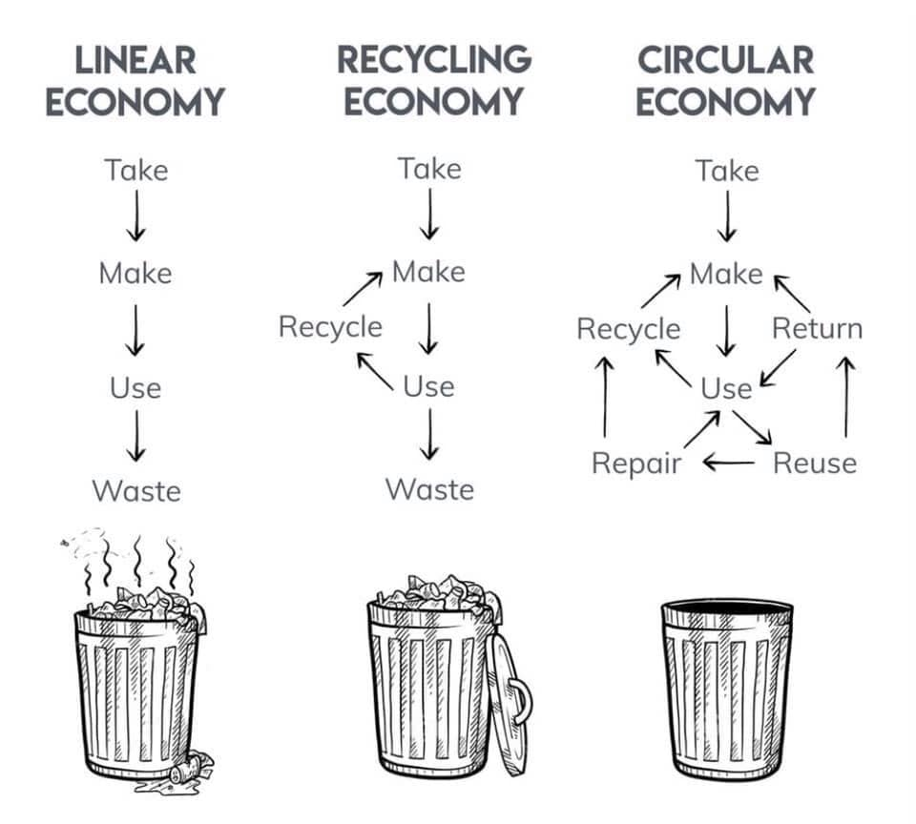
Notes:
To summarise, sustainable education, the use of QR codes and green technology funding will all encourage a circular economy- meeting a host of UN SDGs

