Slide 1
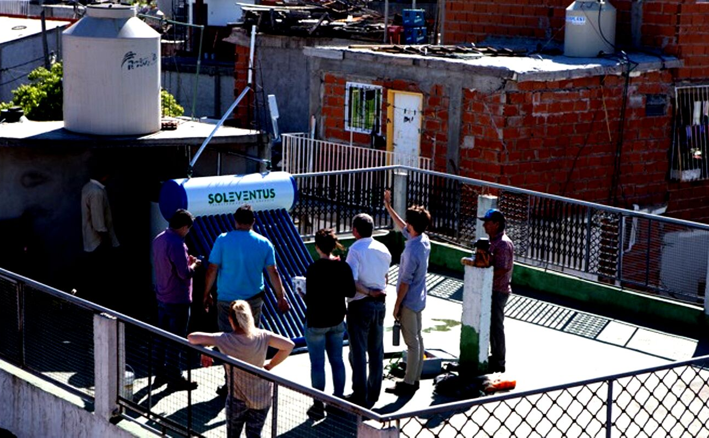
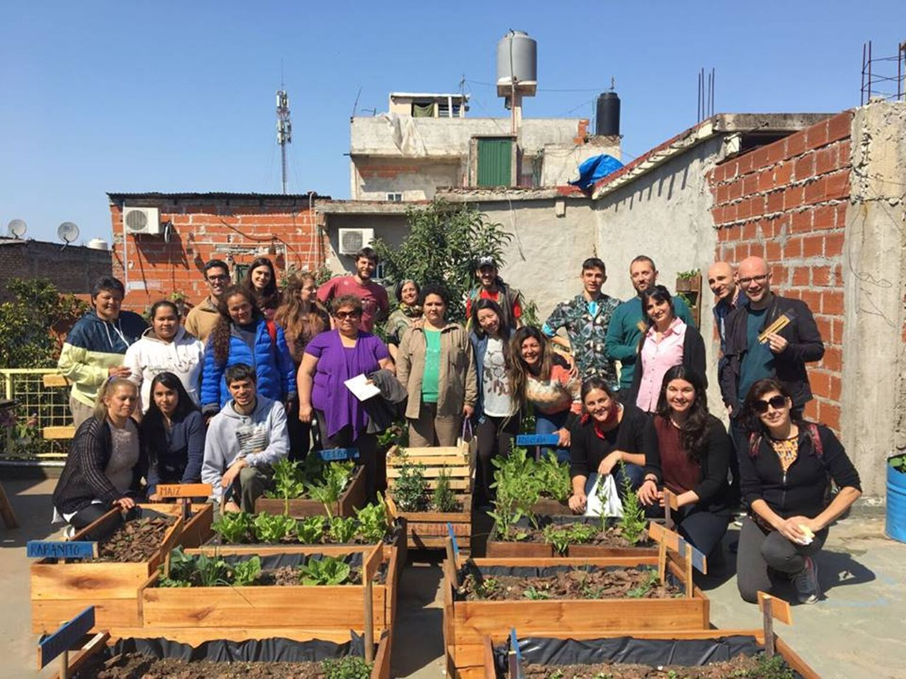
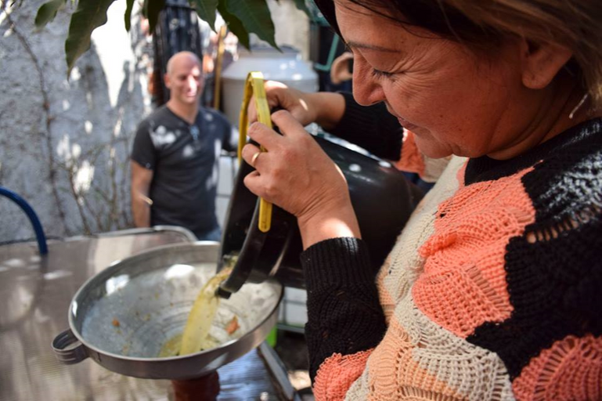
Urban Biosystem
“Civil Society Strategy for Urban Resilience”
Gonzalo del Castillo,
Director of consulting centre on sustainability, CeSUS
Notes:
Urban Biosystem
Strategy for Urban Resilience

Slide 2

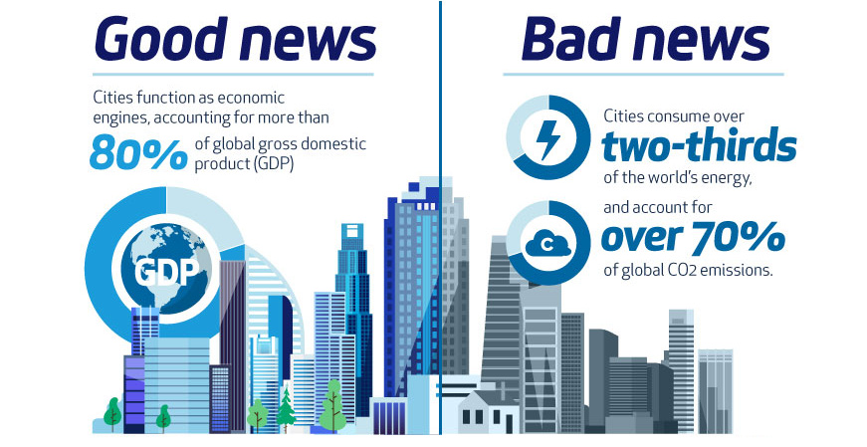
Good news
Cities function as economic engines, accounting for more than
especially in cities
that concentrate both the opportunities and the greatest challenges and impacts
80%
of global gross domestic products (GDP)

Slide 3
Cities consume over
two thirds
of the world´s energy
and account of
over 70%
of global CO2 emissions.
Bad news

Slide 4
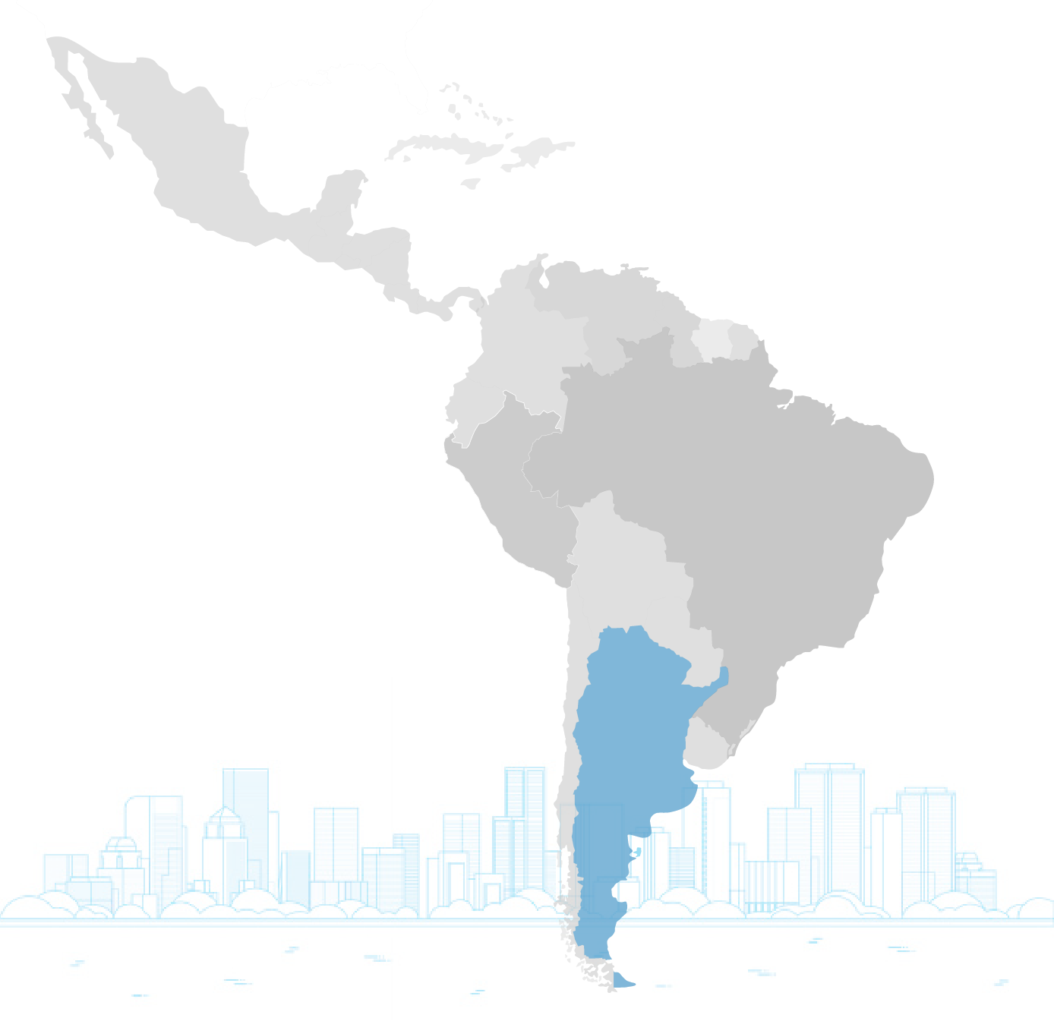

In Latin America and Argentina
the situation is enhanced
+90%
living in cities

Slide 5
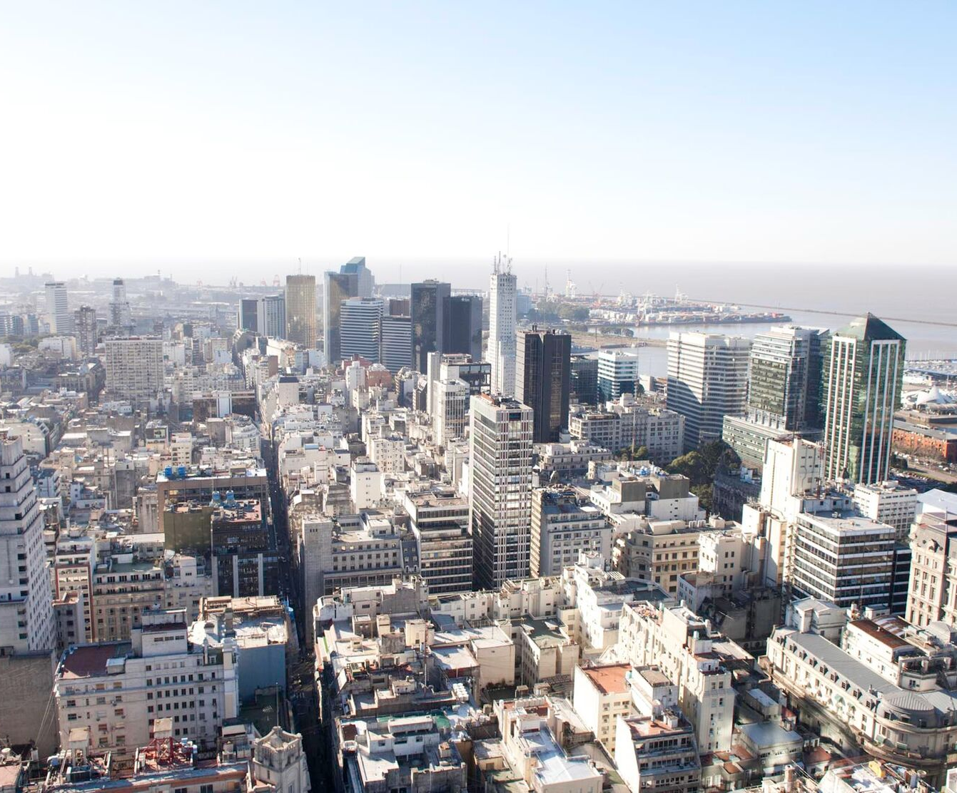
PROBLEM
LINEAR
FUNCTIONING
Notes:
Problem
Linear Functioning

Slide 6
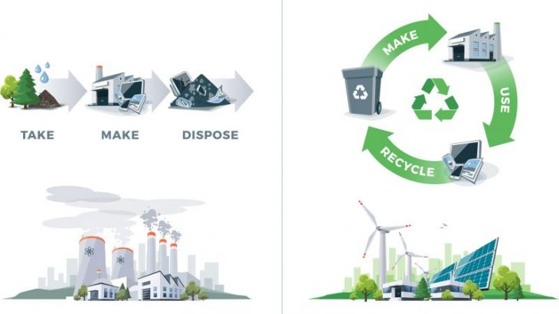
The CIRCULAR ECONOMY
it can be an ally to find solutions / alternatives.
LINEAR ECONOMY
CIRCULAR ECONOMY
WASTE
WASTE
WASTE

Slide 7
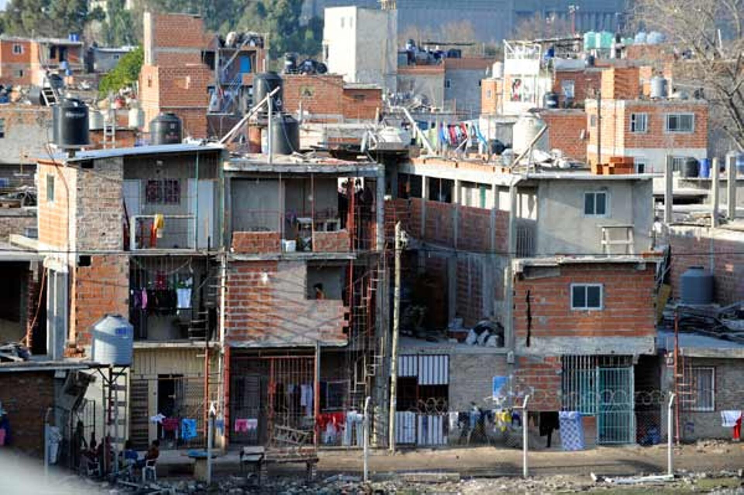

Slide 8
300.000 people live in slums
Notes:
300.000 people live in slums

Slide 9
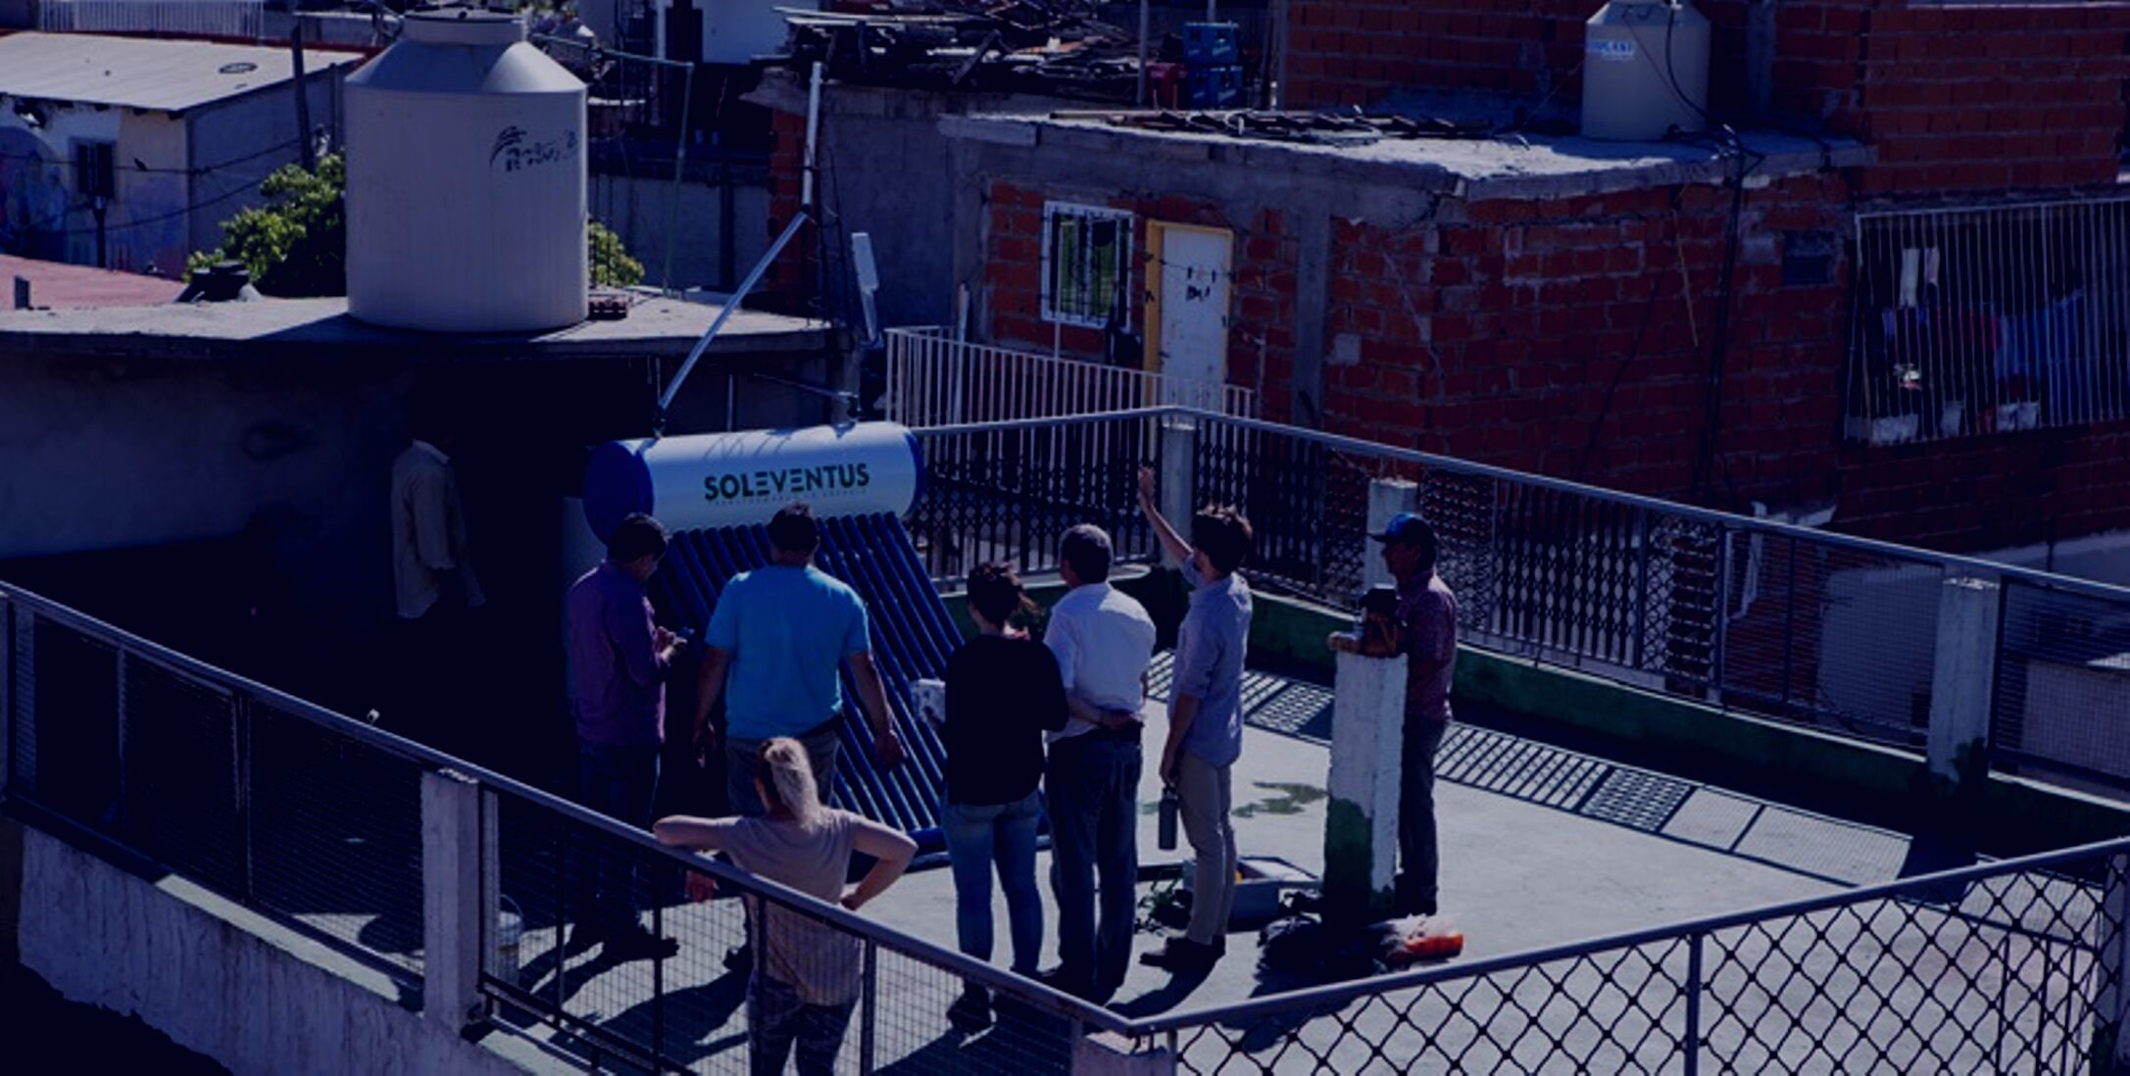

SOLUTION
URBAN
BIOSYSTEM
Notes:
Solution
Urban Biosystem

Slide 10
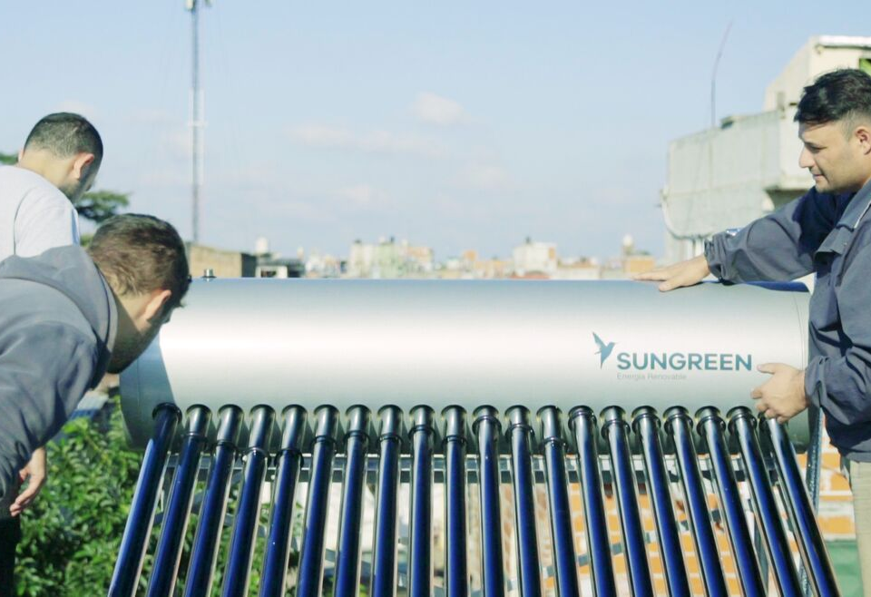
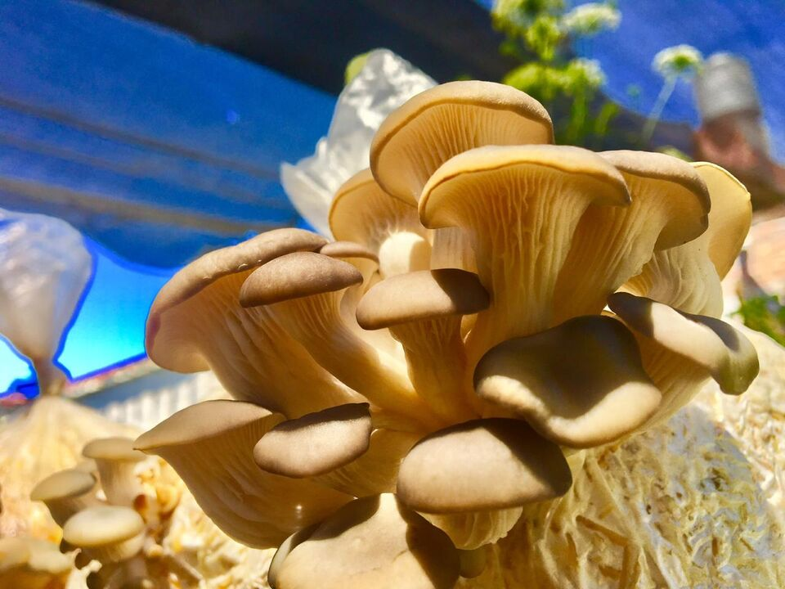
TECHNOLOY
PROCESSES
Notes:
Technology
Processes

Slide 11
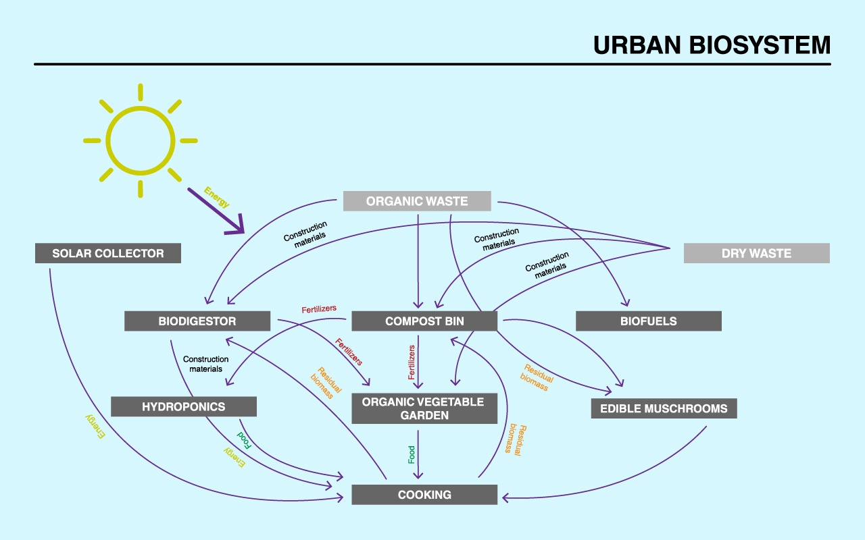

Slide 12
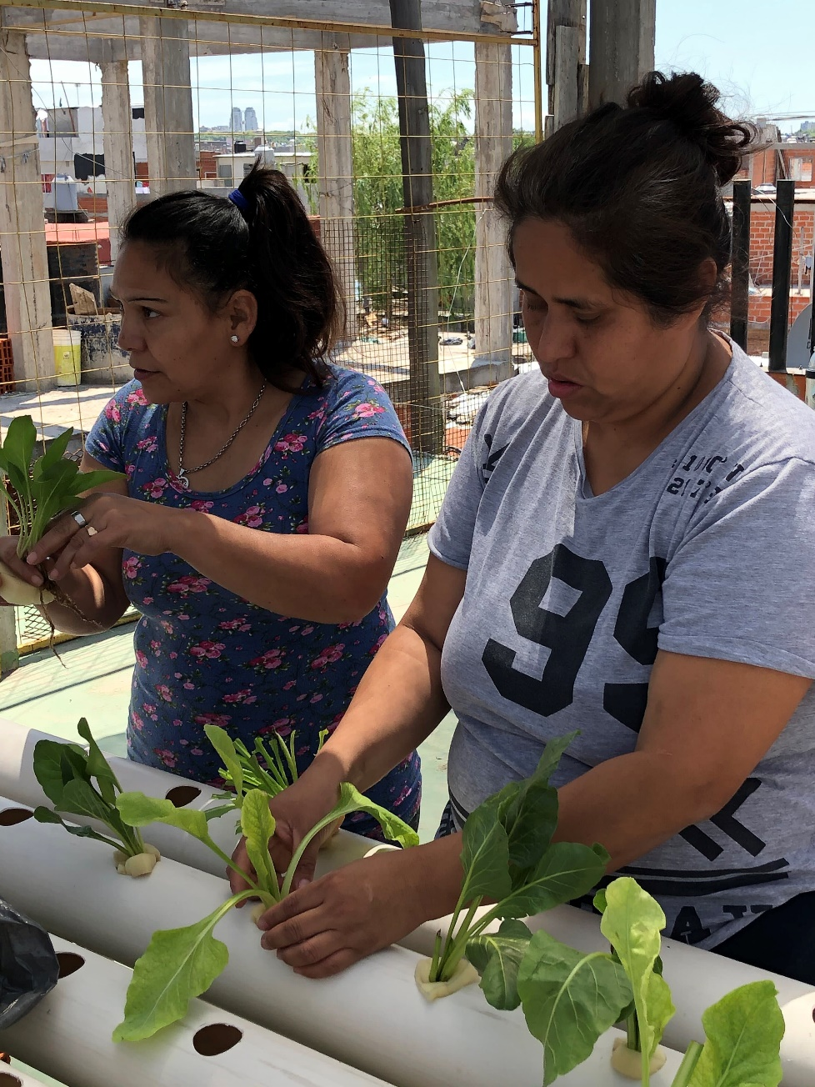
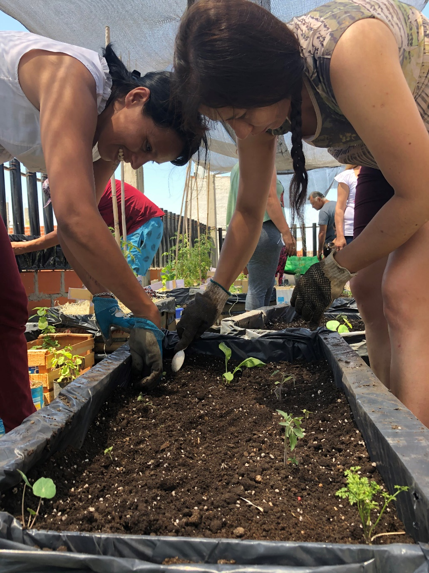
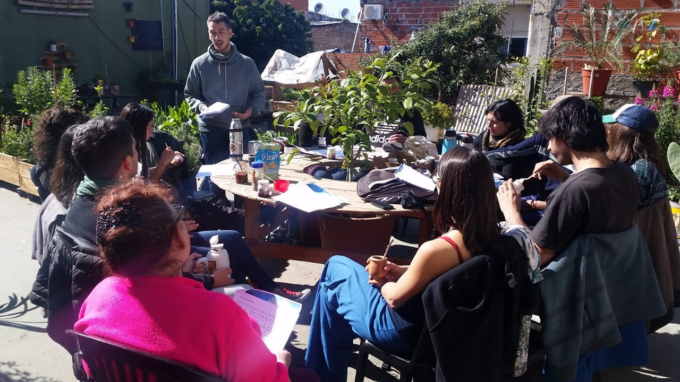
Food Autonomy: Learning How to Produce Your Own Food
Notes:
Food Autonomy: Learning How to Produce Your Own Food

Slide 13
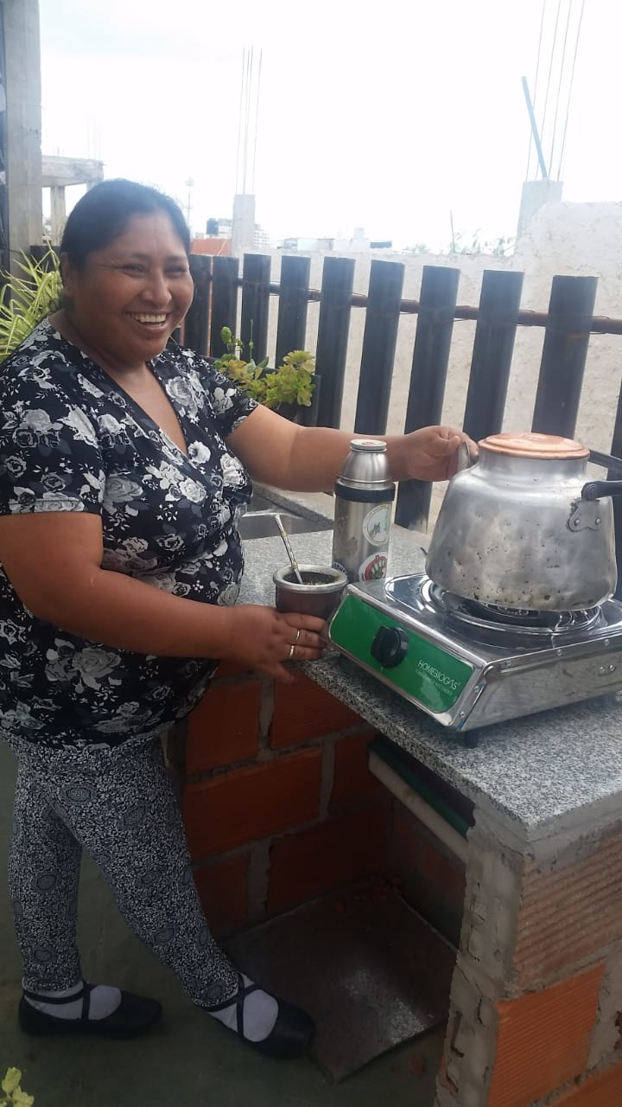
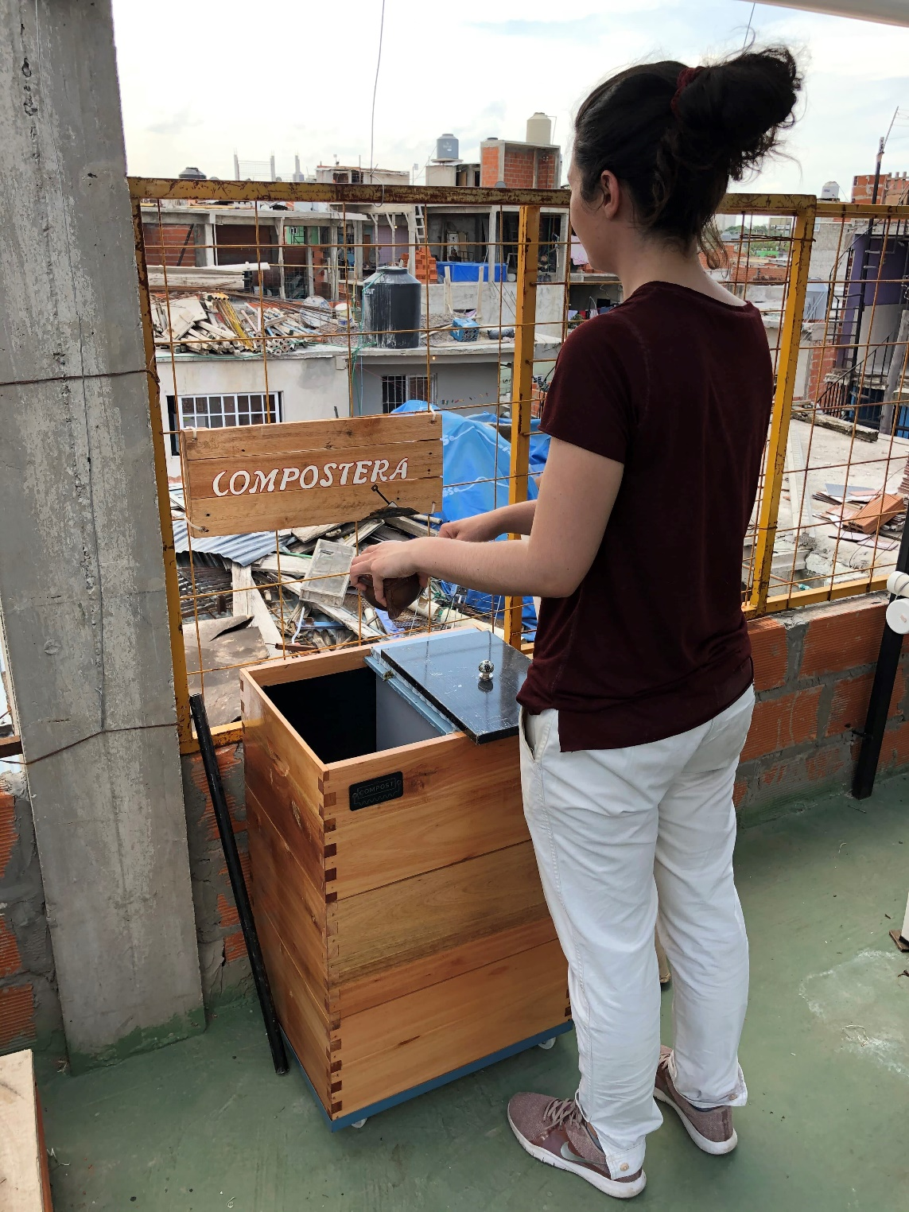
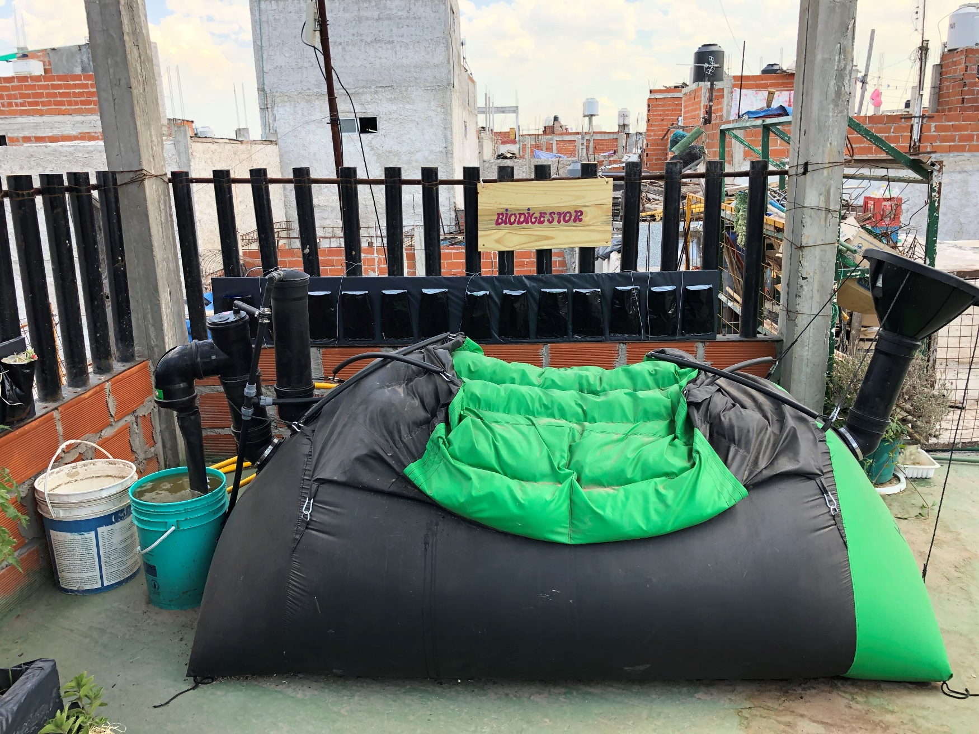
Ecosystem Development and Circular Economy Training
Notes:
Ecosystem Development and Circular Economy Training

Slide 14
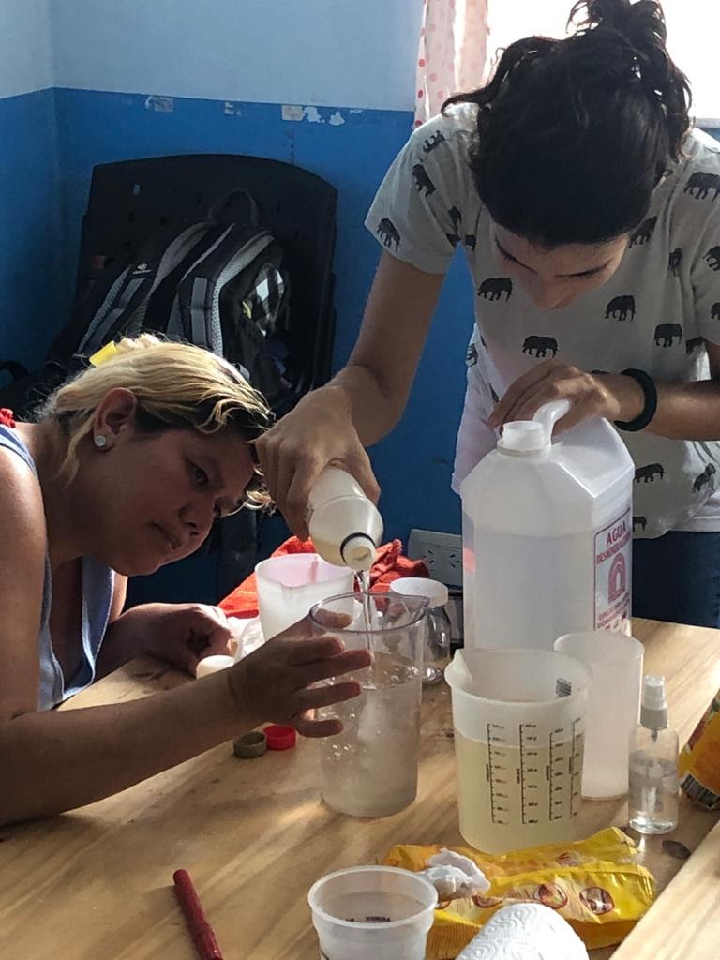
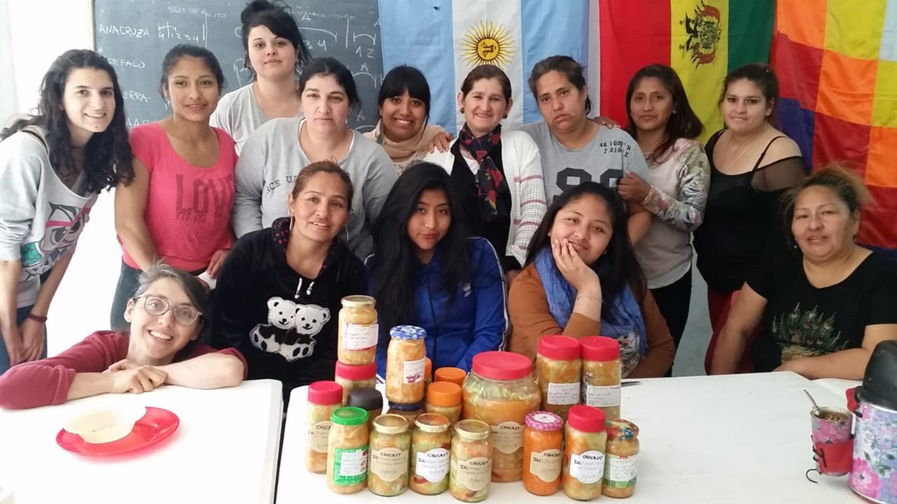
Training in Phytocosmetics and Healthy Eating
Notes:
Training in Phytocosmetics and Healthy Eating

Slide 15
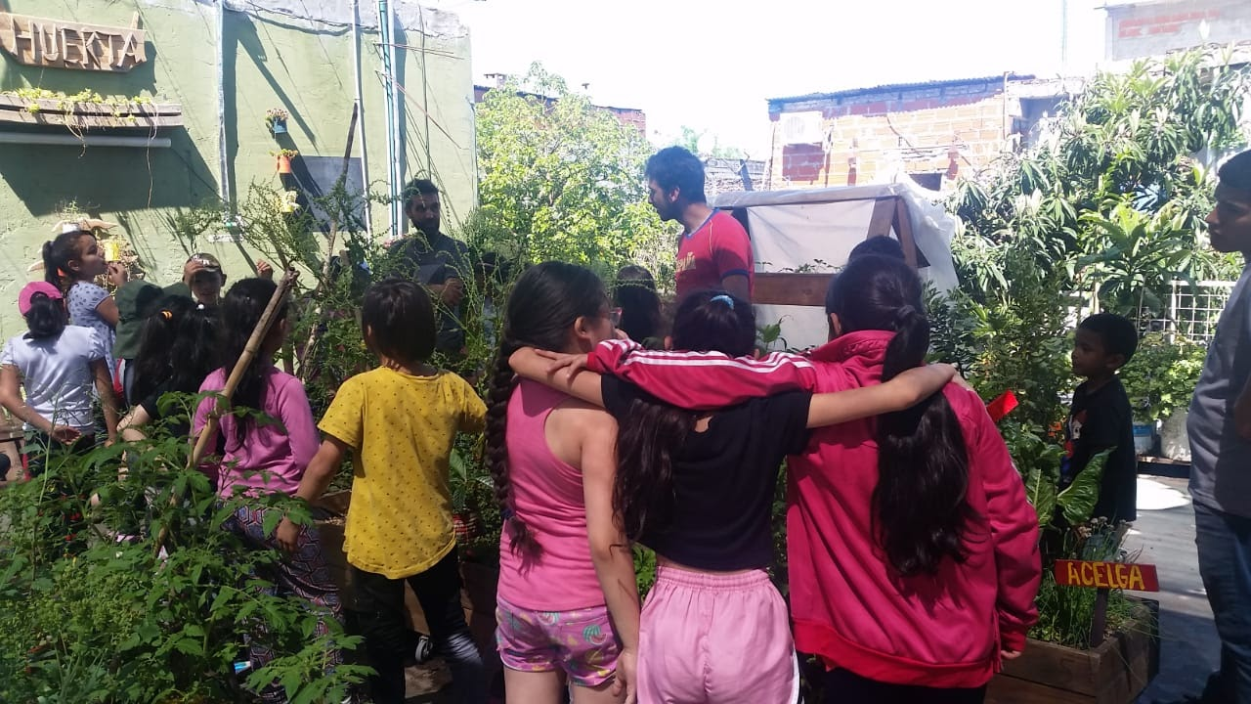
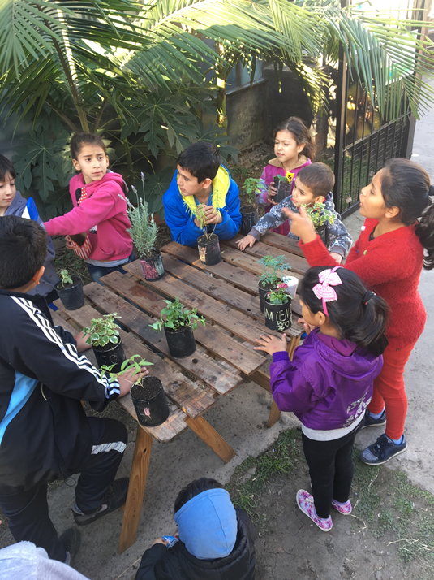
Developing Leaders from Childhood
Notes:
Developing Leaders from Childhood

Slide 16
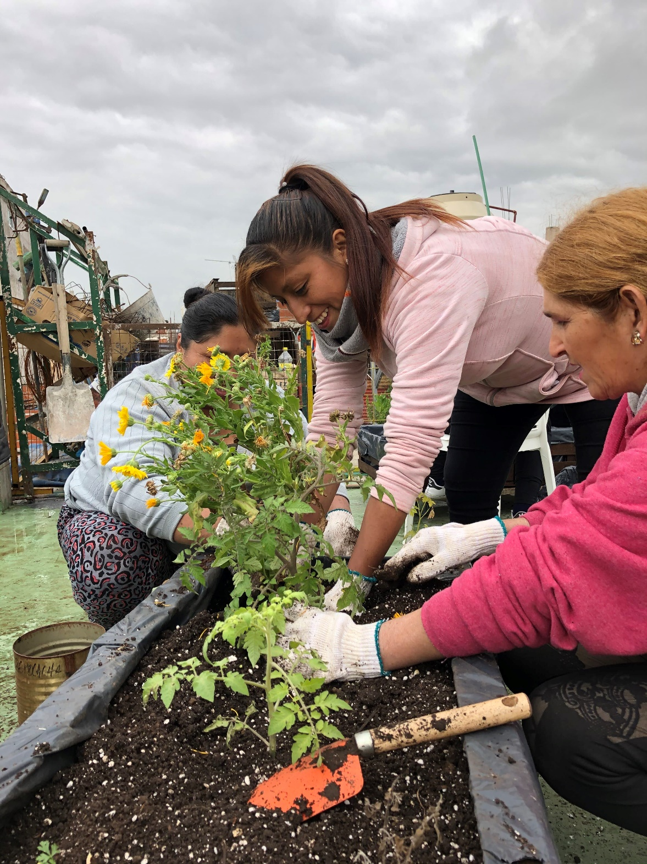
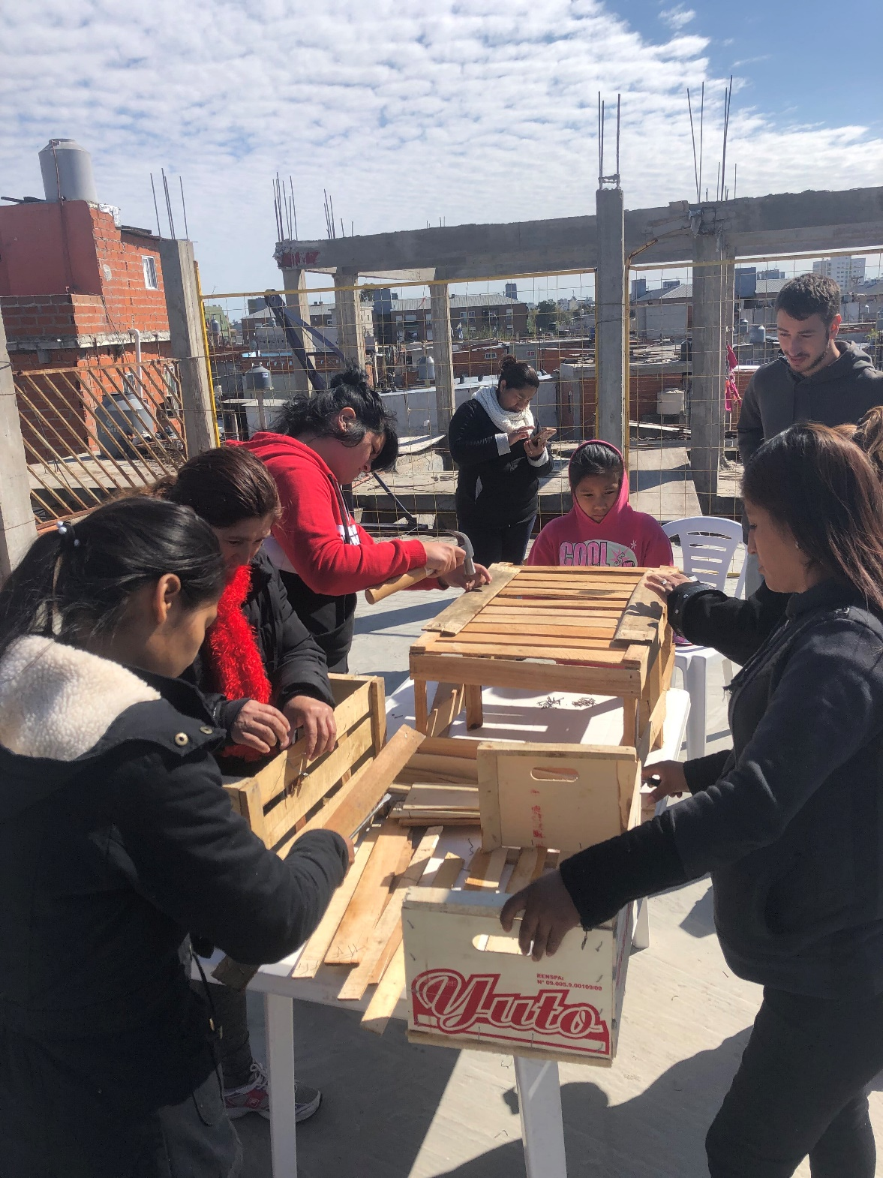
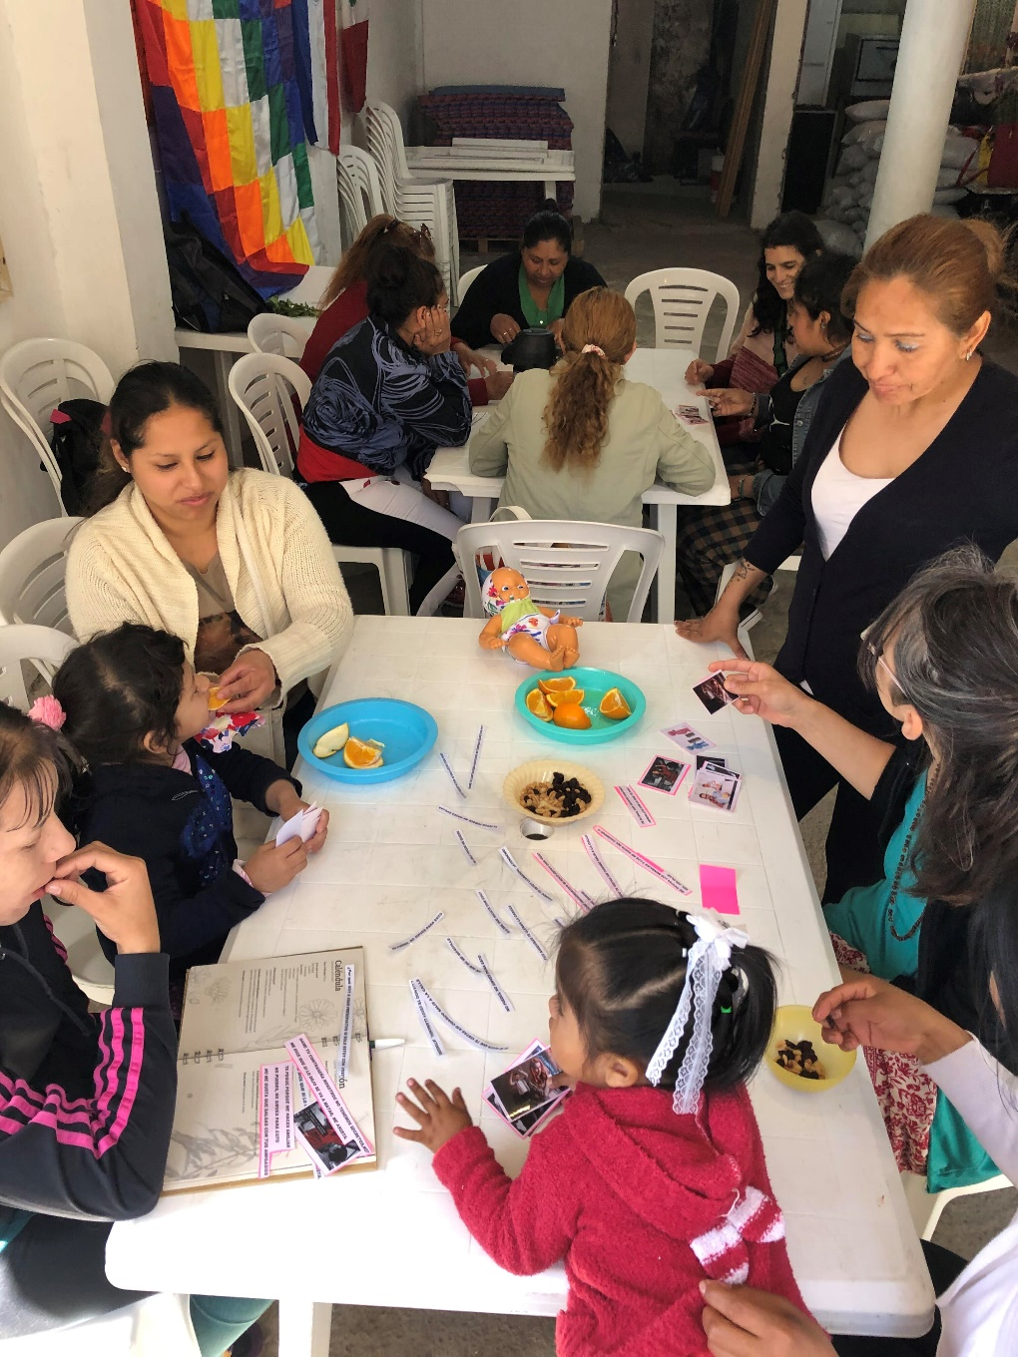
Promoting Gender Equity:
Training for Women in the Neighborhood
Notes:
Promoting Gender Equity:
Training for Women in the Neighborhood

Slide 17
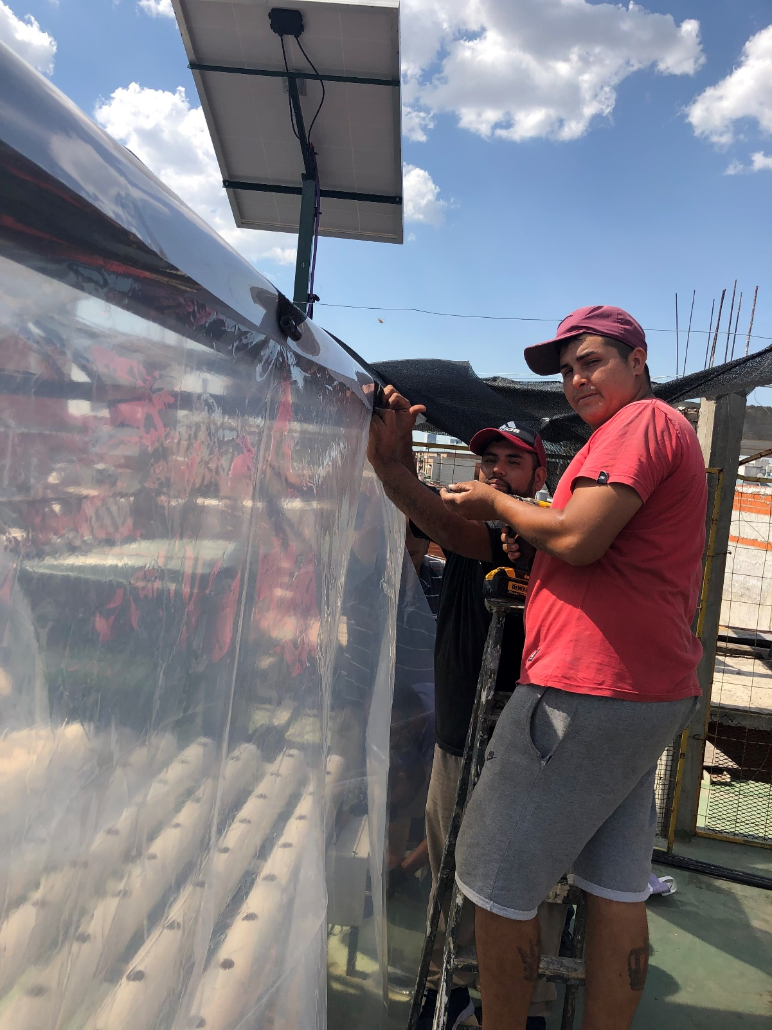
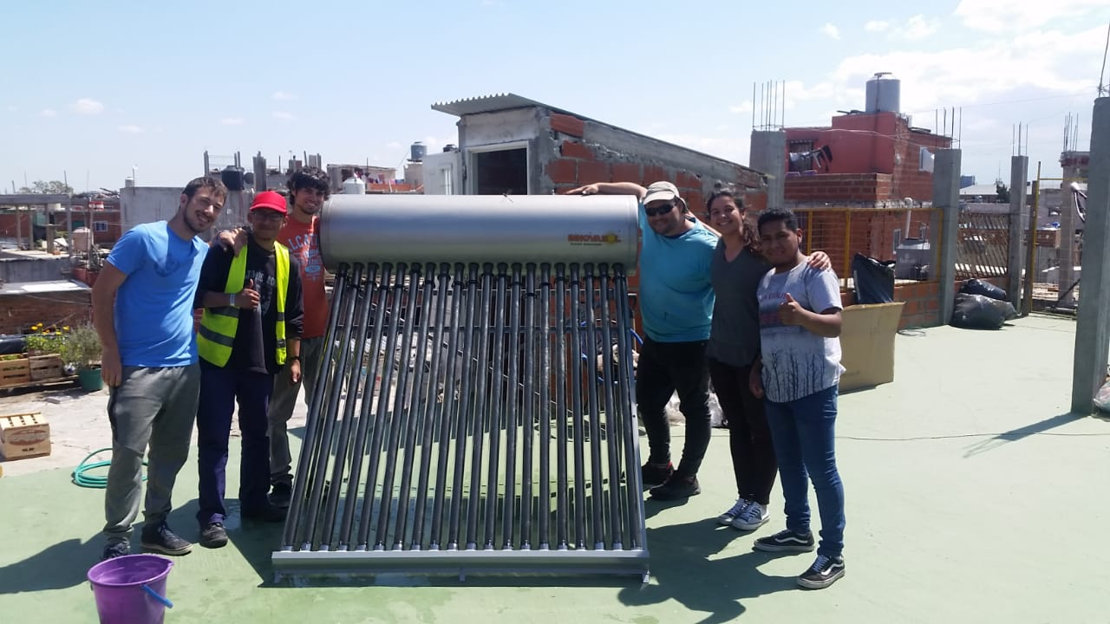
Energy Autonomy: Sustainable Technology Training
Notes:
Energy Autonomy: Sustainable Technology Training

Slide 18
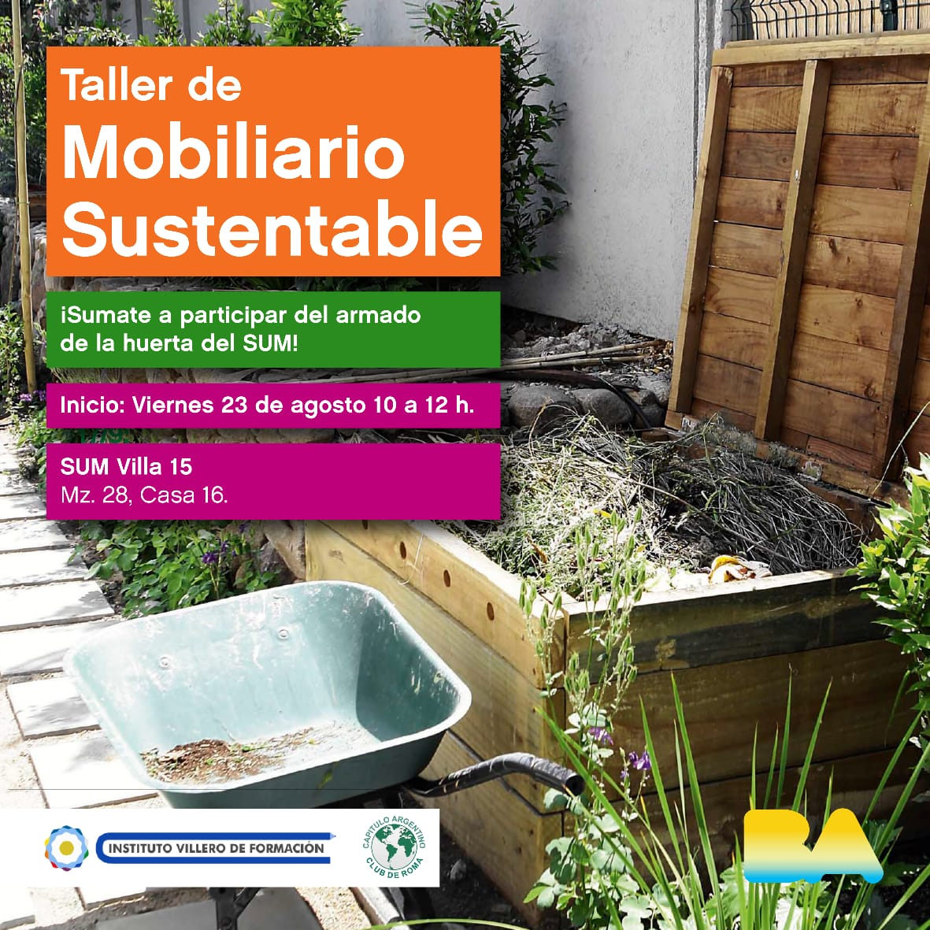
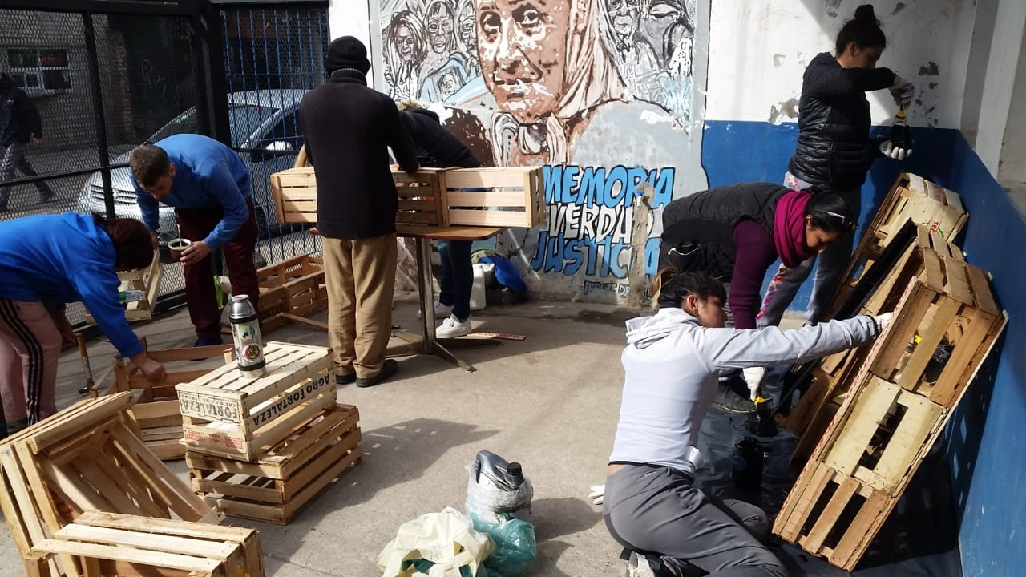
Building a New World: Sustainable Furniture Workshop
Notes:
Building a New World: Sustainable Furniture Workshop

Slide 19
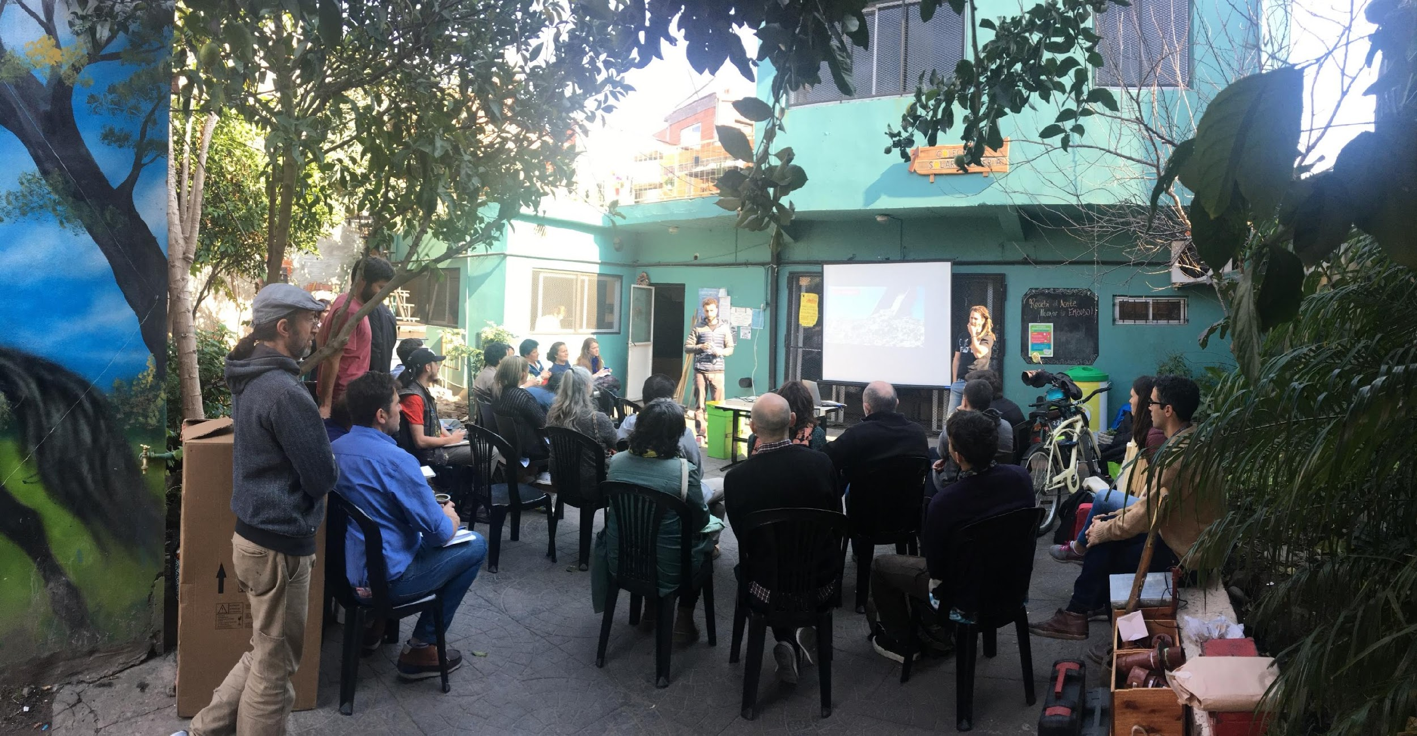
Open Talks to the Community
Notes:
Open Talks to the Community

Slide 20
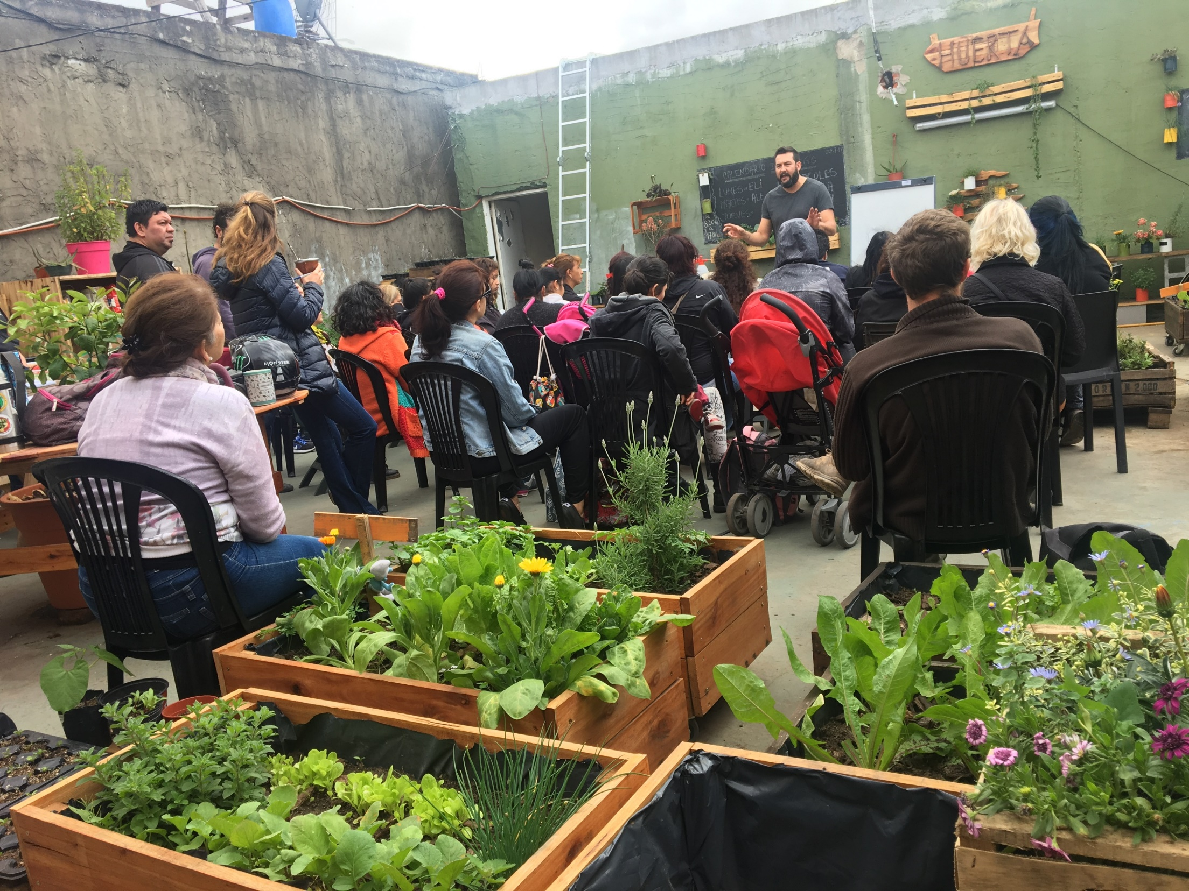
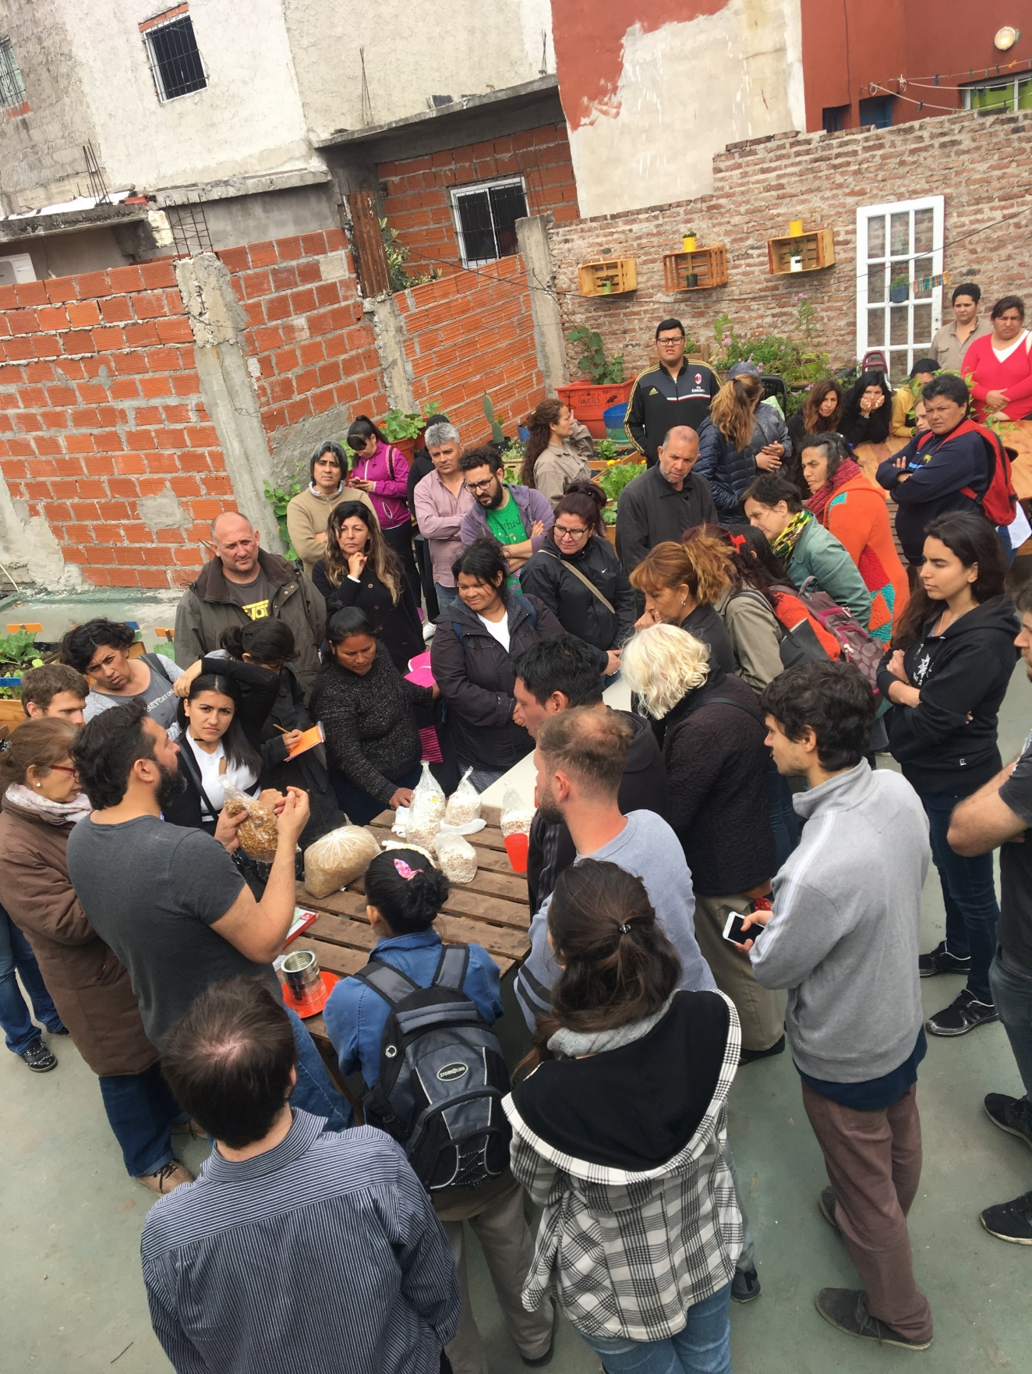

Slide 21
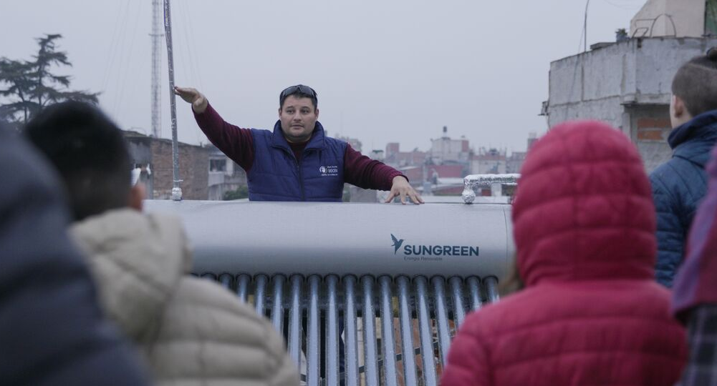
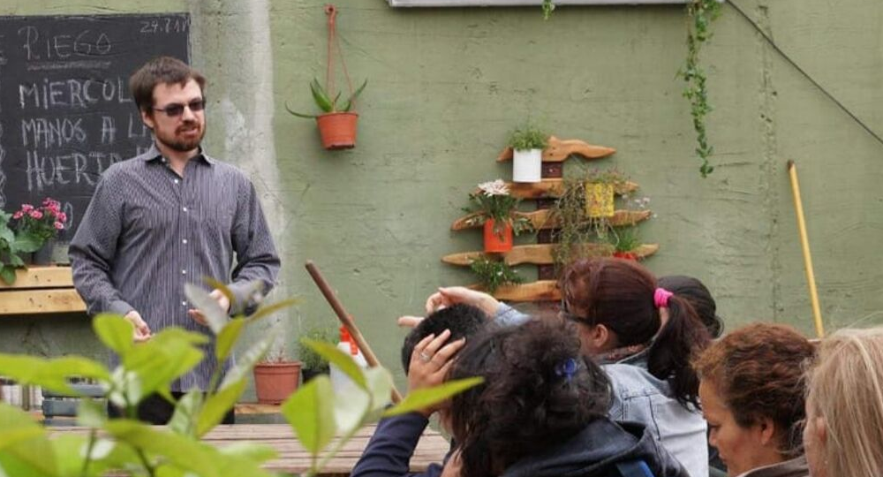
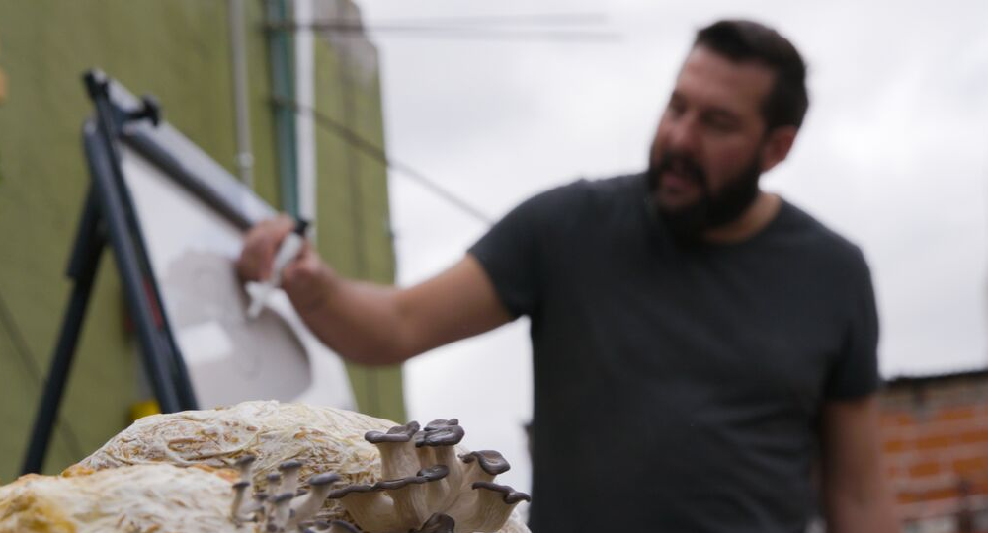
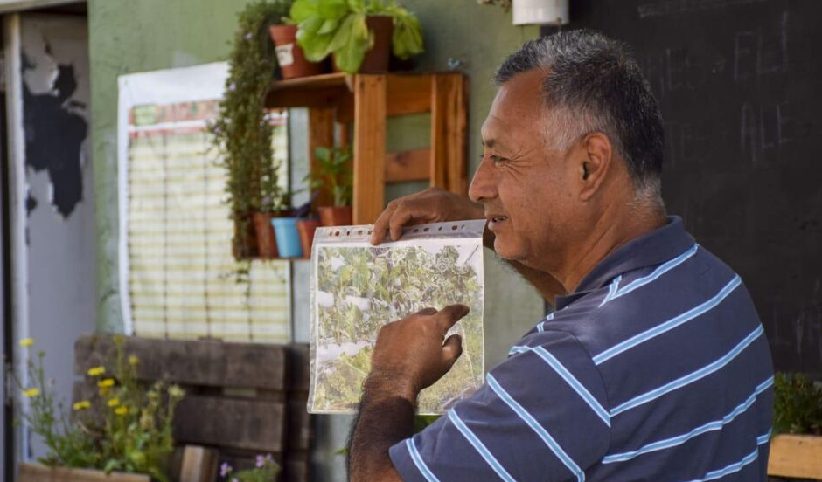

Slide 22
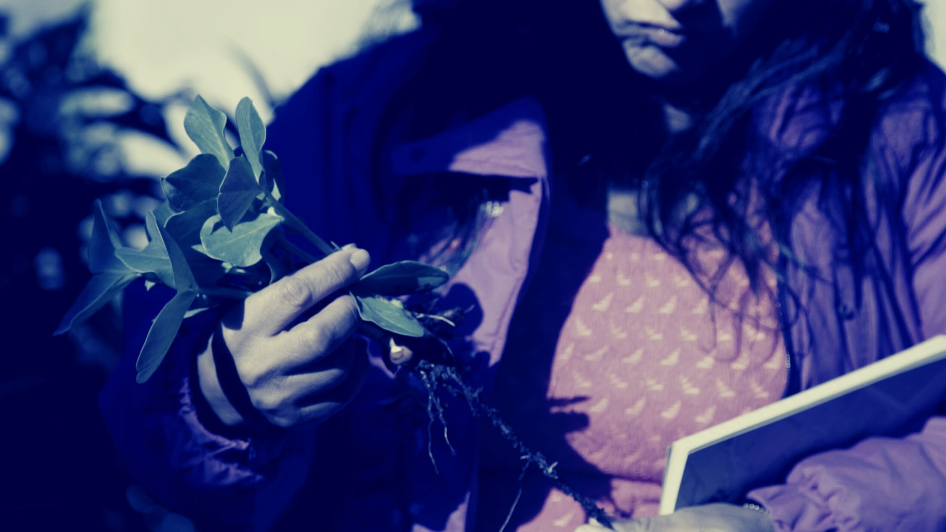


IMPACT
A City With Greater Social and Urban Resilience
Transition to Circularity
Notes:
Impact
A City With Greater Social and Urban Resilience
Transition to Circularity

Slide 23





Environment (Atmosphere)
1
GHG emissions and waste in final disposal
Urban Biodiversity
OPPORTUNITIES
2
Labor skills, production of inputs with added value
3
GENDER
Training, new job opportunities
INTEGRATION
4
Connection between the formal and informal city
RISK MANAGEMENT
5
Food sovereignty, energy and water autonomy
Notes:
Note: What is in () is a question/uncertainty about translation
Indicator of Unified Resilience
Environment (Atmosphere)
GHG emissions and waste in final stage of disposal
Urban Biodiversity
Opportunities
Labor skills, production of inputs with added value
Gender
Training, new job opportunities
Integration
Connection between the formal and informal city
Risk Management
Autonomy of energy and water, food sovereignty

Slide 24
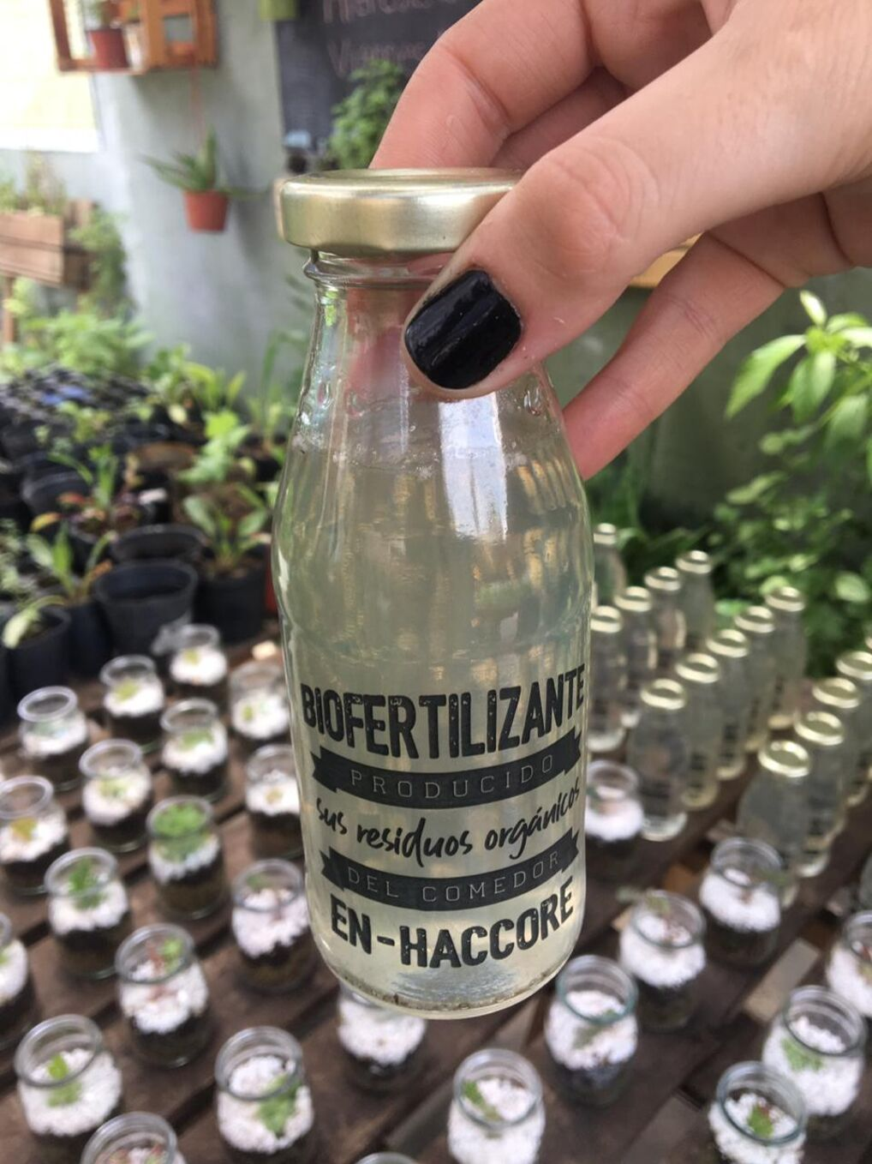

Value Proposal
FOOD PRODUCTION
ENERGY SAVINGS
ETC
ECONOMICAL SAVINGS
PRODUCTS WITH HIGHER ADDED VALUE
Notes:
Note: What is in () is a question/uncertainty about translation
Value Proposal
Food Production
Save Energy
Save (Money)
Inputs of Value Added

Slide 25
THANKS!
Notes:
Thank You Very Much!

