Slide 3
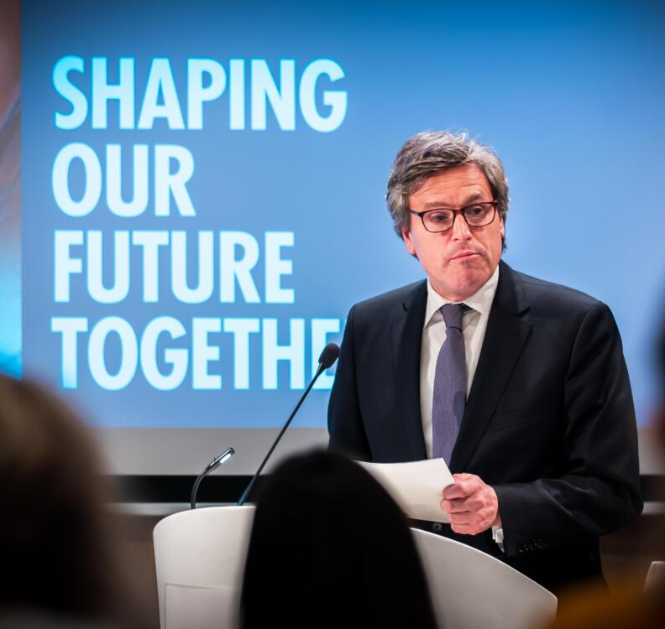
Conference UN75 Feb 2020, Estonia
Office of the Special Adviser to the Secretary-General for #UN75 UNHQ

Slide 4
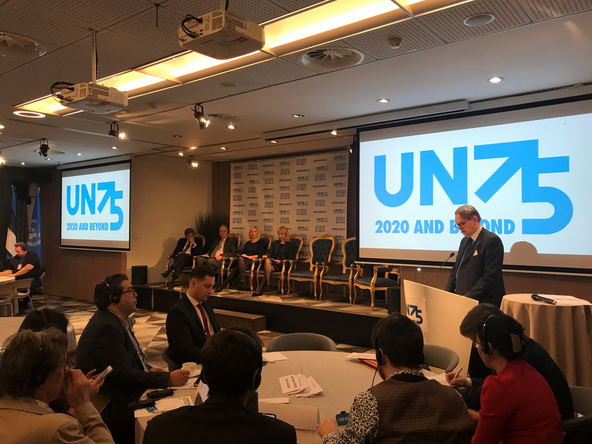

Slide 5
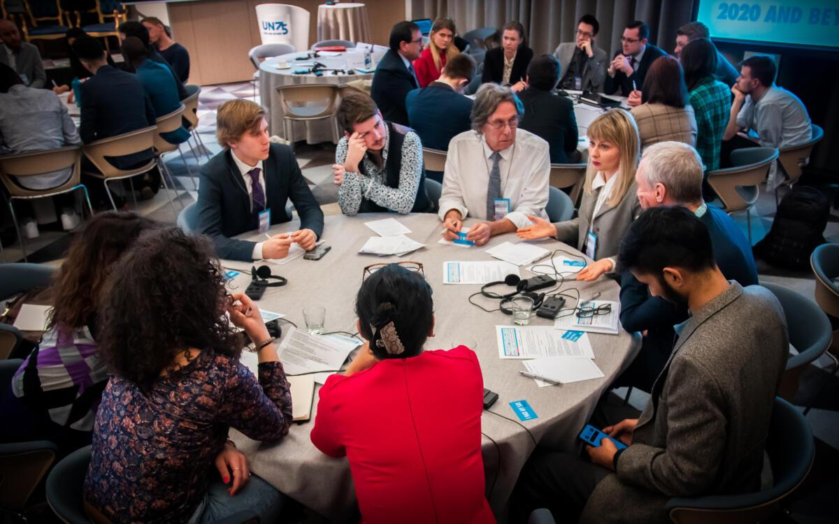

Slide 6
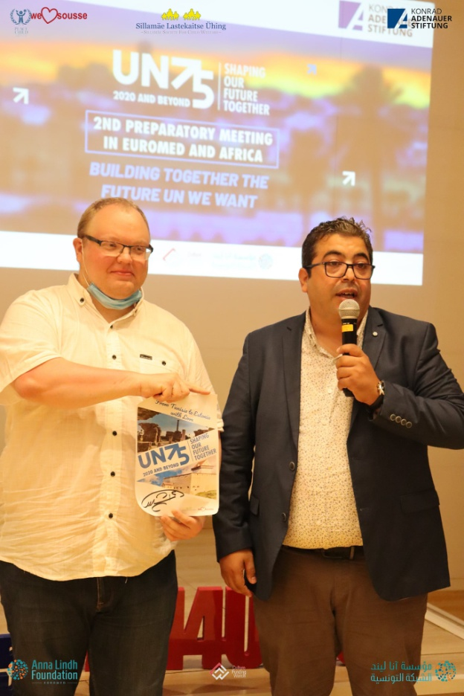
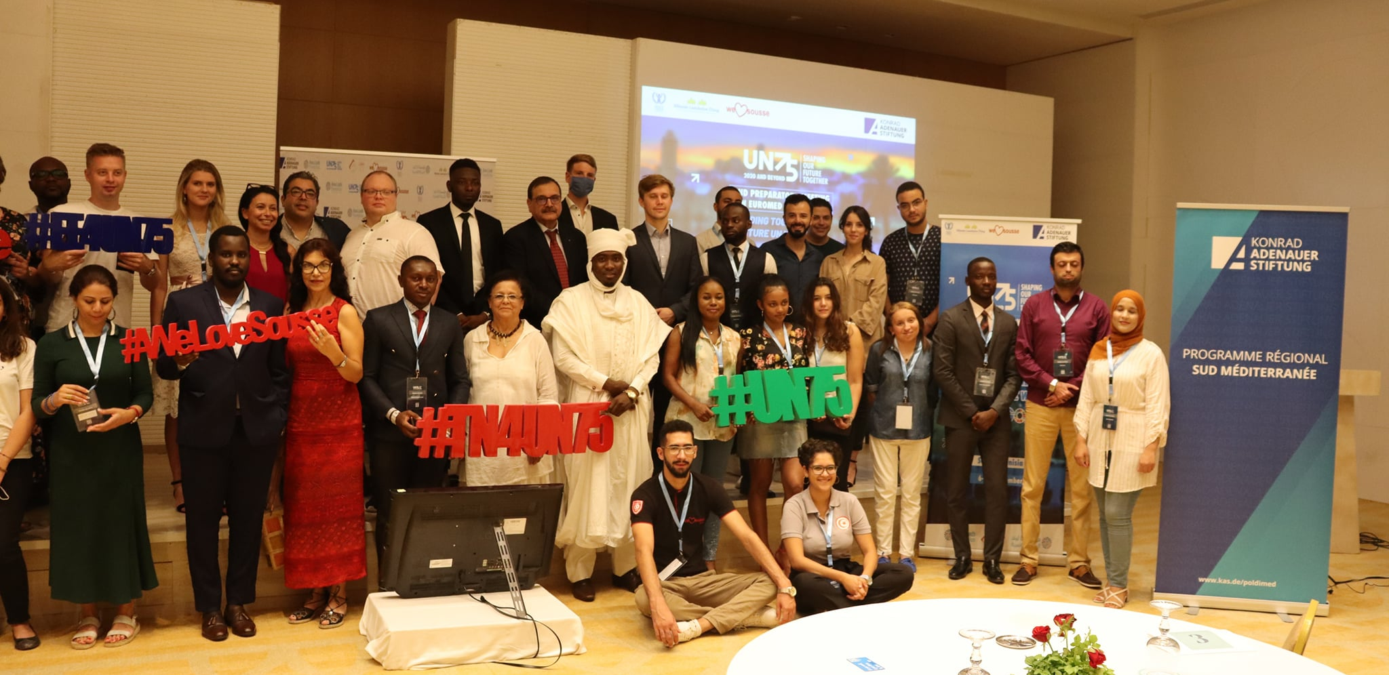
Conference UN75 – Sep 2020 (Euromed & Africa)

Slide 7
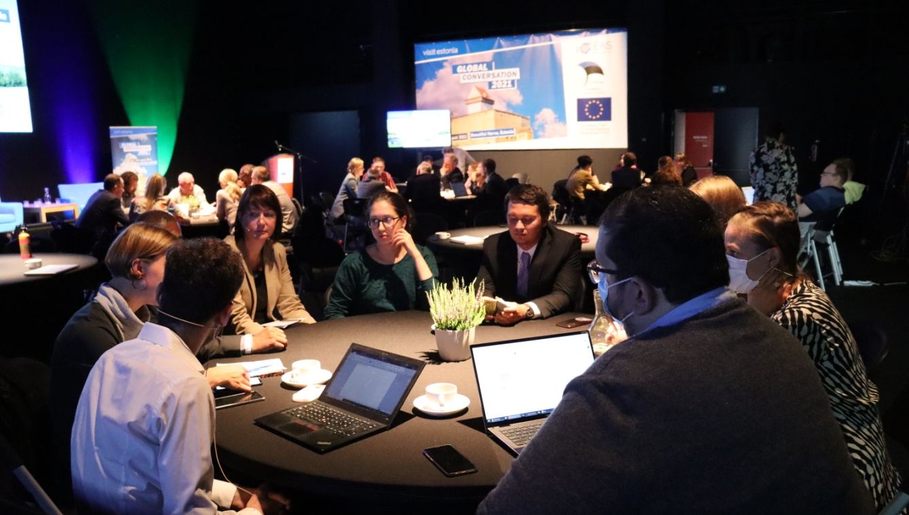
The view from:
Europe
Africa
America
Asia

Slide 8
“Civil Society Ideas for the sustaiable and secure future of Europe”, May 2022

Slide 9
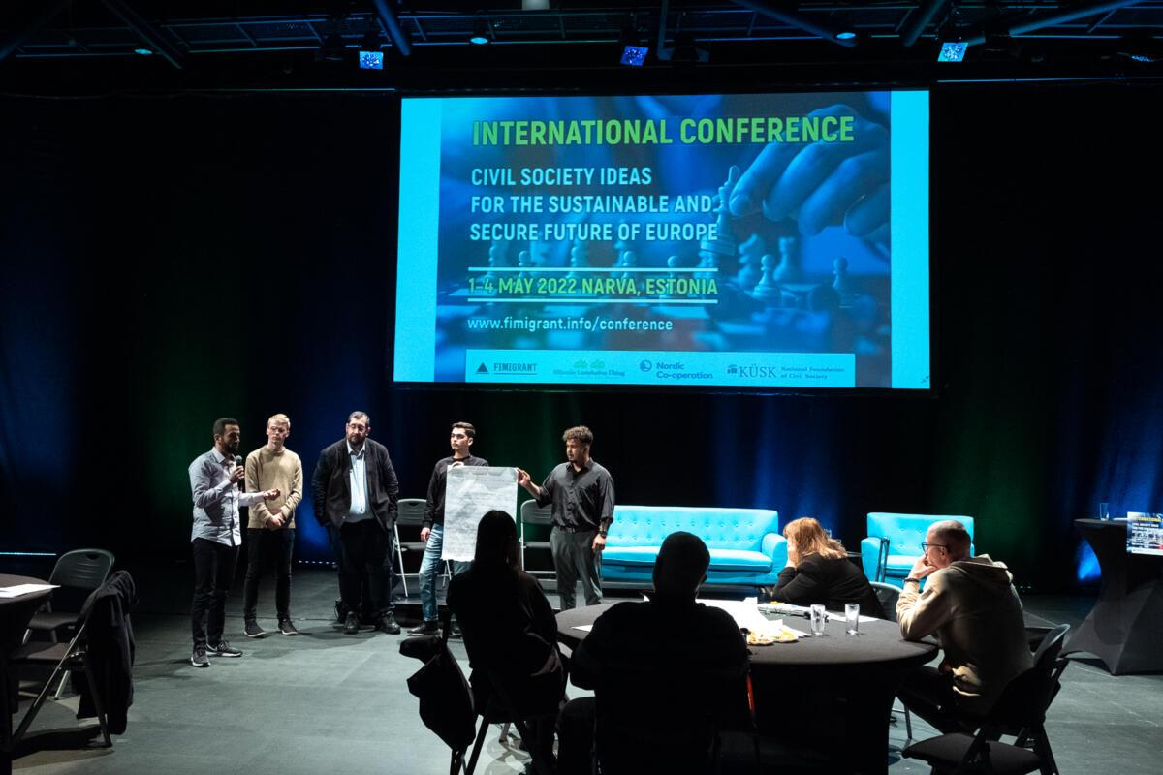

Slide 10
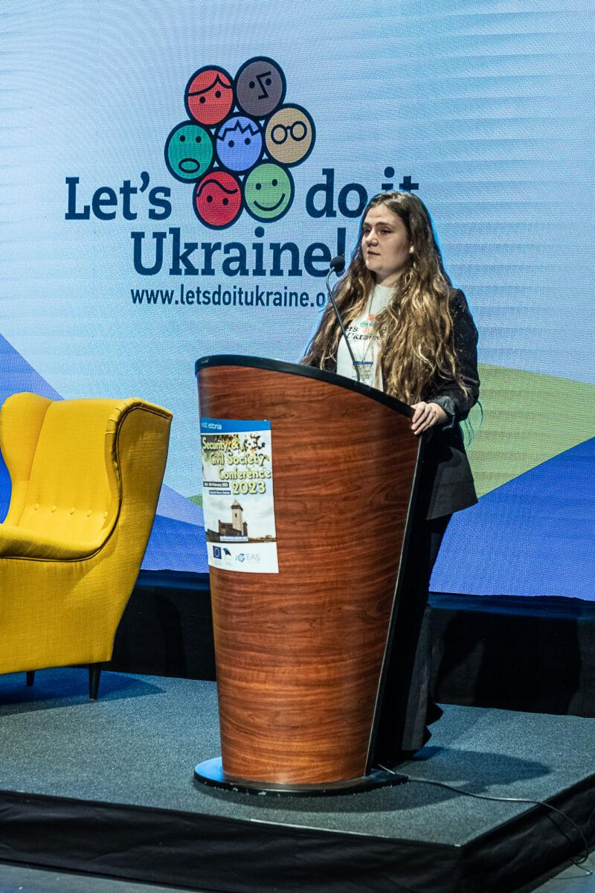
“Reflections on Security: International Community, CSOs and their contribution for a more secure and sustainable Europe” February 2023

Slide 12
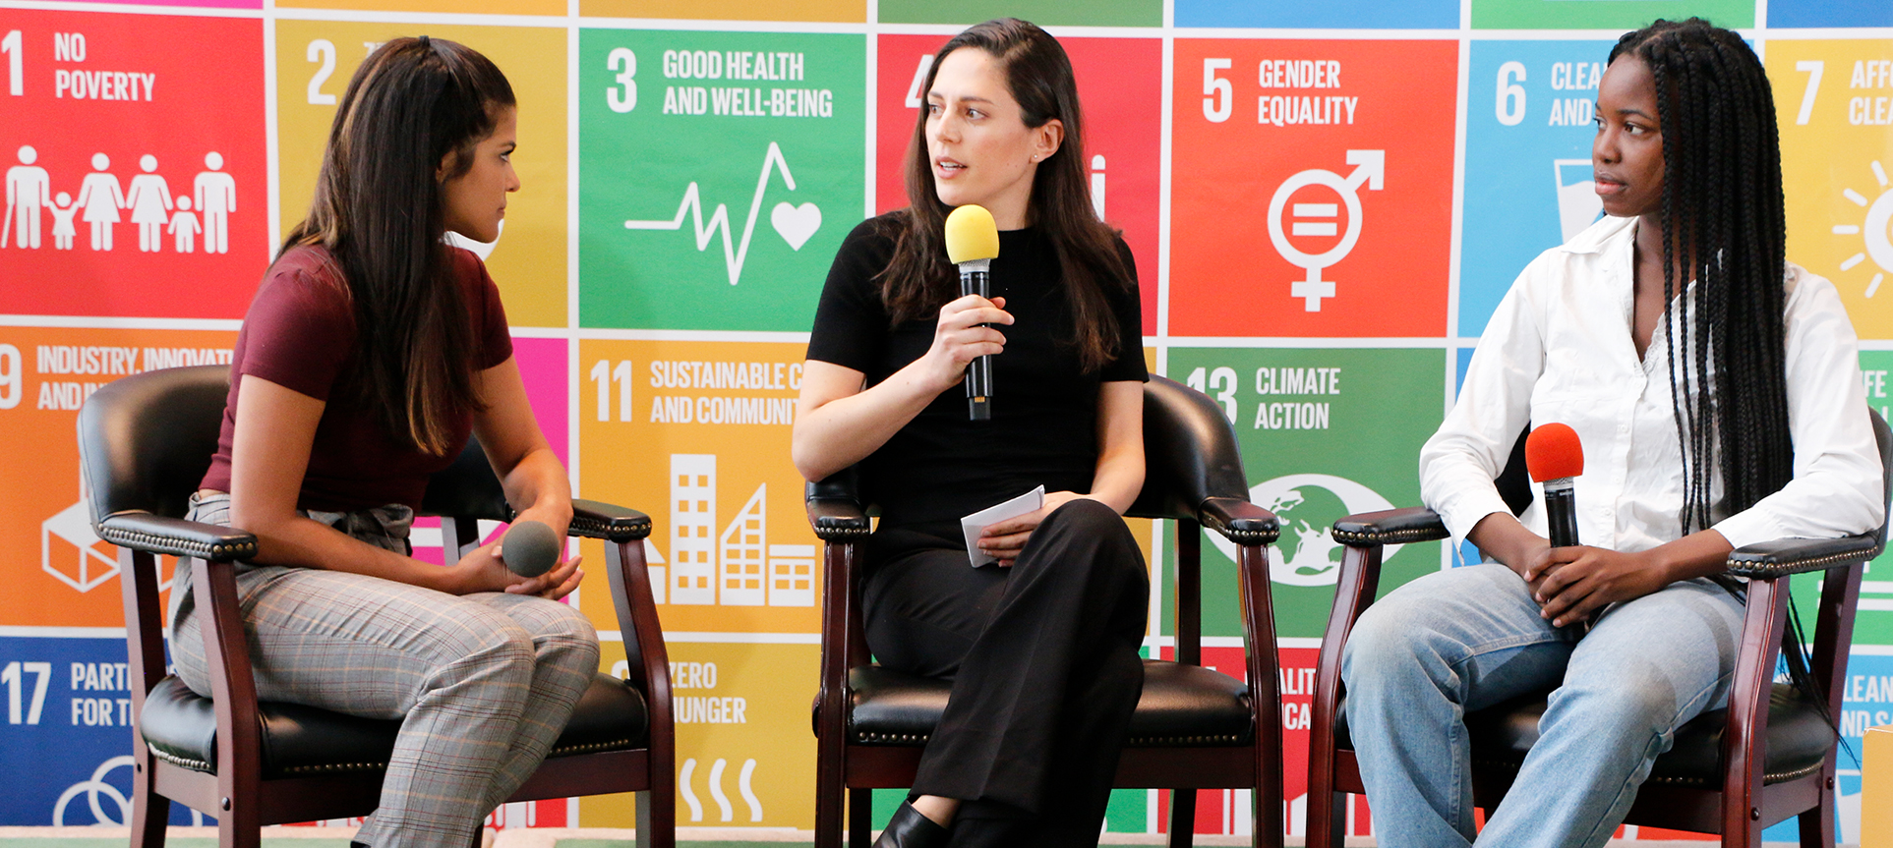
Conference Series on the UN Sustainable Development Goals
https://conference.sscw.ee/

